Slide 1
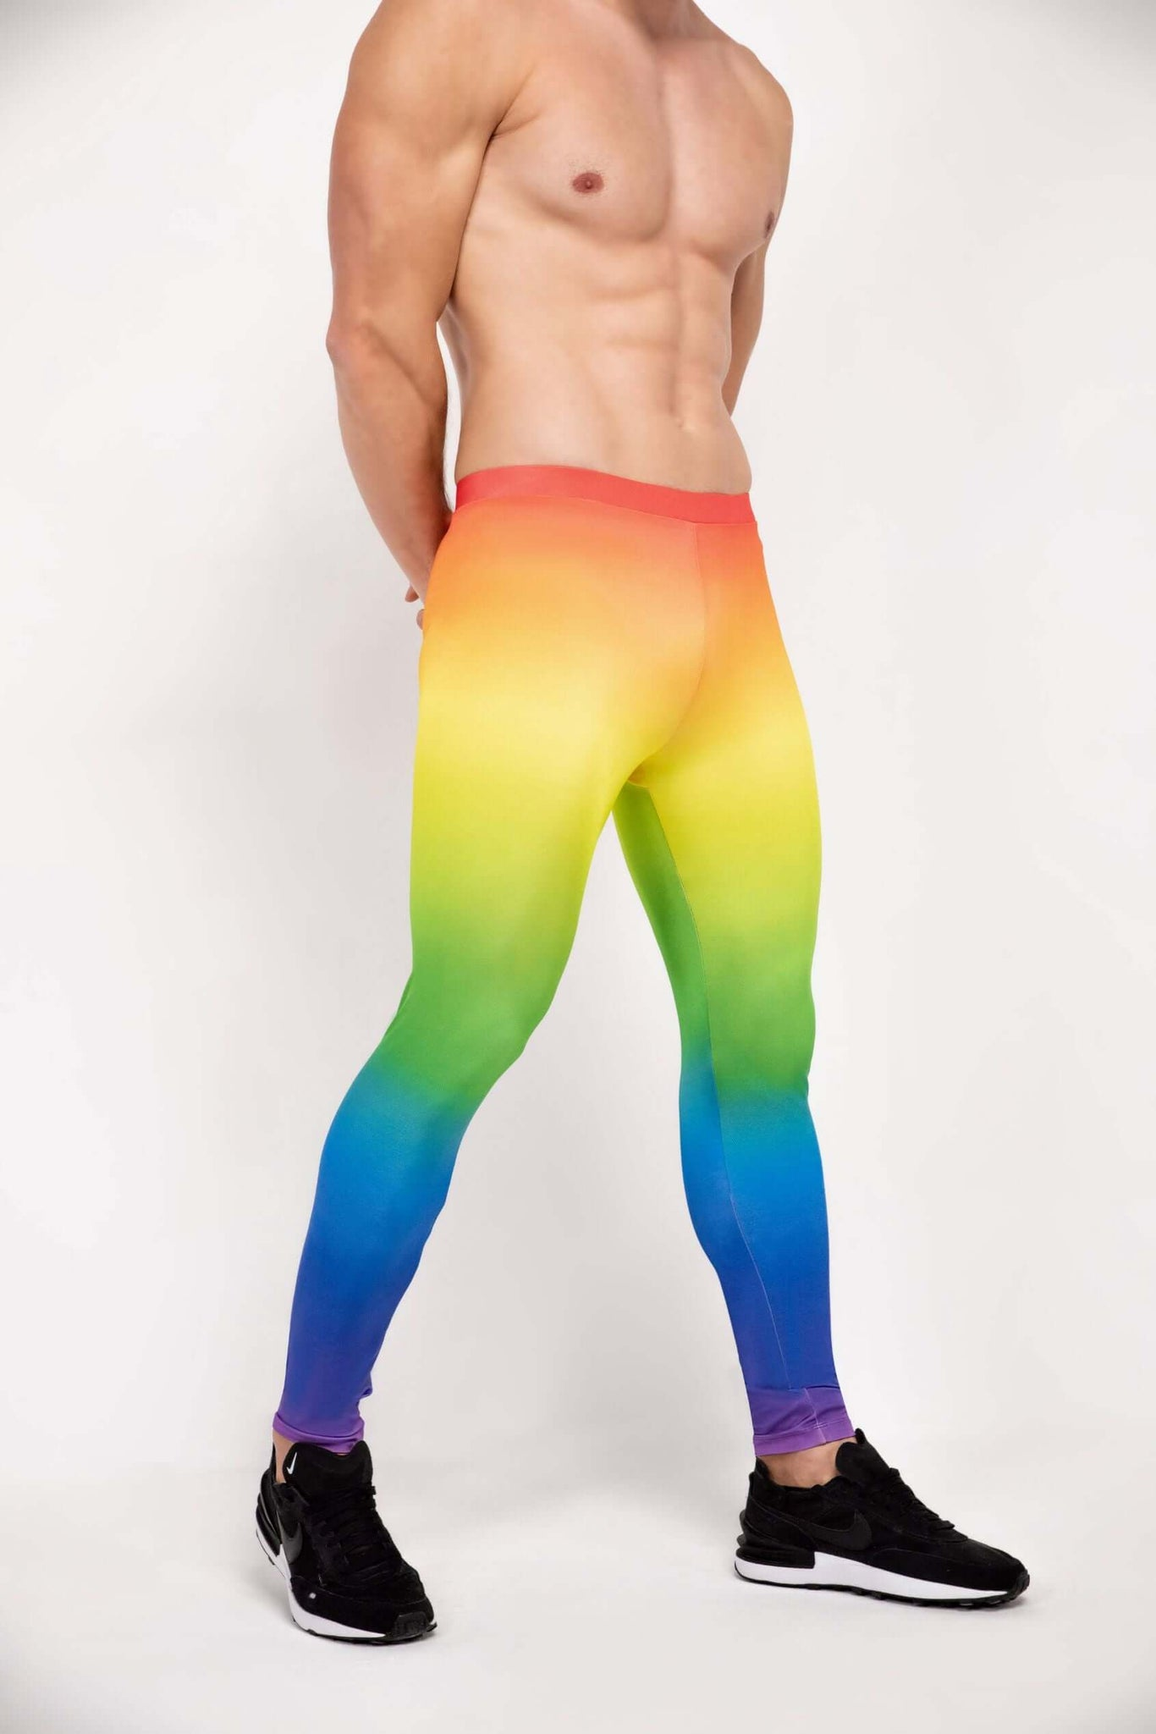
What are deggings?
Deggings are high-performance leggings specifically designed for male dancers. They combine the flexibility of activewear with the support and durability needed for dance movements, offering comfort, style, and functionality.

Slide 2
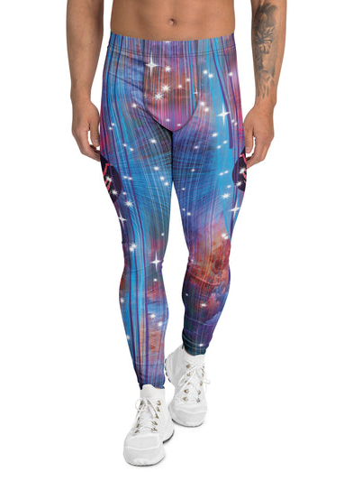
What problems does it solove?
Most leggings on the market are designed for women, leaving male dancers with limited, uncomfortable, or poorly fitting options. Deggings solve this by providing a dancewear solution tailored to the male physique and performance needs—improving movement, confidence, and reducing wardrobe malfunctions or discomfort during performances and rehearsals.

Slide 3
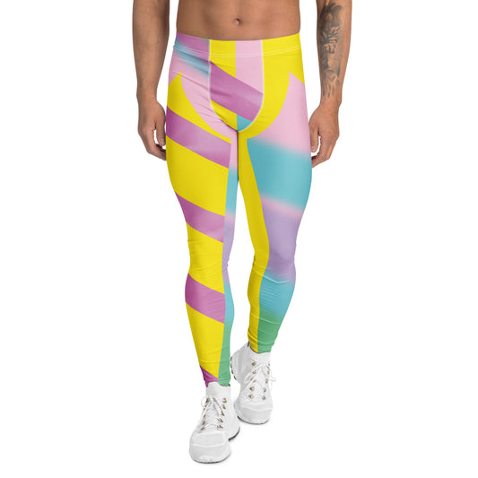
Who is our target market?
Our primary target market is male dancers aged 14–35, from students to professionals, across styles such as ballet, contemporary, hip-hop, and jazz. Secondary markets include dance schools, performance troupes, and fitness enthusiasts who want flexible and supportive men’s leggings.

Slide 4
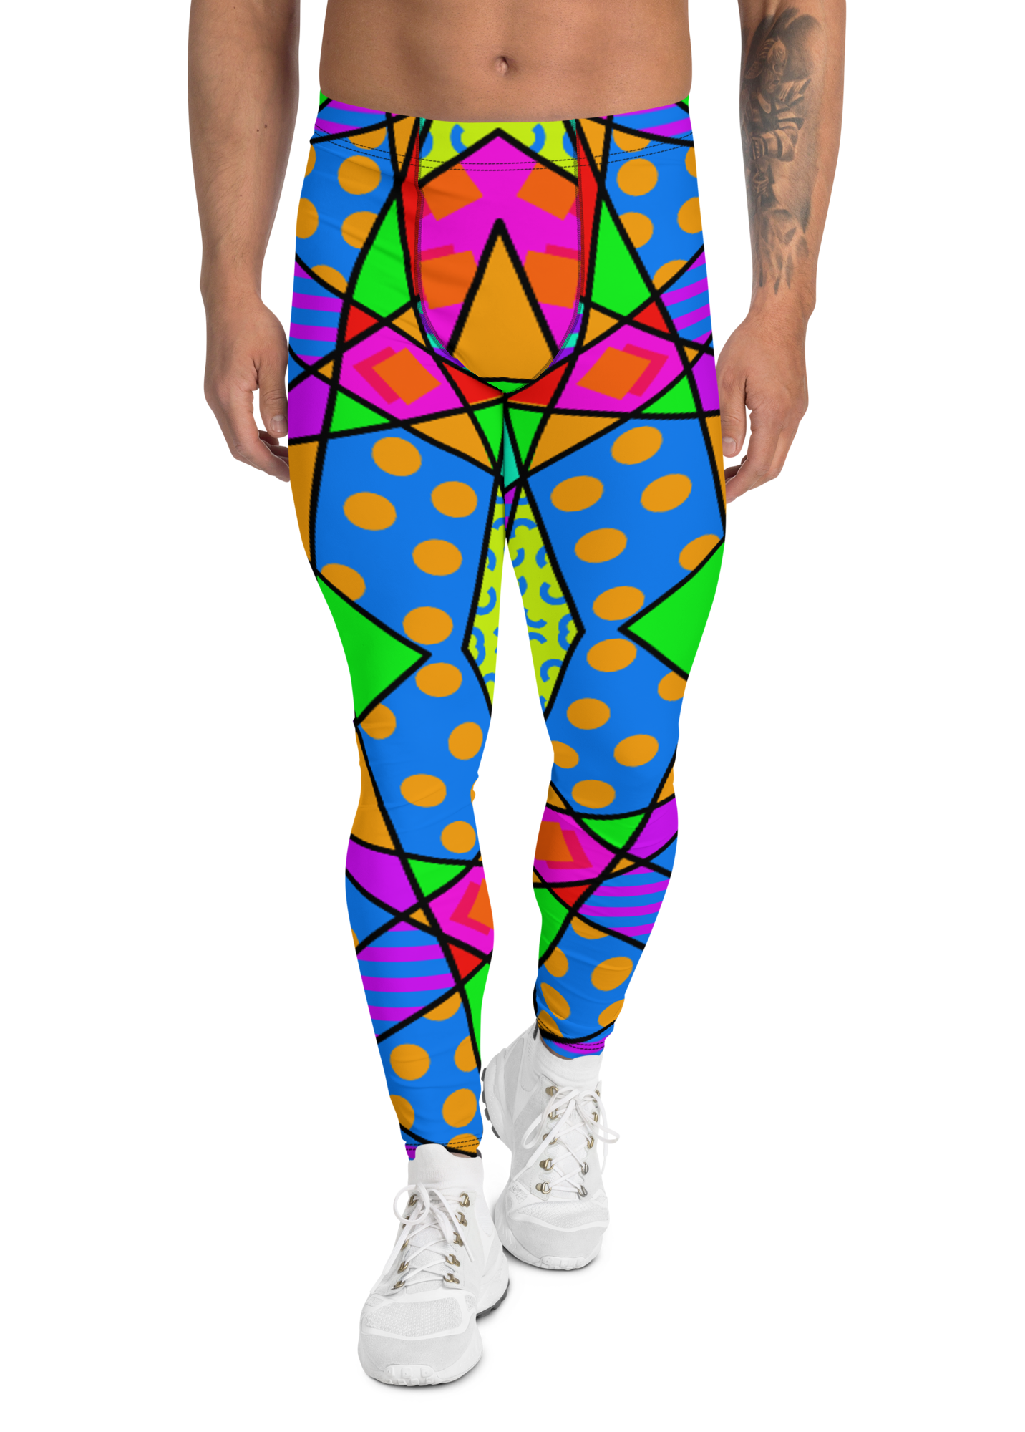
What makes us unique and different from the comp?
Deggings are engineered for male anatomy and dance-specific motion. Features like reinforced stitching, moisture-wicking fabric, groin support, and stretch zones give them a distinct edge over generic activewear or unisex options. Plus, our designs blend performance with style—giving dancers confidence on and off stage.

Slide 5
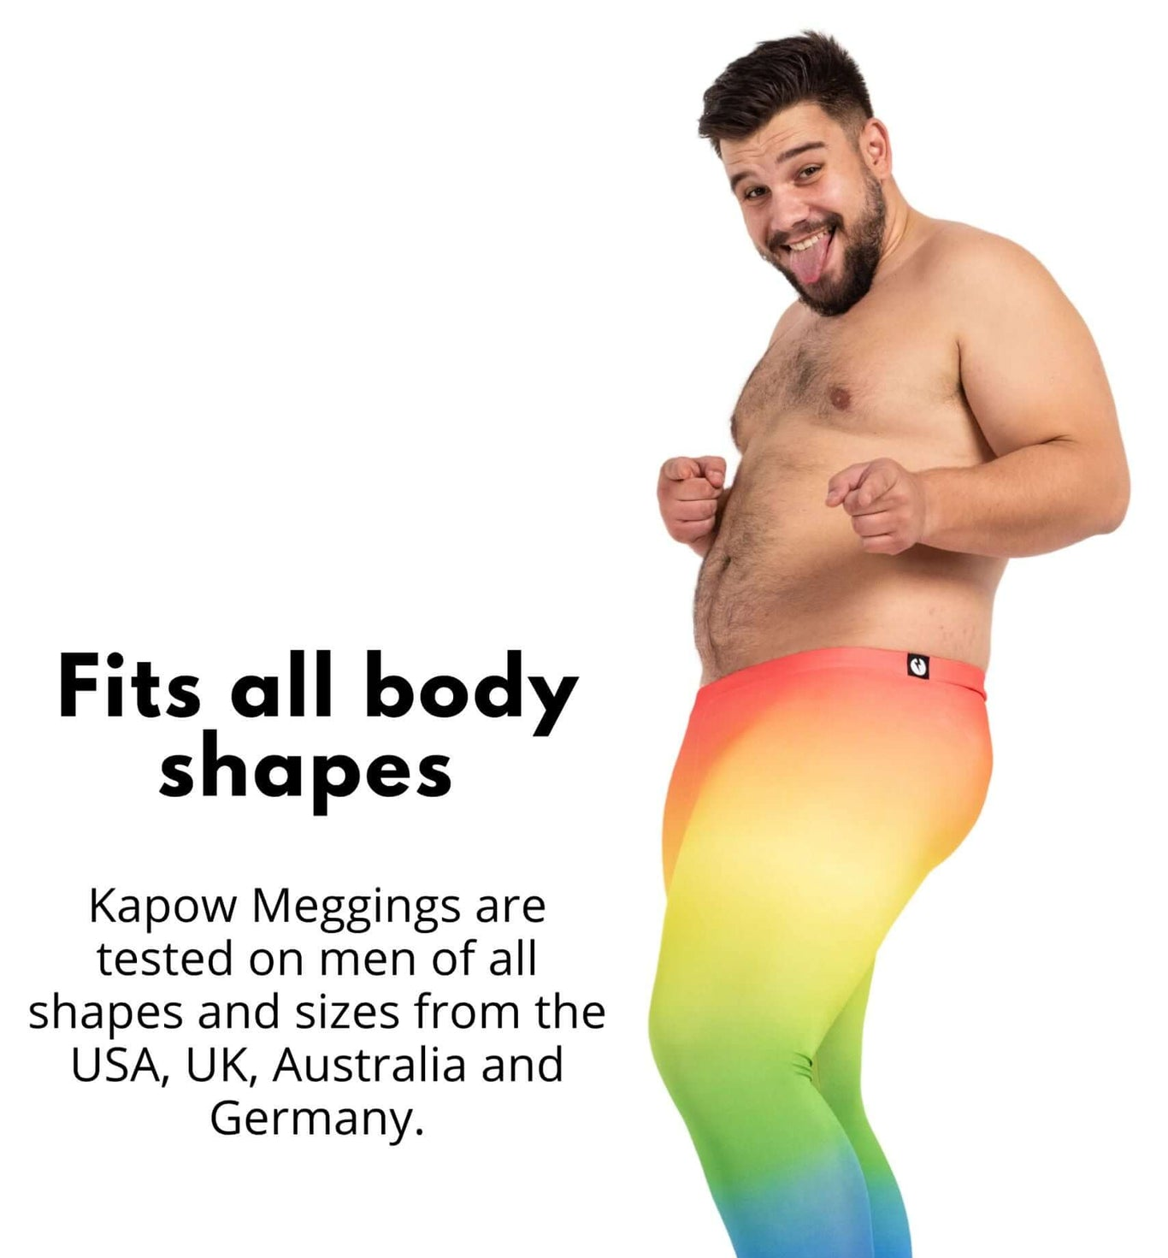
How does it work?
Deggings are made from a premium blend of spandex, recycled polyester, and bamboo fibers. The product includes:
Four-way stretch panels for unrestricted movement
Compression zones for muscle support
Breathable fabric to regulate temperature
Reinforced groin support for comfort and safety
Anti-slip waistband to keep them in place during intense movement

Slide 6
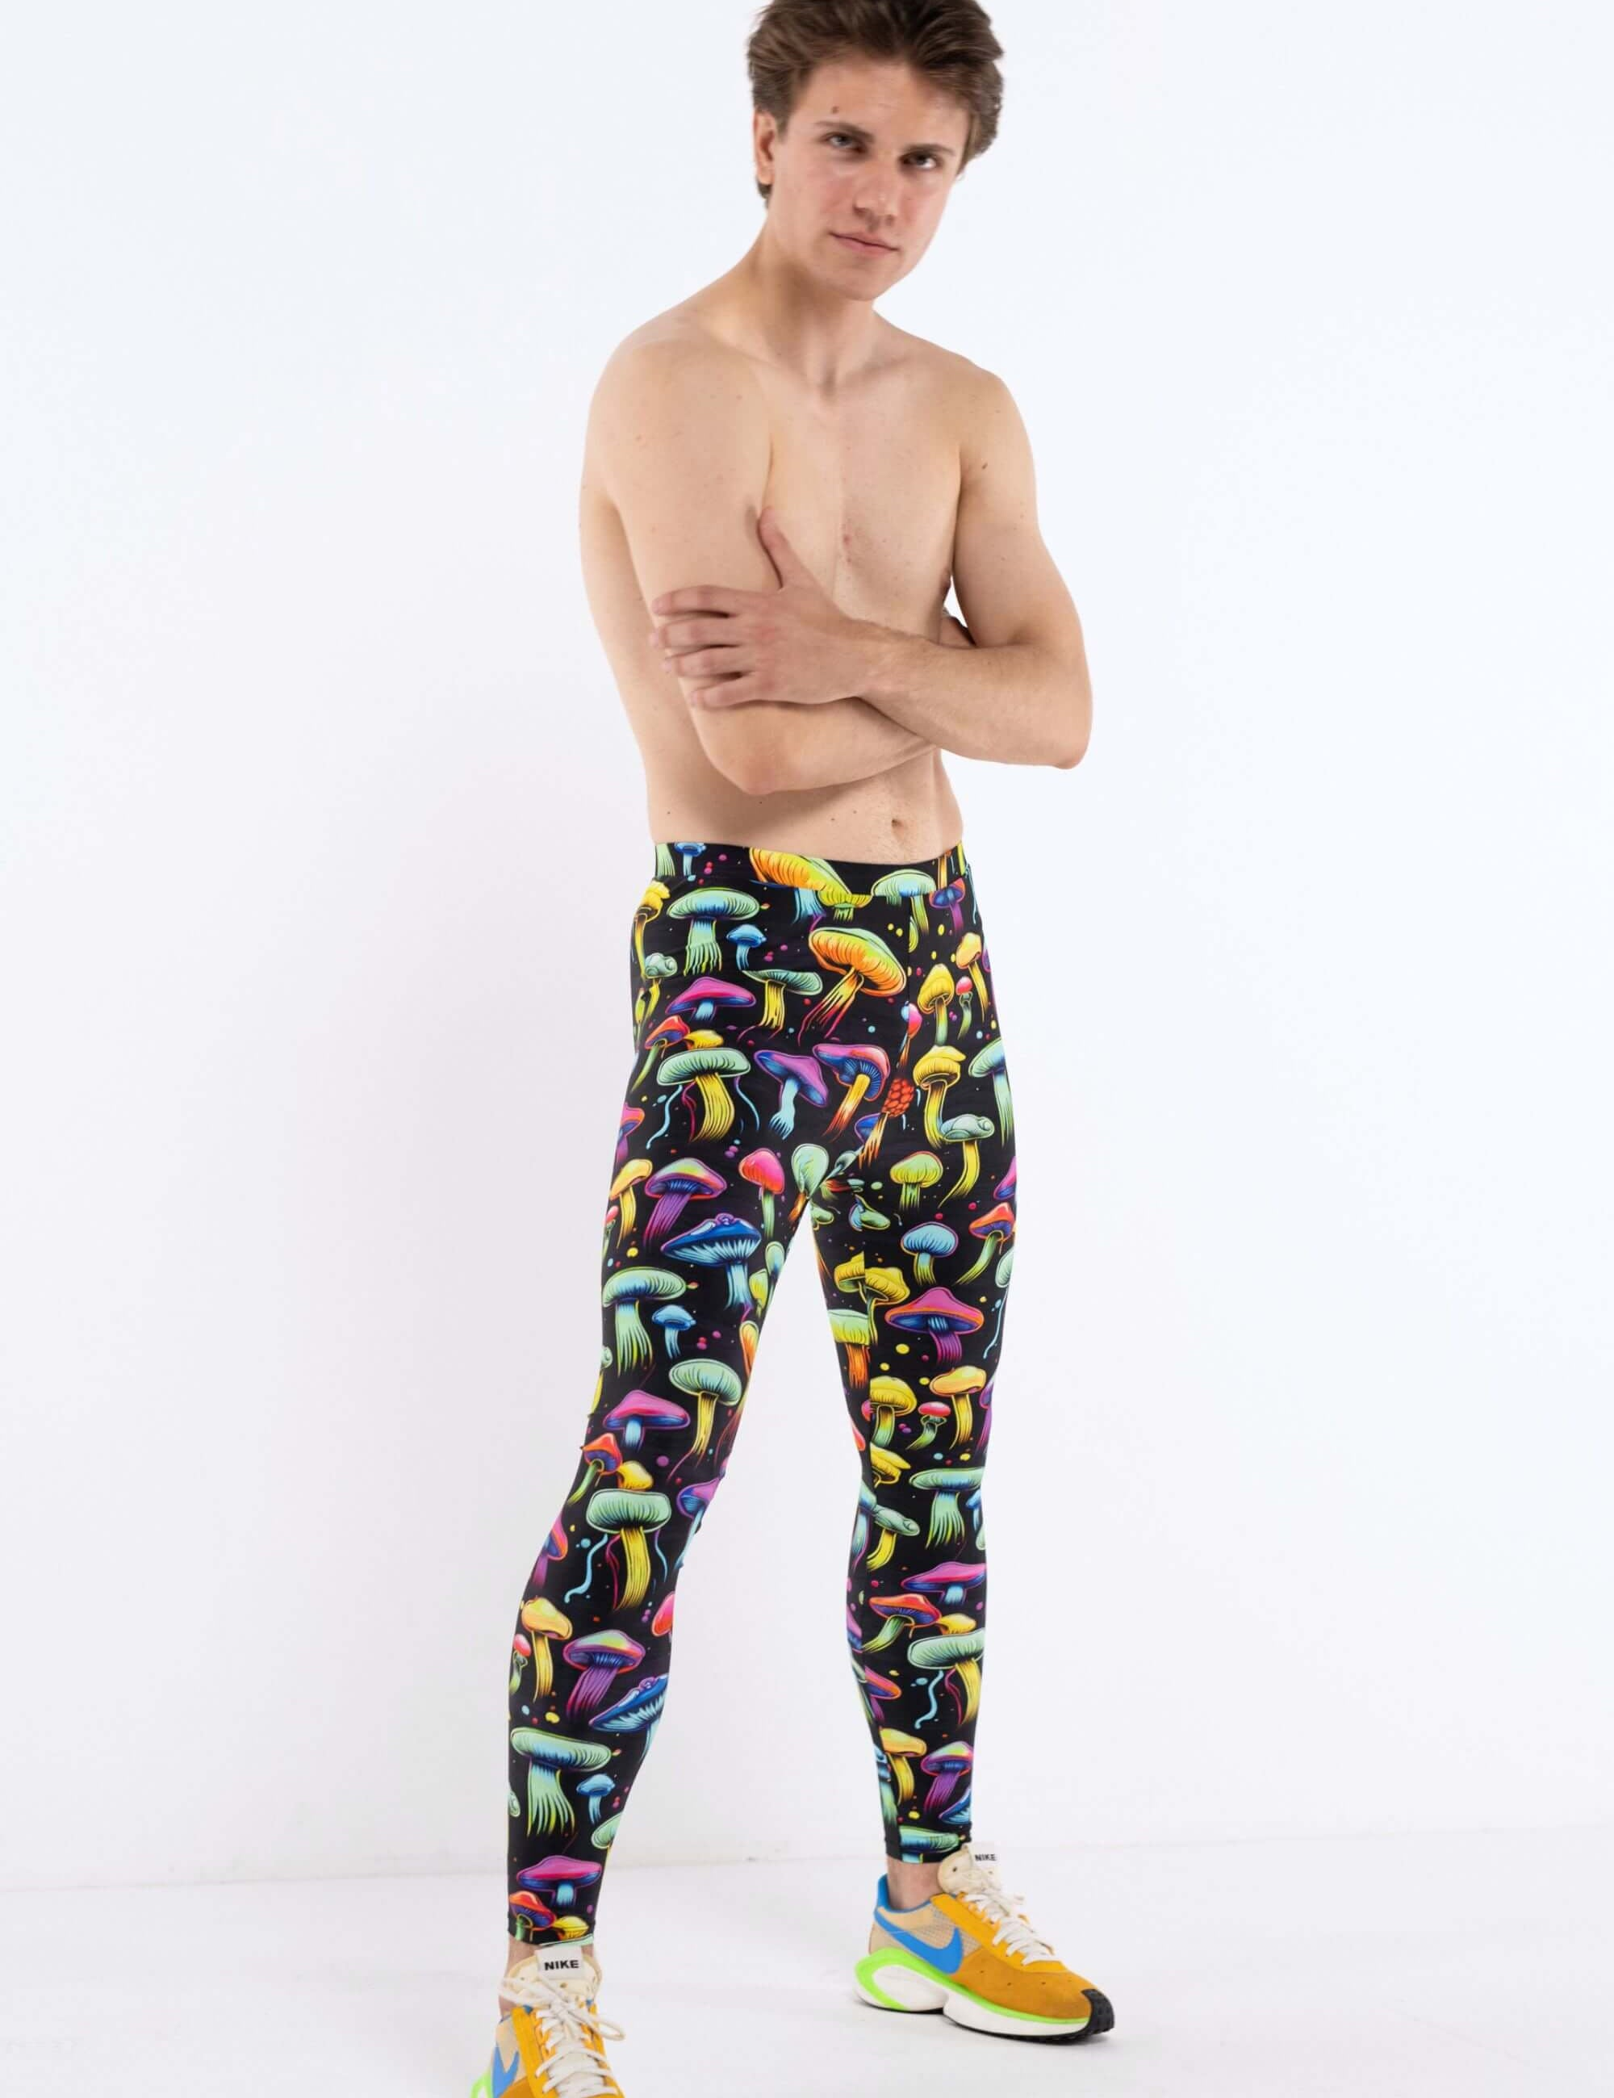
What is our business model?
We operate a direct-to-consumer (DTC) e-commerce model through our website, with additional revenue from:
Wholesale partnerships with dance studios and retailers
Limited edition drops and collaborations with influencers and dance companies
Subscription model for monthly releases or replacements for professionals

Slide 7
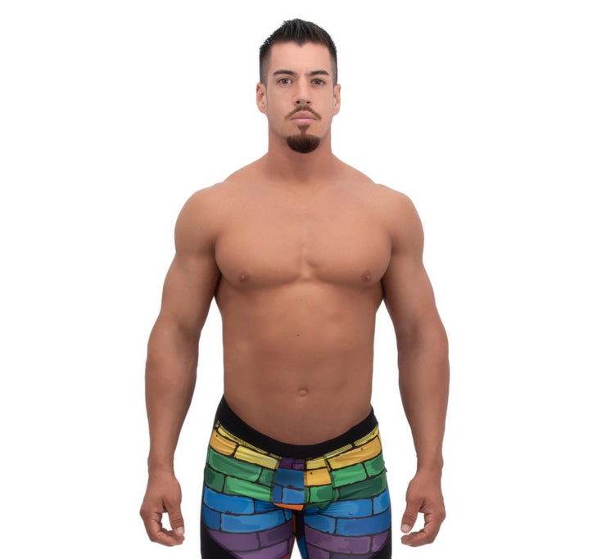
What is our marketing and sales stratedgy?
We plan to use:
Social media marketing on TikTok and Instagram, where dance content thrives
Partnerships with male dance influencers and YouTubers
Sponsorships and brand deals with dance schools and competitions
Targeted online ads based on search behavior and dance interests
Ambassador program with early adopters and professionals offering referrals

Slide 8
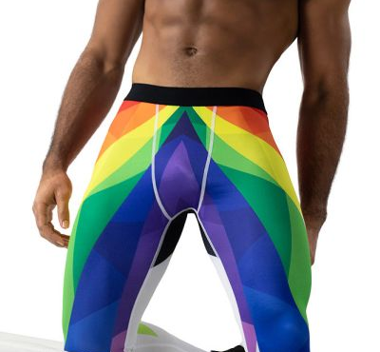
What progress or validation have we achieved so far?
Developed and tested three working prototypes with input from male dancers
Received positive feedback from 15 early testers across different dance styles
Built a waiting list of 500+ interested customers via a pre-launch campaign
Featured in a niche dancewear blog as a “brand to watch”
Secured a collaboration agreement with a regional dance academy

Slide 9
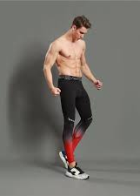
Our projections
Year 1: $75K revenue (online sales, limited production), $20K net loss (due to startup costs)
Year 2: $250K revenue, break-even point
Year 3: $600K revenue, $120K profit (scaling production and partnerships)
COGS is approximately 35%, and we project healthy margins as we scale.

Slide 10
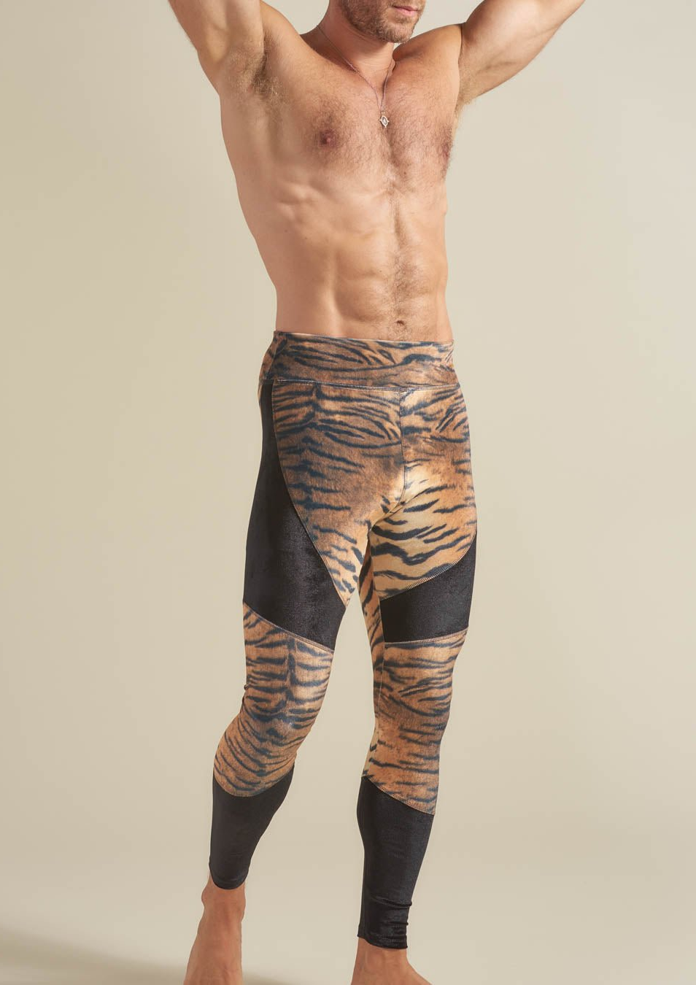
How much investment we are seeking and what it is for?
We’re seeking $100,000 in seed funding. Funds will be allocated as follows:
40%: Manufacturing first large-scale production run
25%: Marketing and influencer campaigns
20%: E-commerce development and branding
15%: Operational costs, legal, and distribution setup

Slide 11
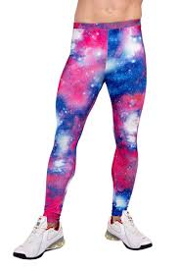
Why you should invest in us?
Deggings fills a real, overlooked gap in the growing dancewear and athleisure market. We have early traction, a clear brand identity, and a dedicated founding team with both dance and design backgrounds. This is more than leggings—it's about giving male dancers gear that respects their craft, enhances their performance, and builds their confidence.
Investing in Deggings means supporting innovation in a niche with massive potential—and getting in early on a brand poised to disrupt men’s dancewear.

