Slide 1
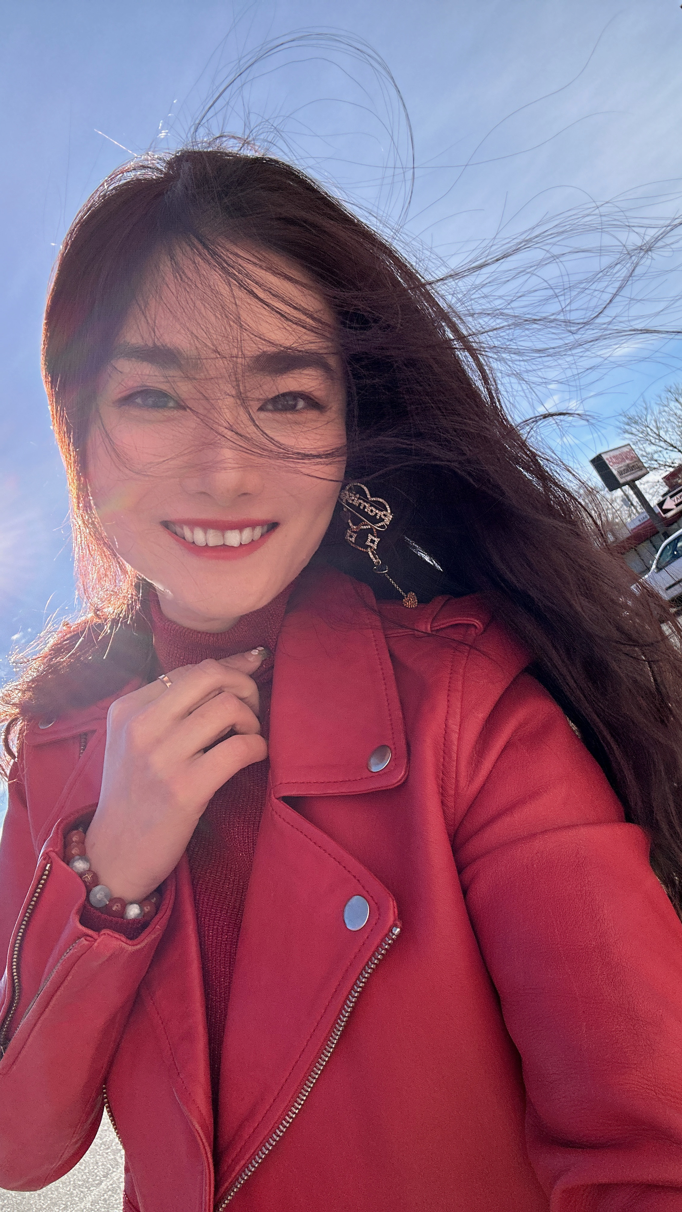
Nerissa BAI
Model & Talent
True happiness comes from belonging.
Sometimes you have to go for it.

Slide 2
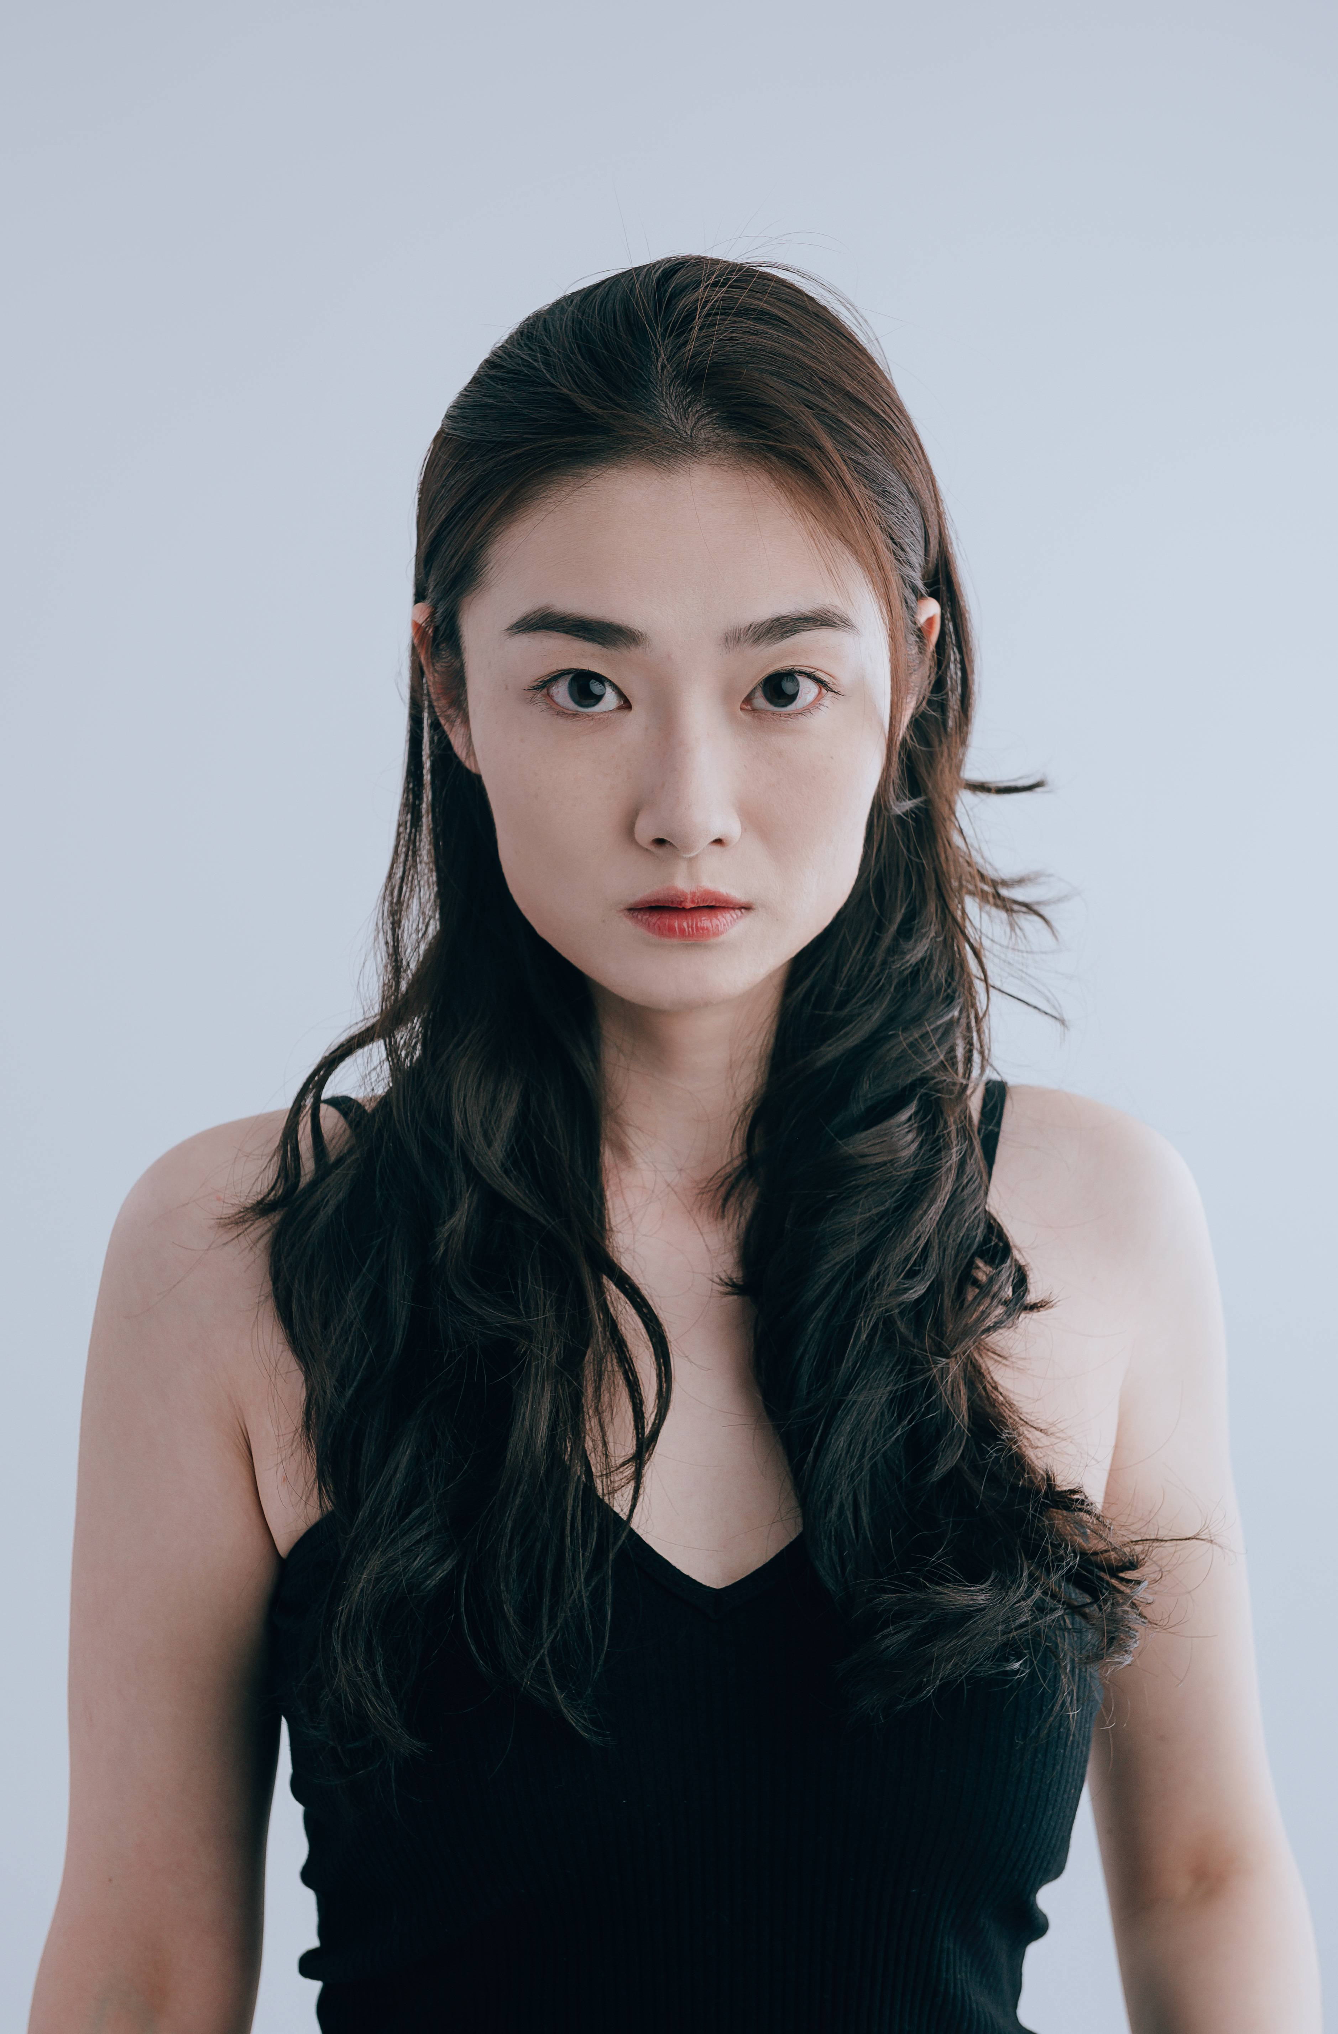
Name: Nerissa BAI
Age:30(08/03/1994)
Phone Number:626 342 9518
Email:nerissabai0803@gmail.com
Current Location:Denver,Colorado
Language:Mandarin\French\English
Education:Master’s degree
INSEEC School of Business and Economics(Paris,France)
BUST:34in
WAIST:25”
HIPS:35in
HEIGHT:172cm/5’8” SHOE:38EU/7US
CUP:B
HAIR:black
EYE:brown

Slide 3
C
O
N
T
E
N
T
1.Model & Talent
2.Actor
3.Host

Slide 4
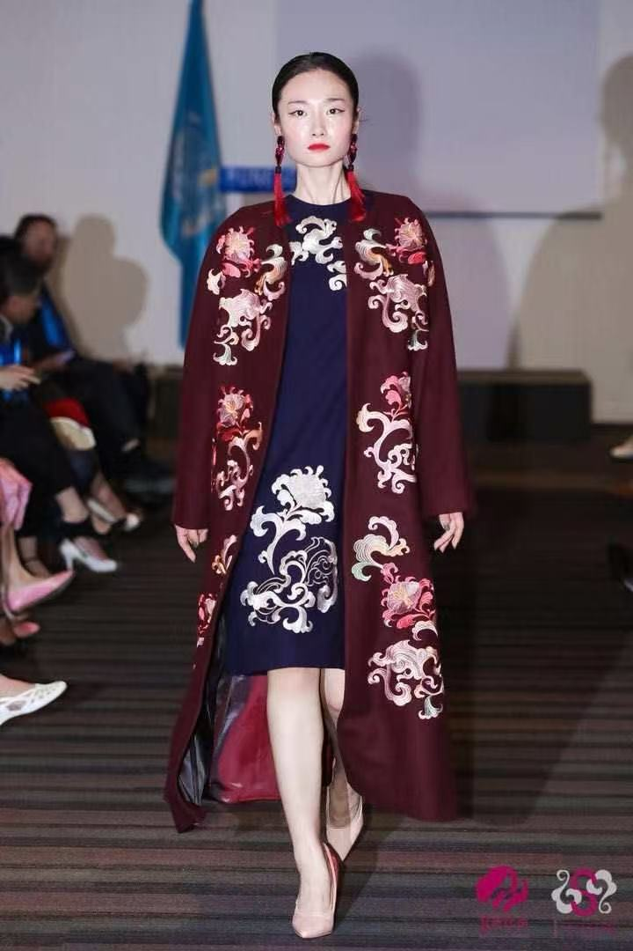
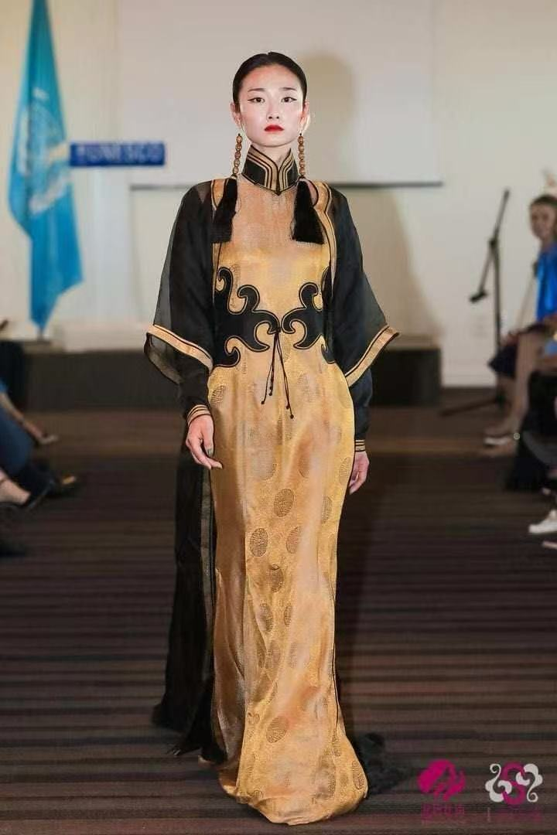
UNESCO Fashion SHOW-Paris
Height 5’8.5” Bust 34 Waist 26 Hips 36 Shoes 8 Hair Black Eyes:Brown
Hauteur 174cm Poitrine 86cm Taille 66cm Hanches 92cm Chaussures 38 Cheveux Noirs Yeux:Marron

Slide 5
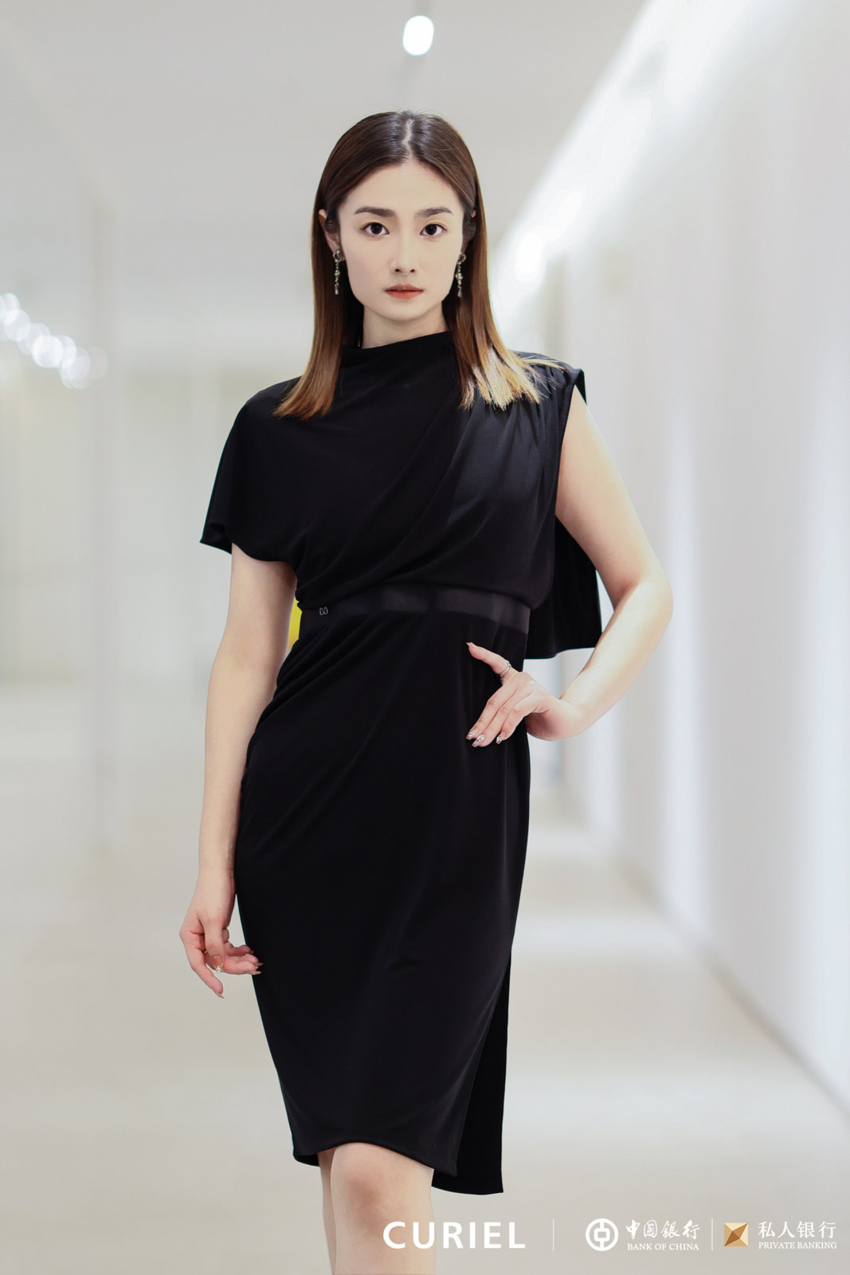
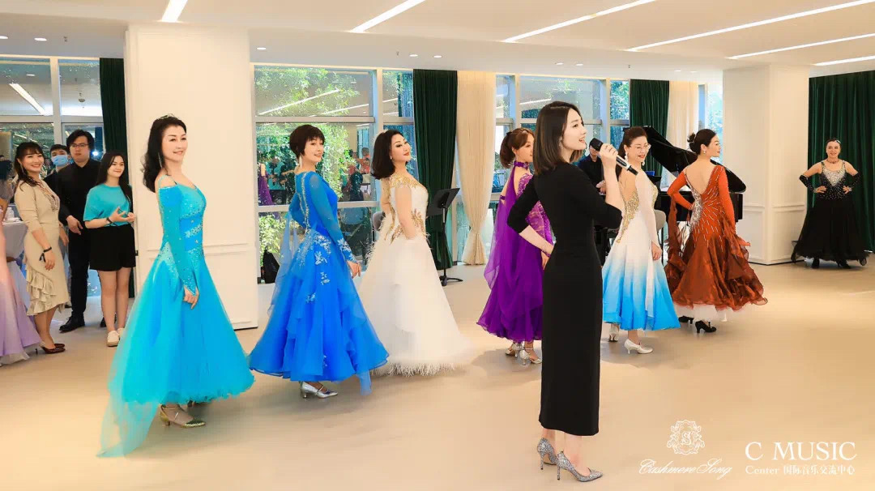
CURIEL
CASHMERE SONG

Slide 6
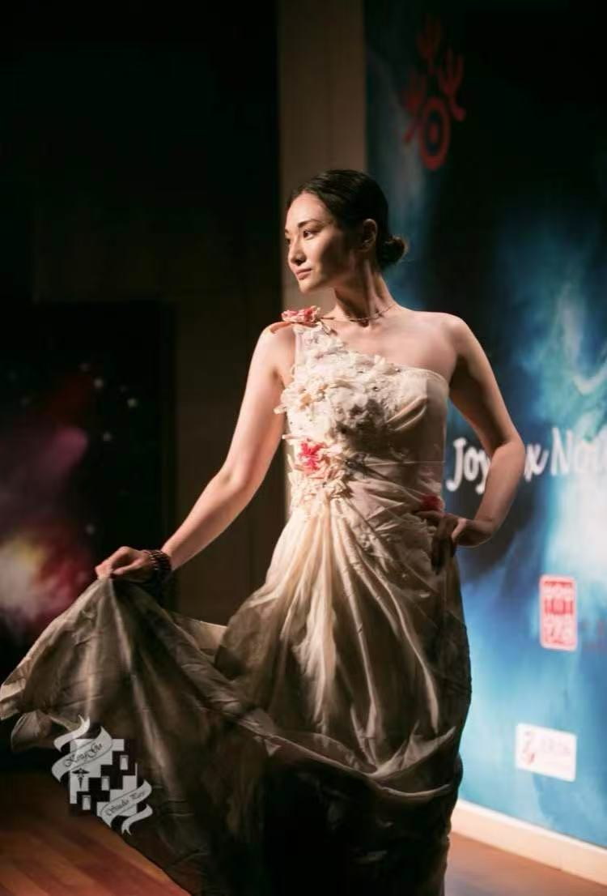
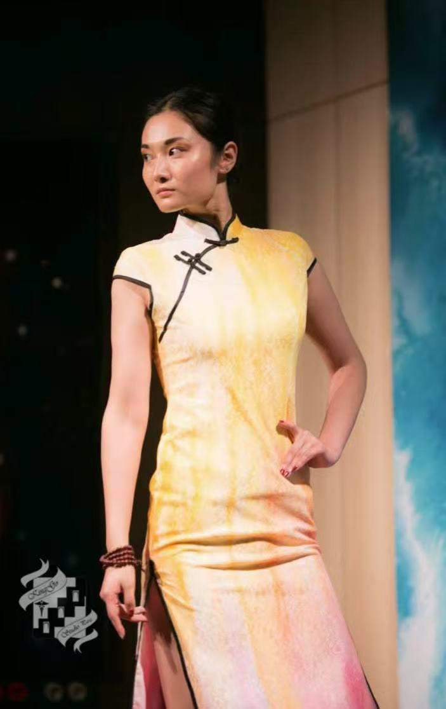
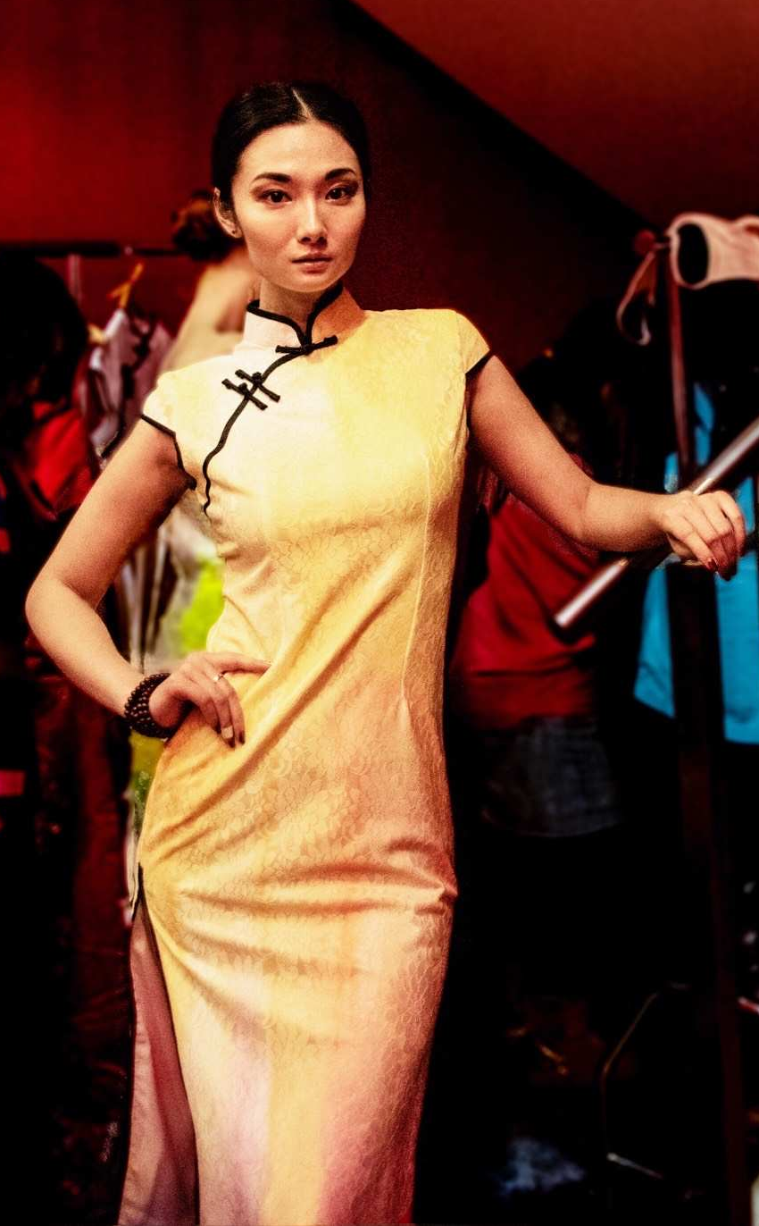
REFOSIAN-China Cultural Center in Paris

Slide 7
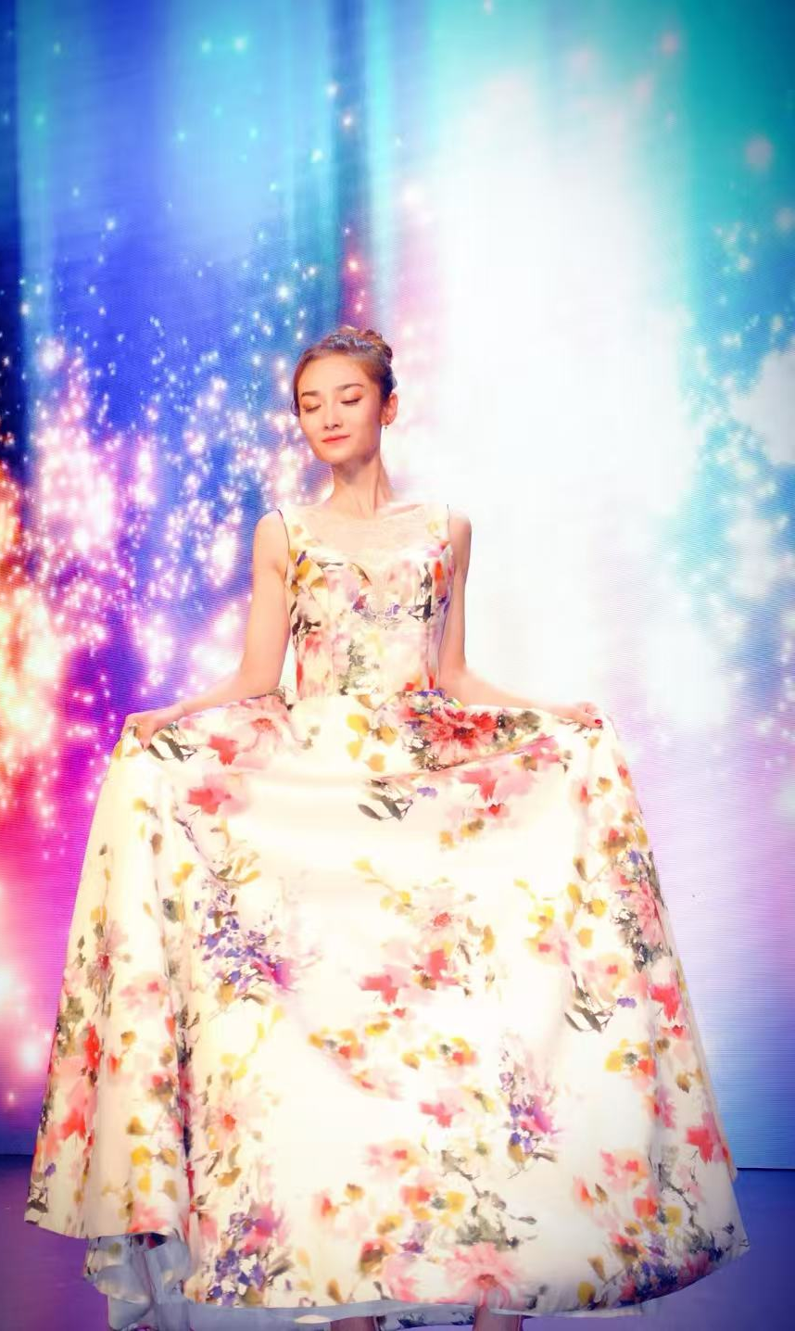
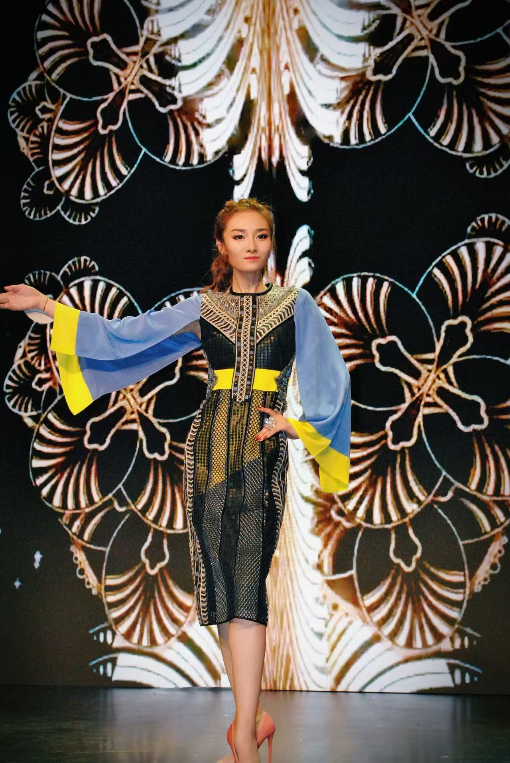

Slide 8
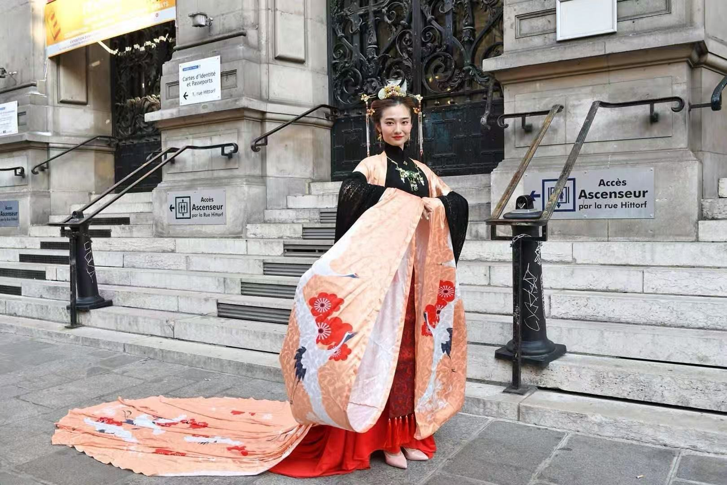
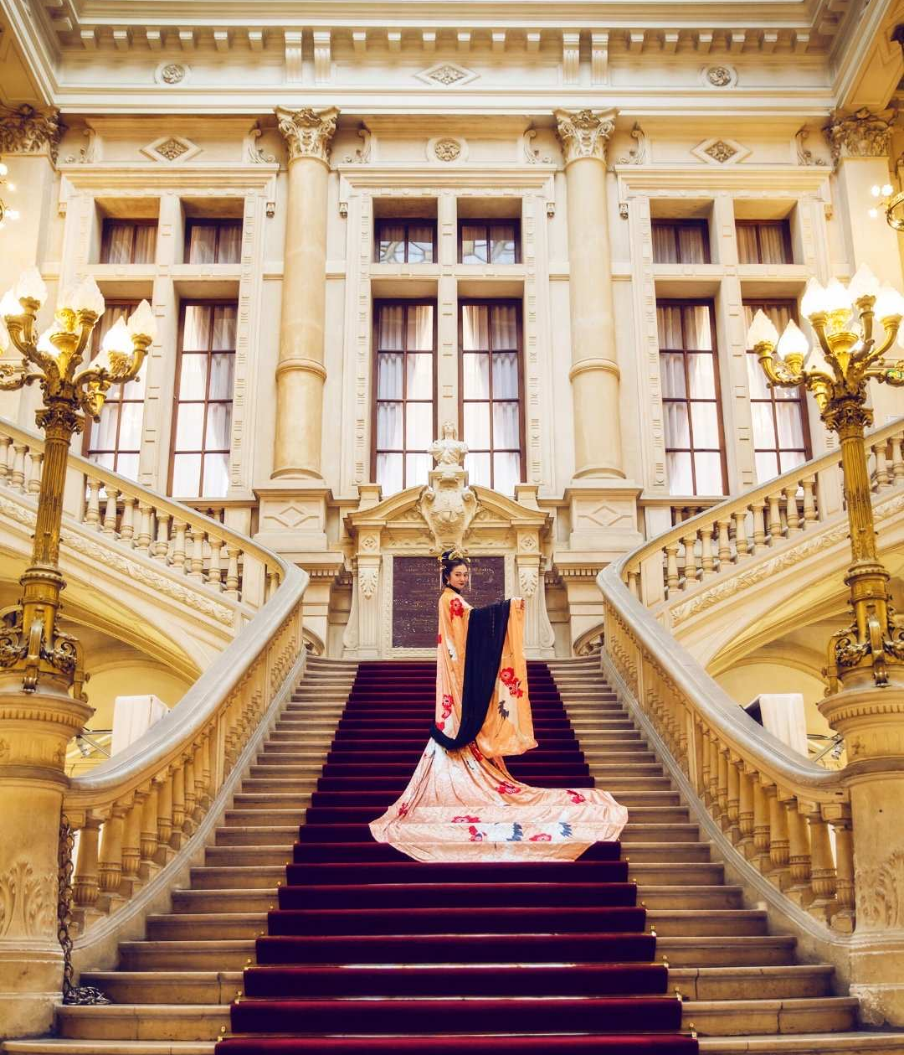
MINGHUATANG-明华堂
Paris City Hall
Runway
Filming a promotional video on cultural exchange between China and France

Slide 9
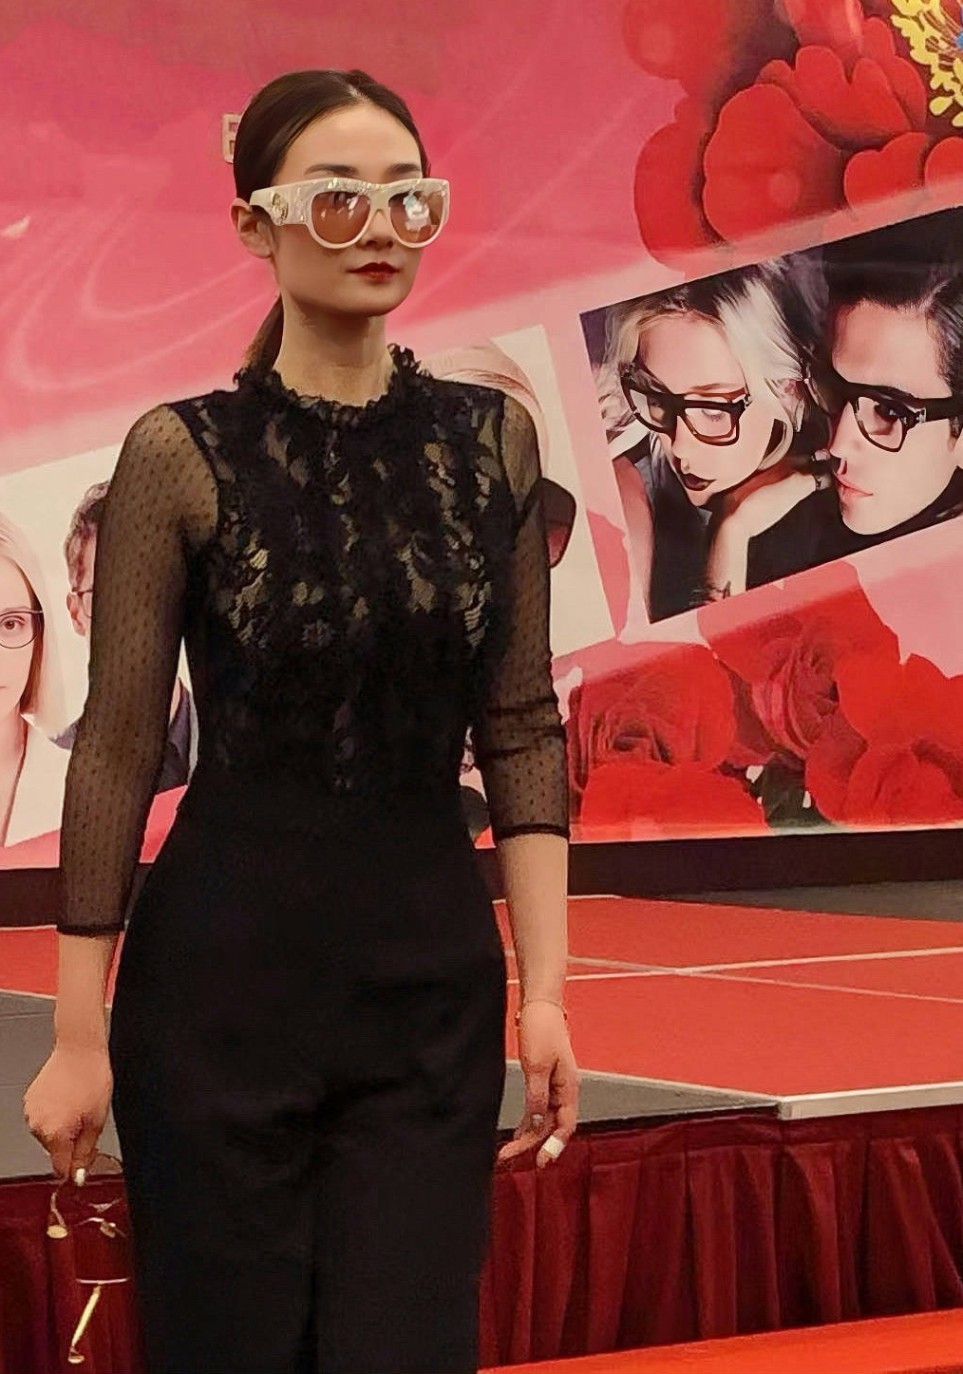
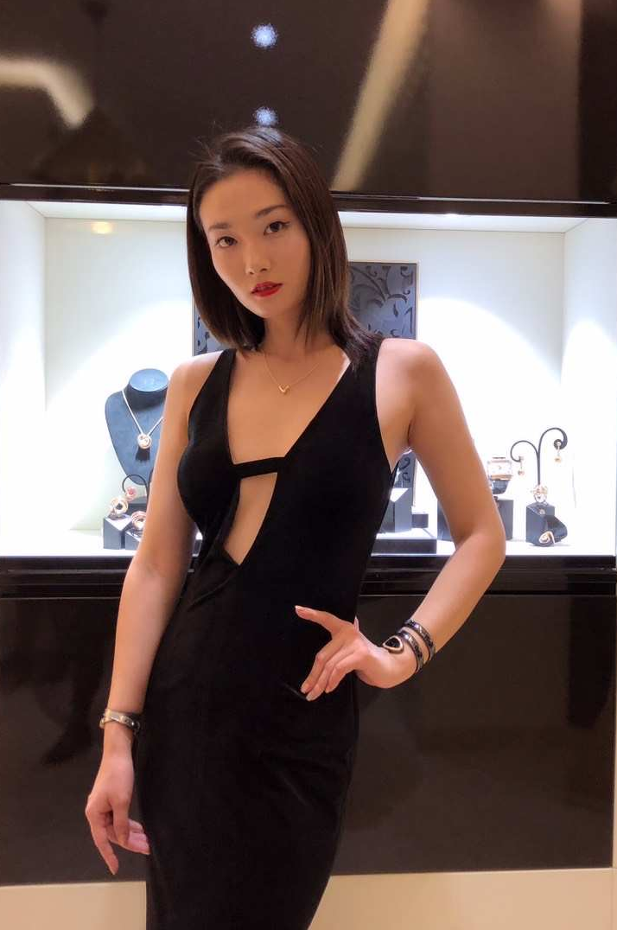
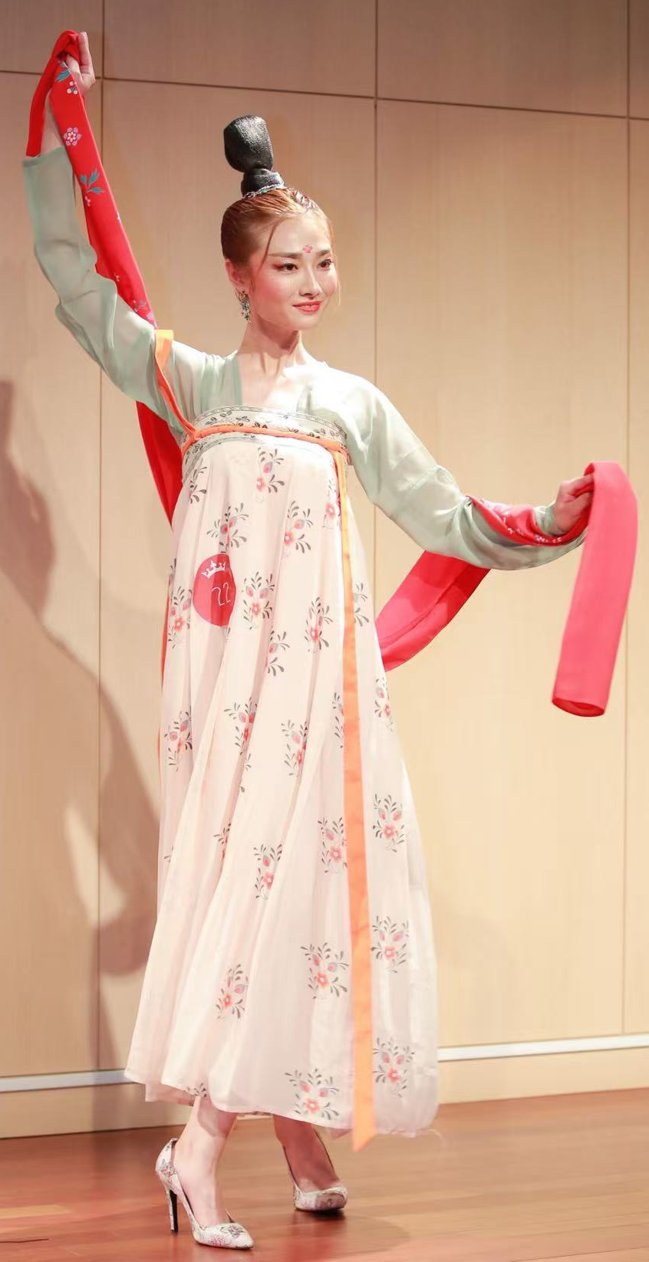
BVLGARI-Watch
BVLGARI Paris Champs Elysees
CHONG HUI HAN TANG
Sunglasses

Slide 10
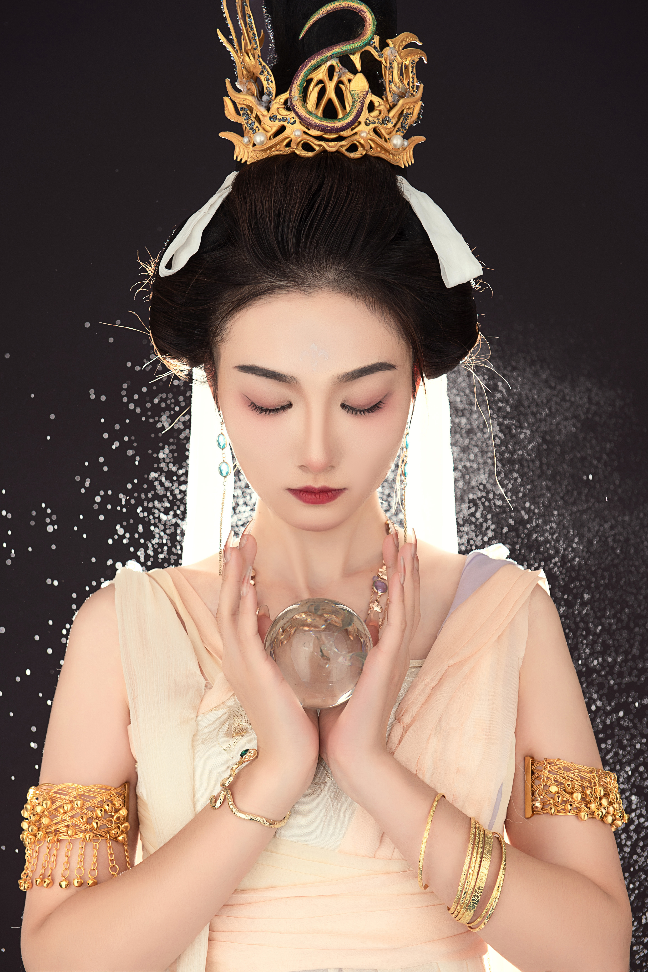
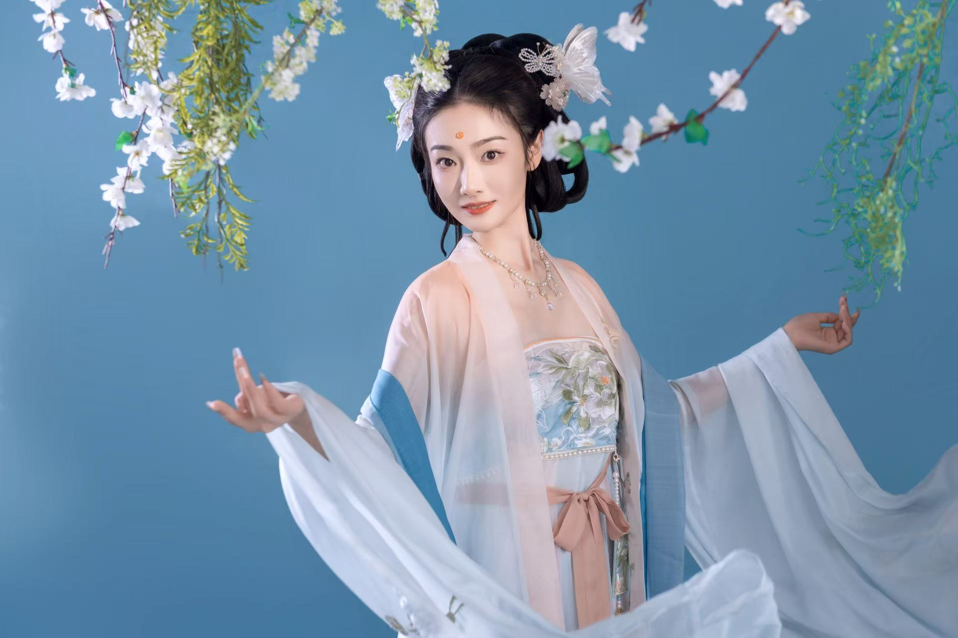
POETIC ORIENTAL BEAUTY

Slide 11
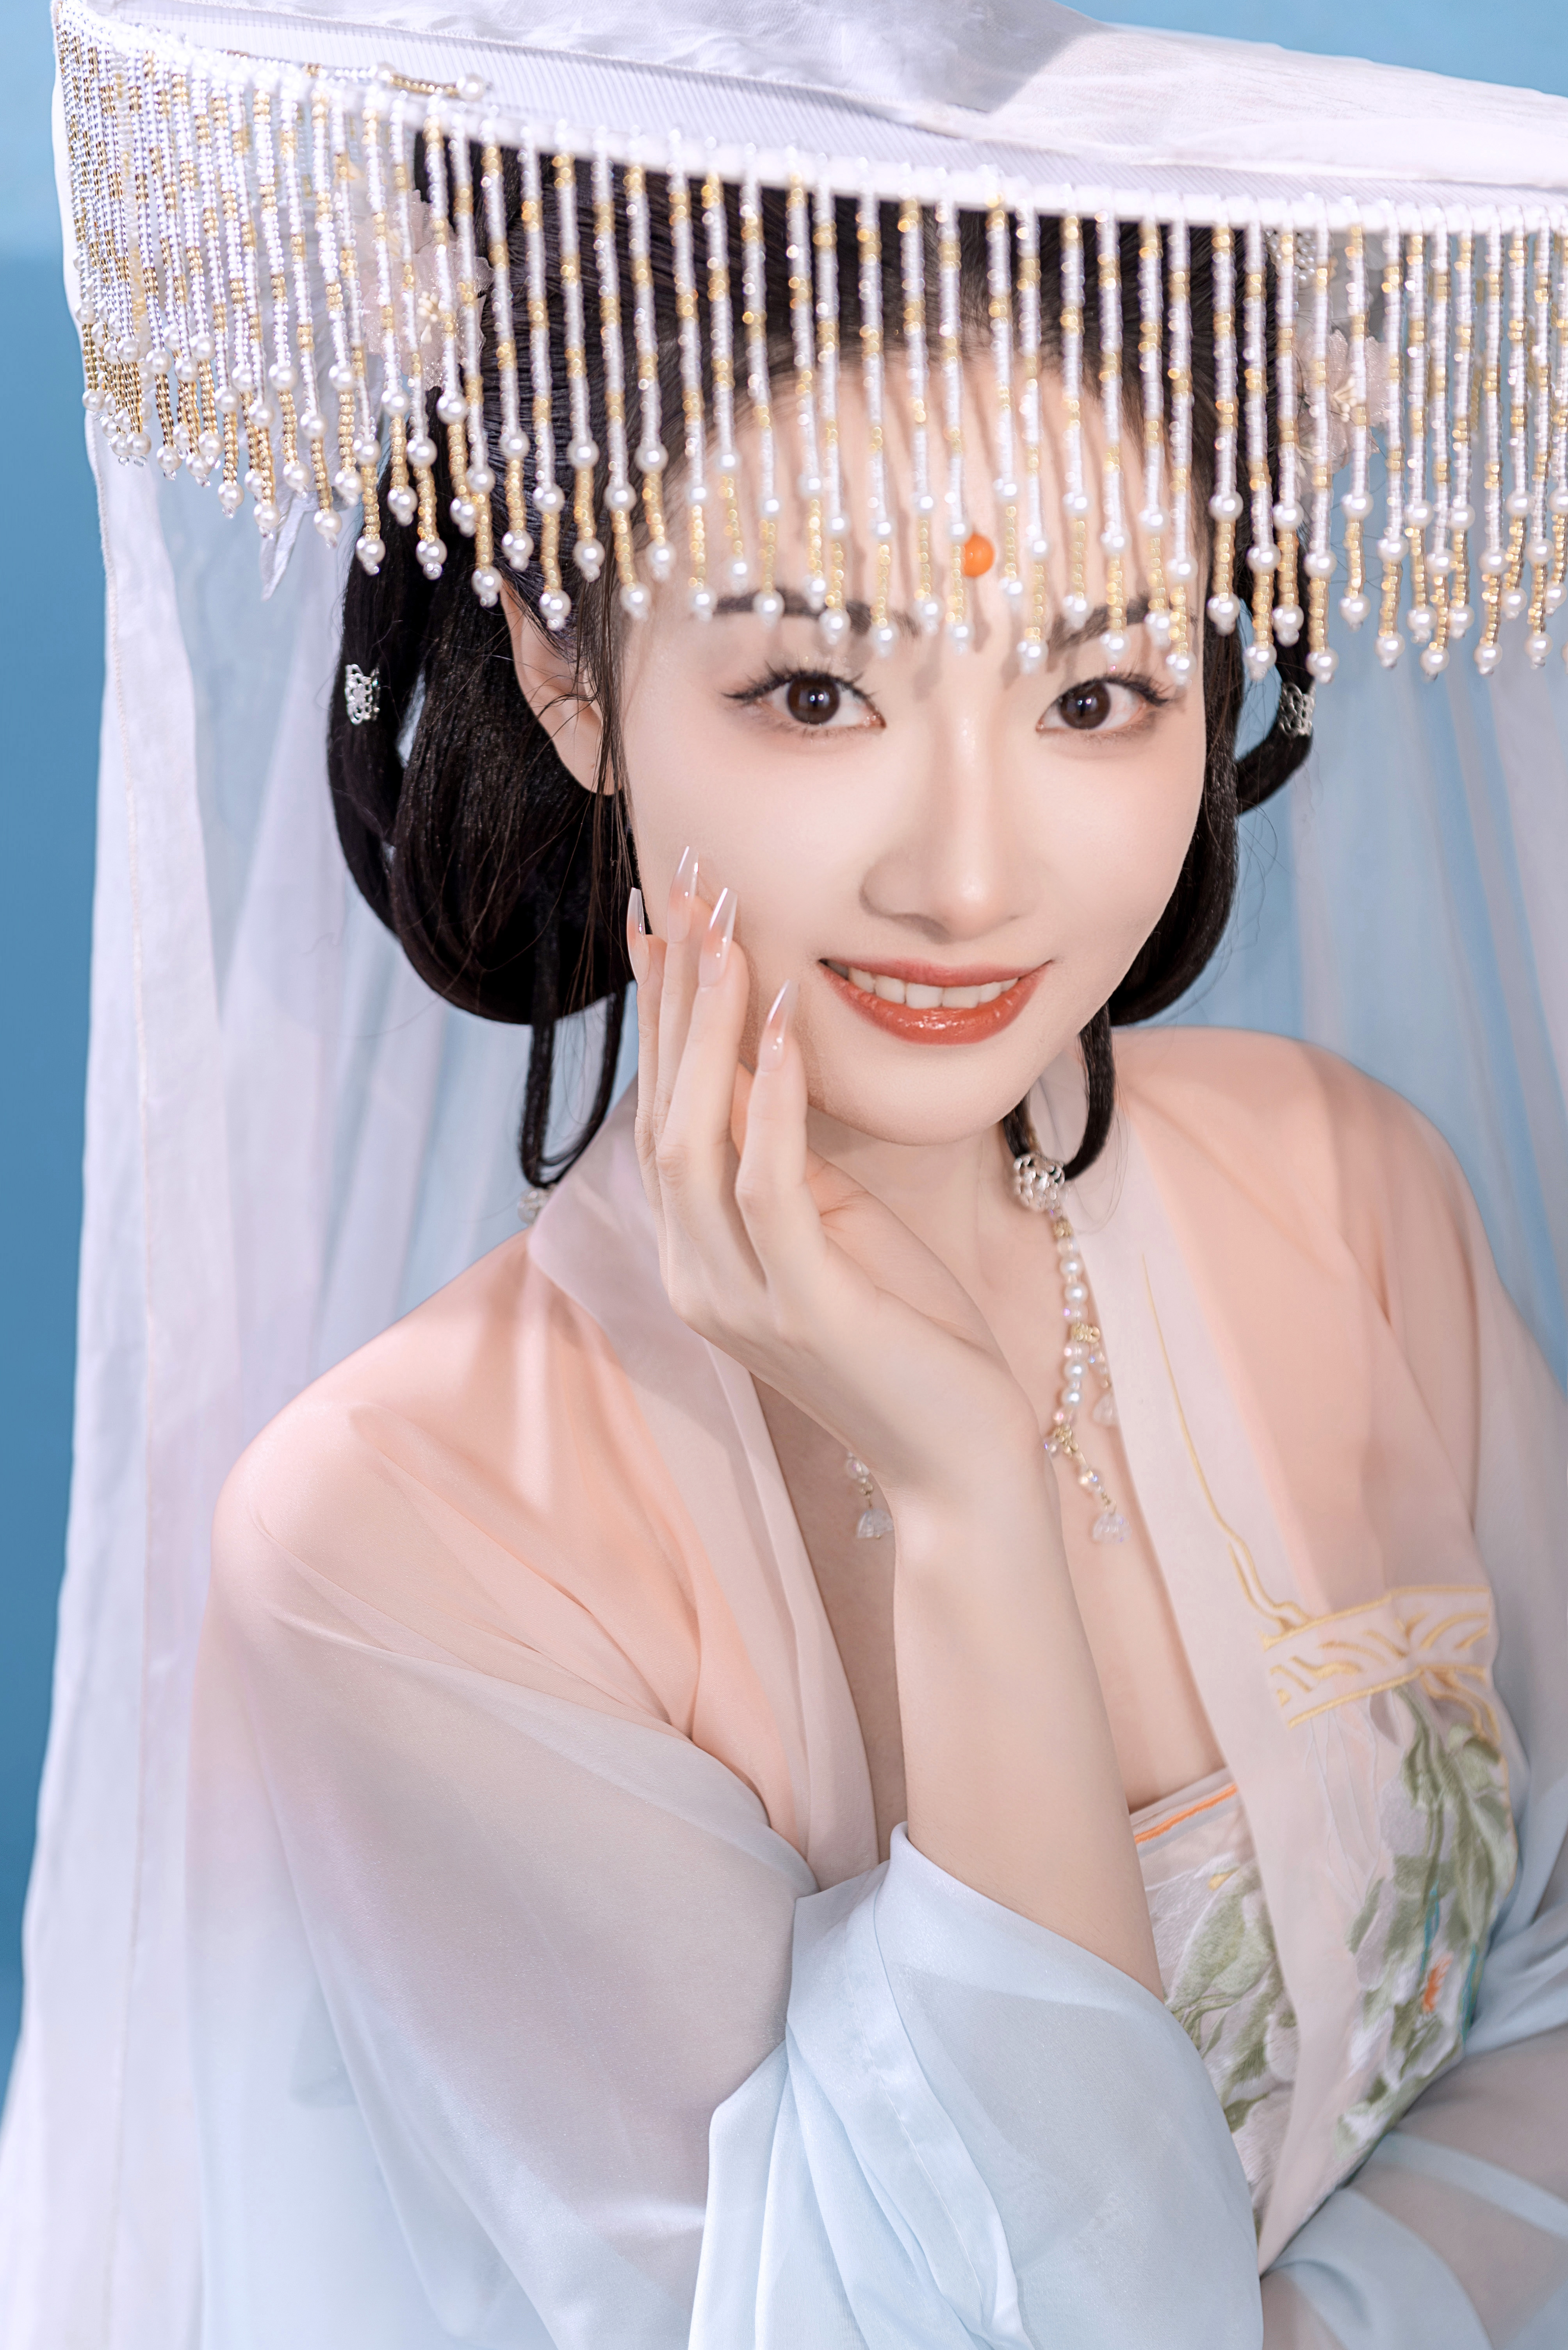
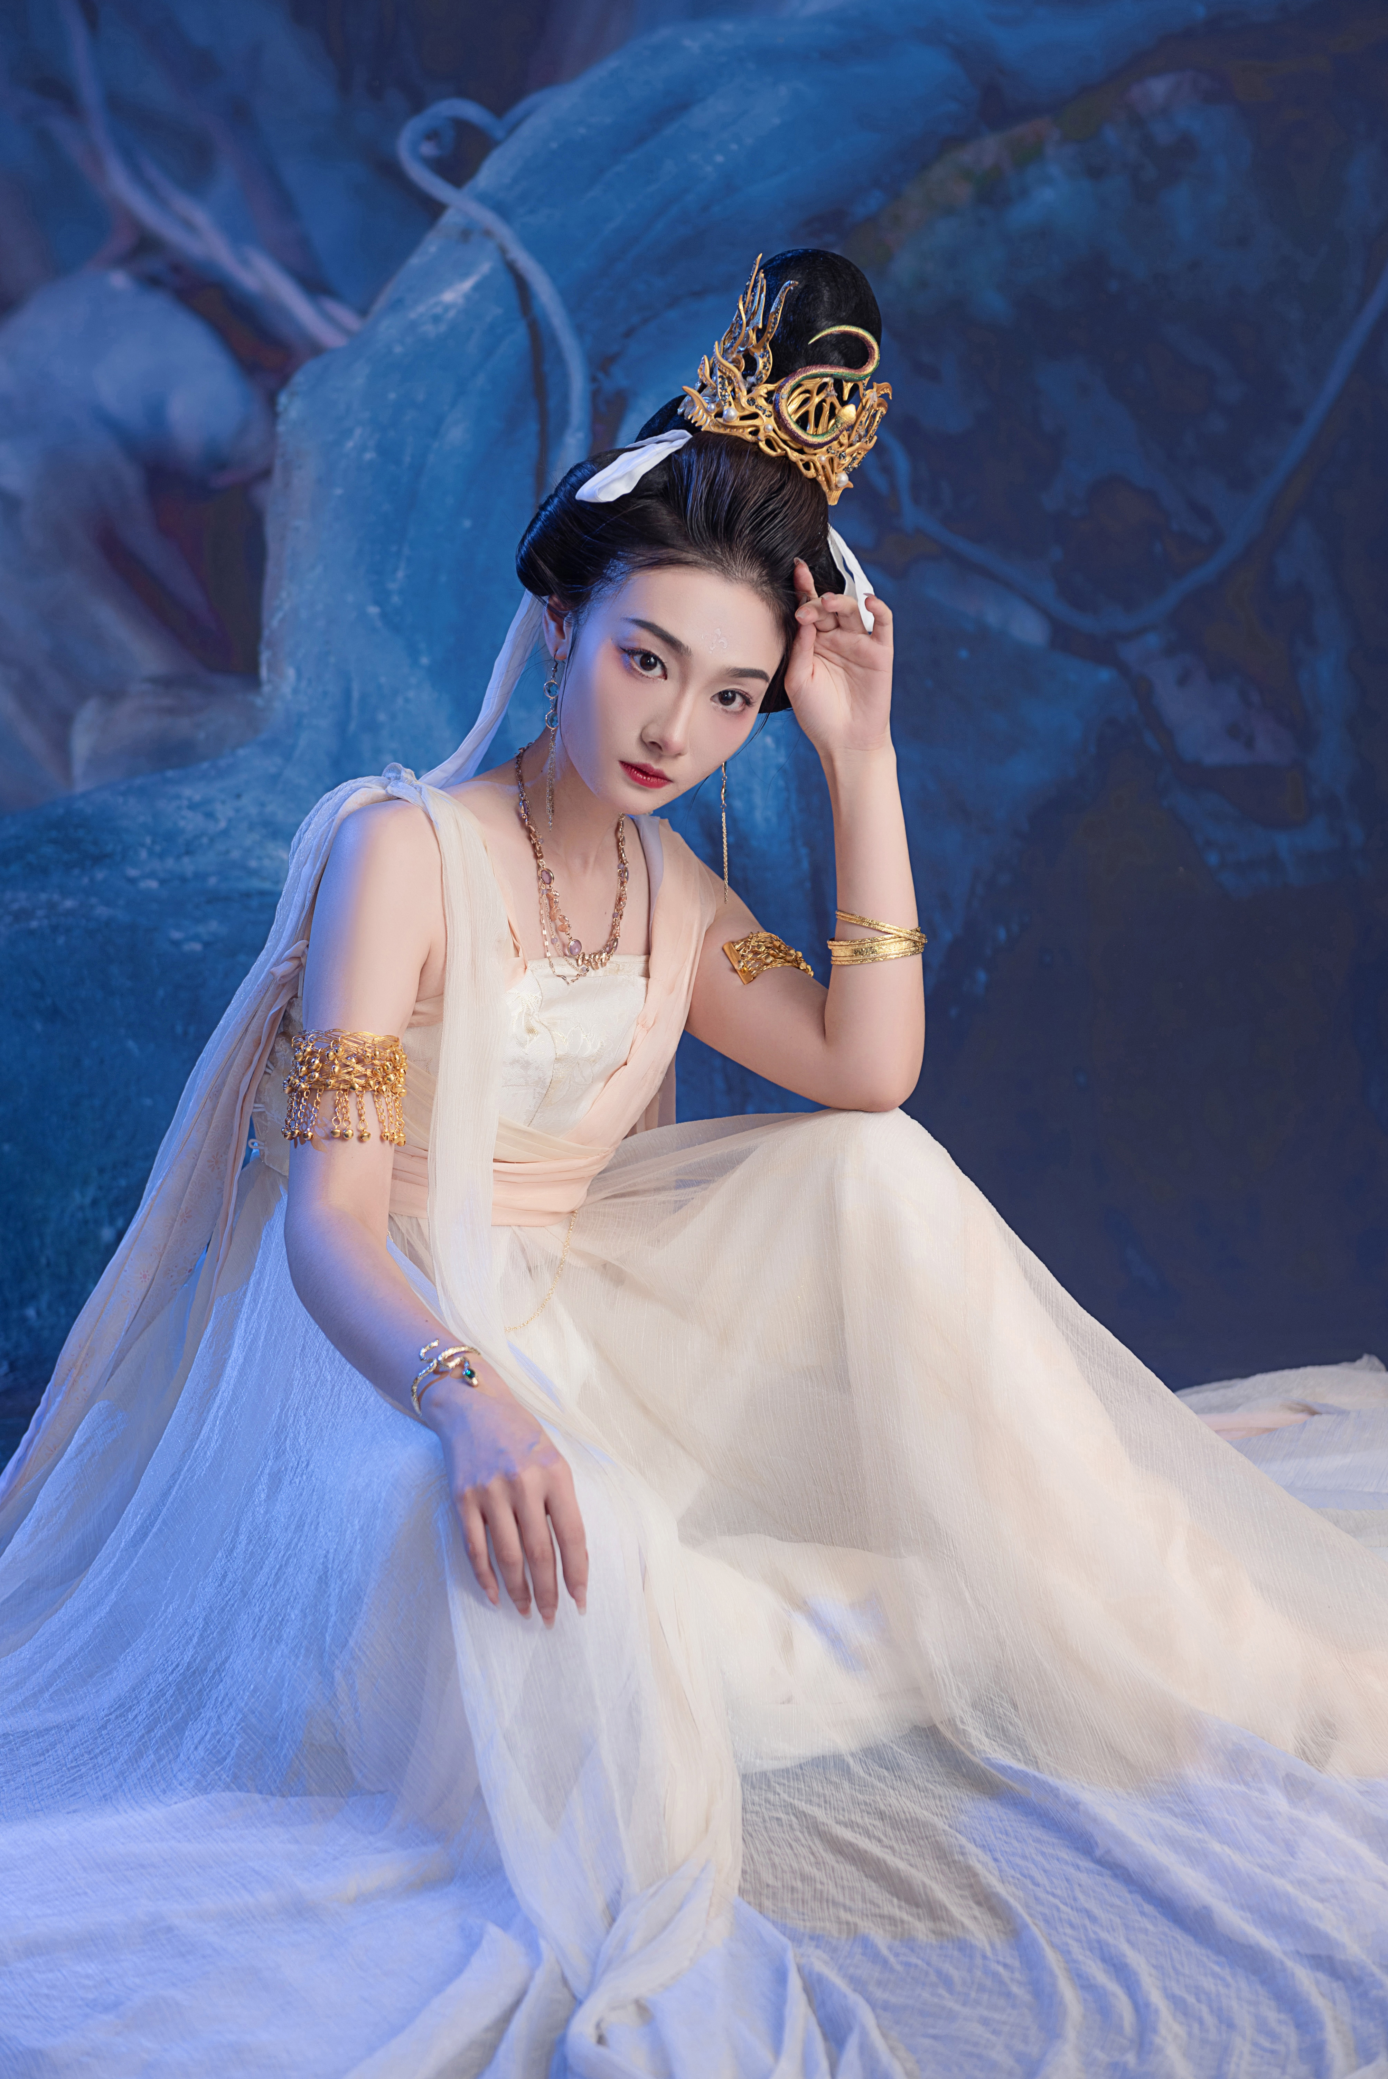
POETIC ORIENTAL BEAUTY

Slide 12
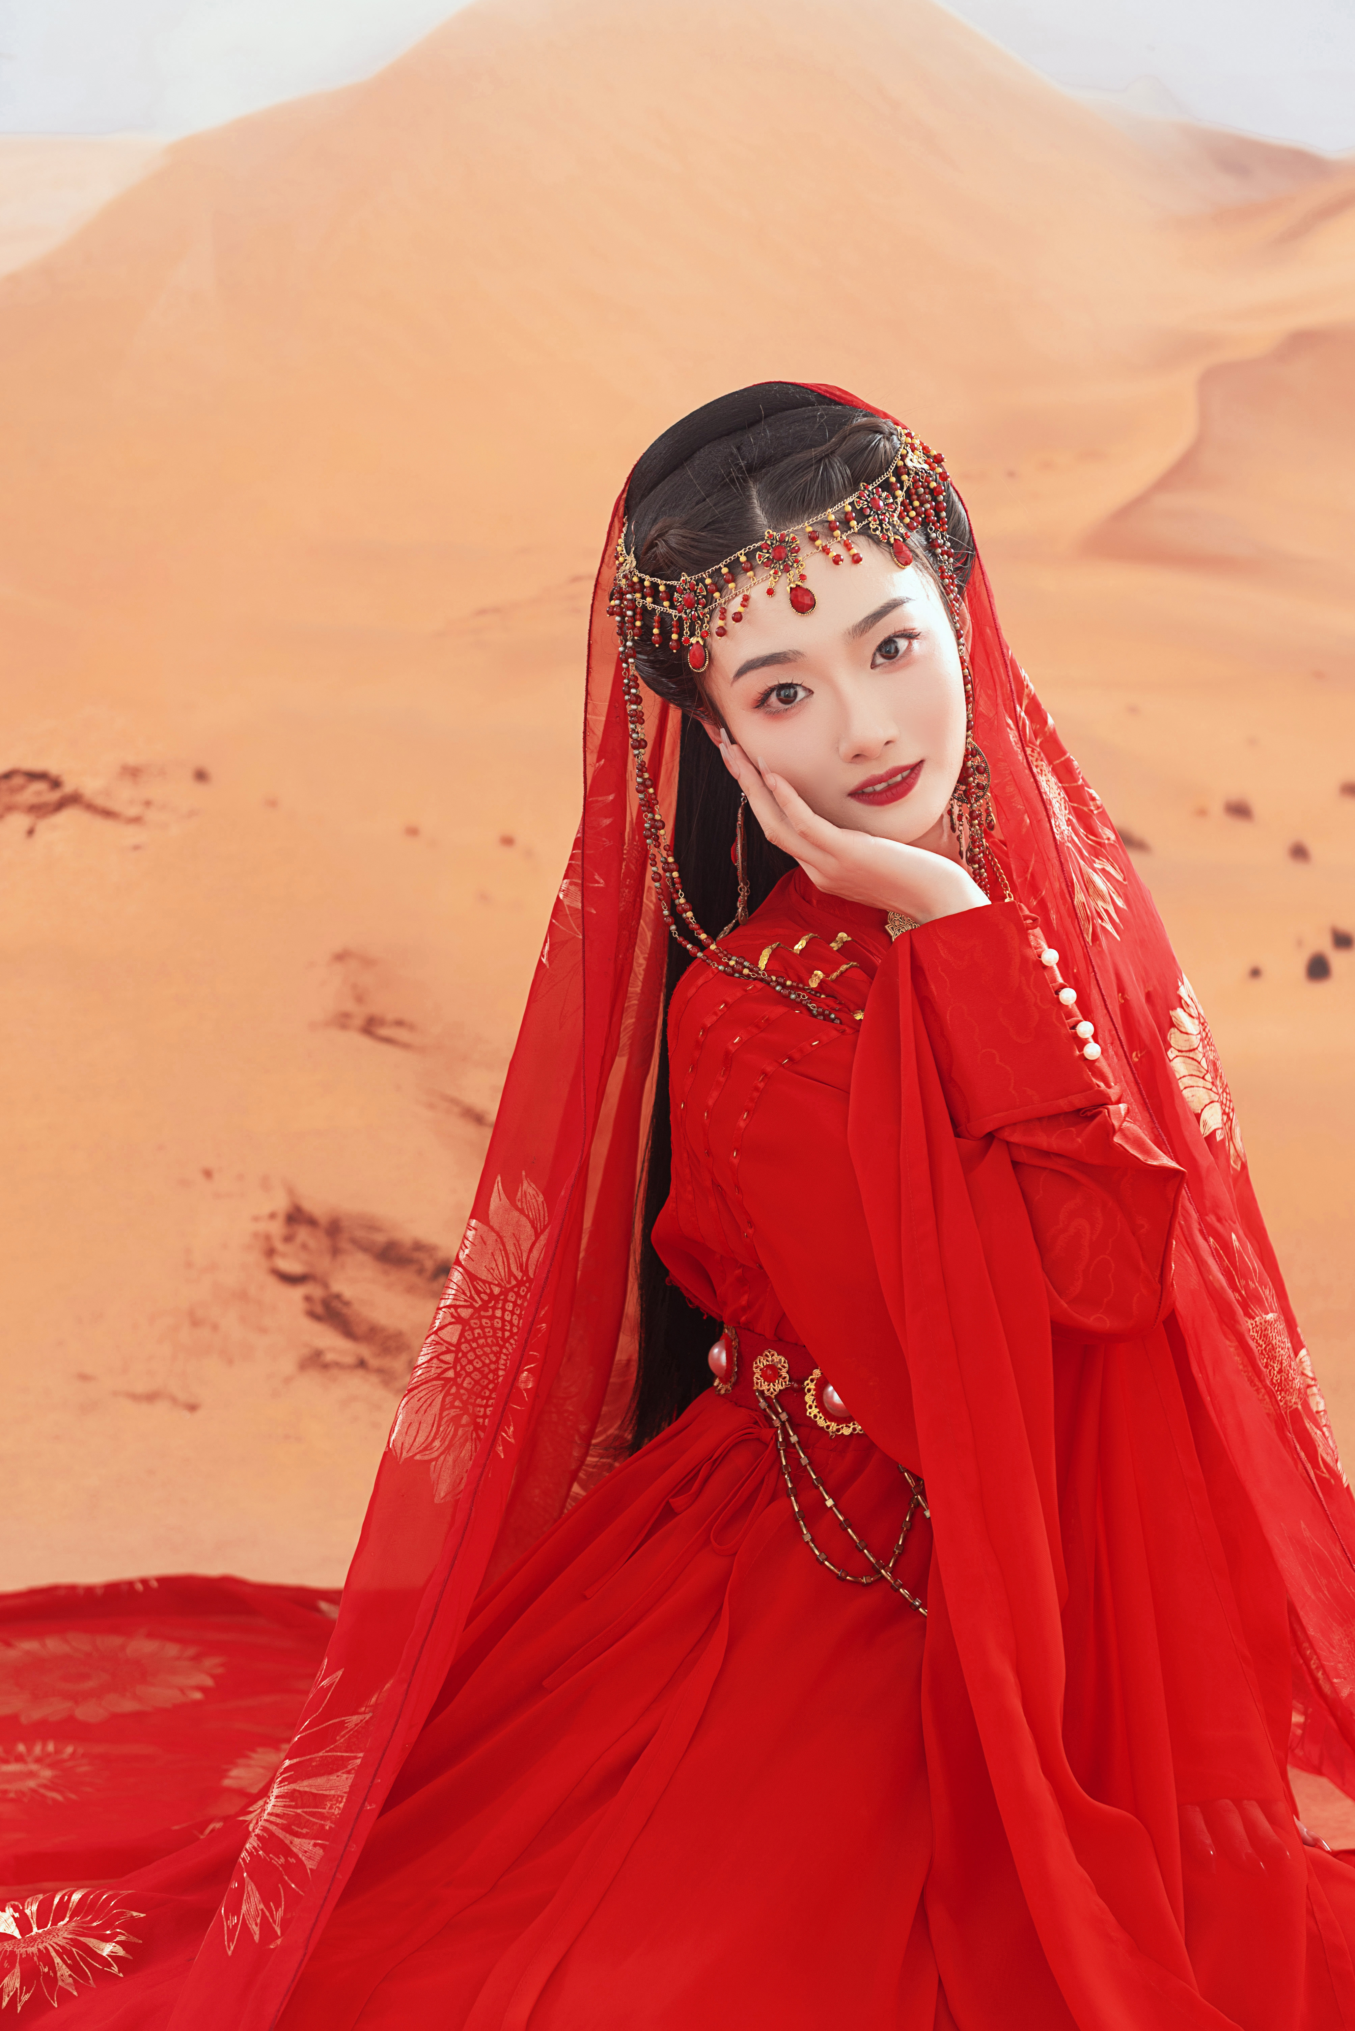
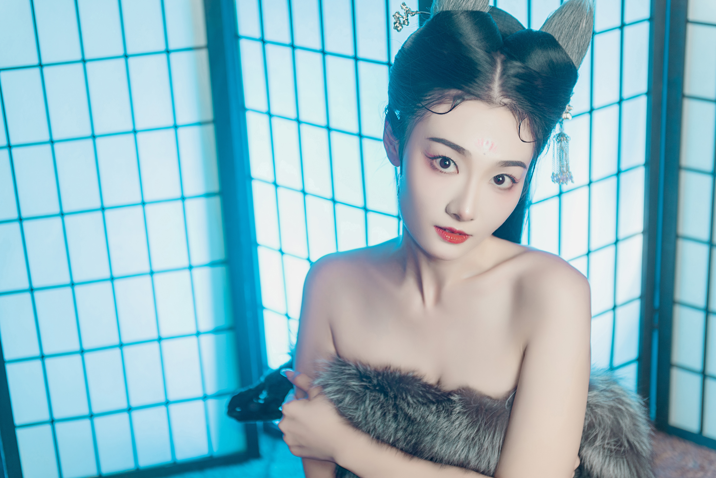
POETIC ORIENTAL BEAUTY

Slide 13
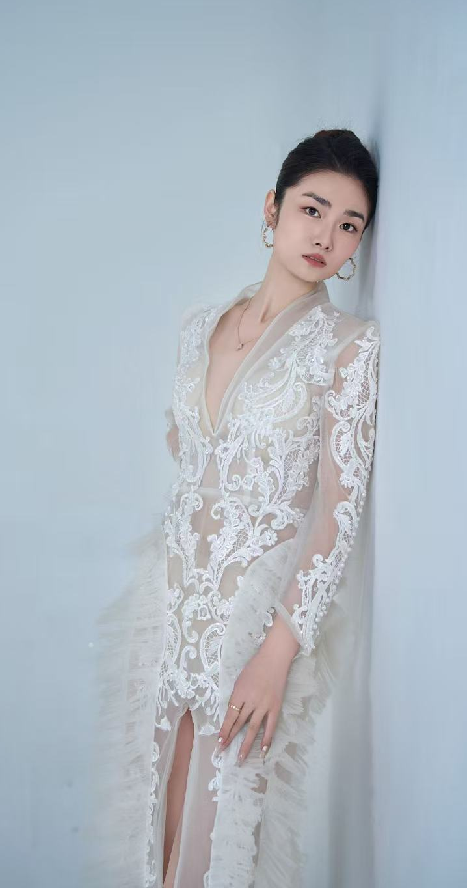
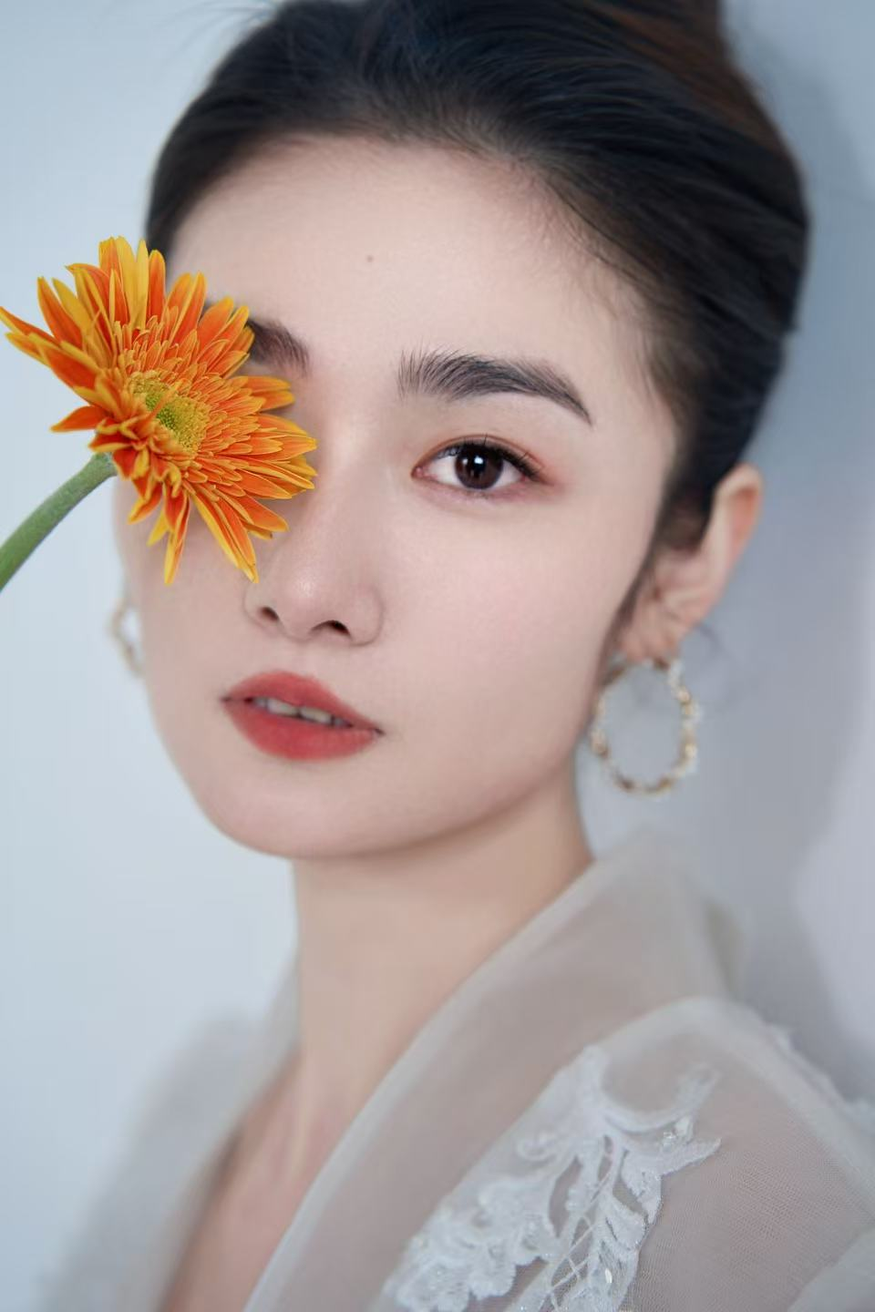
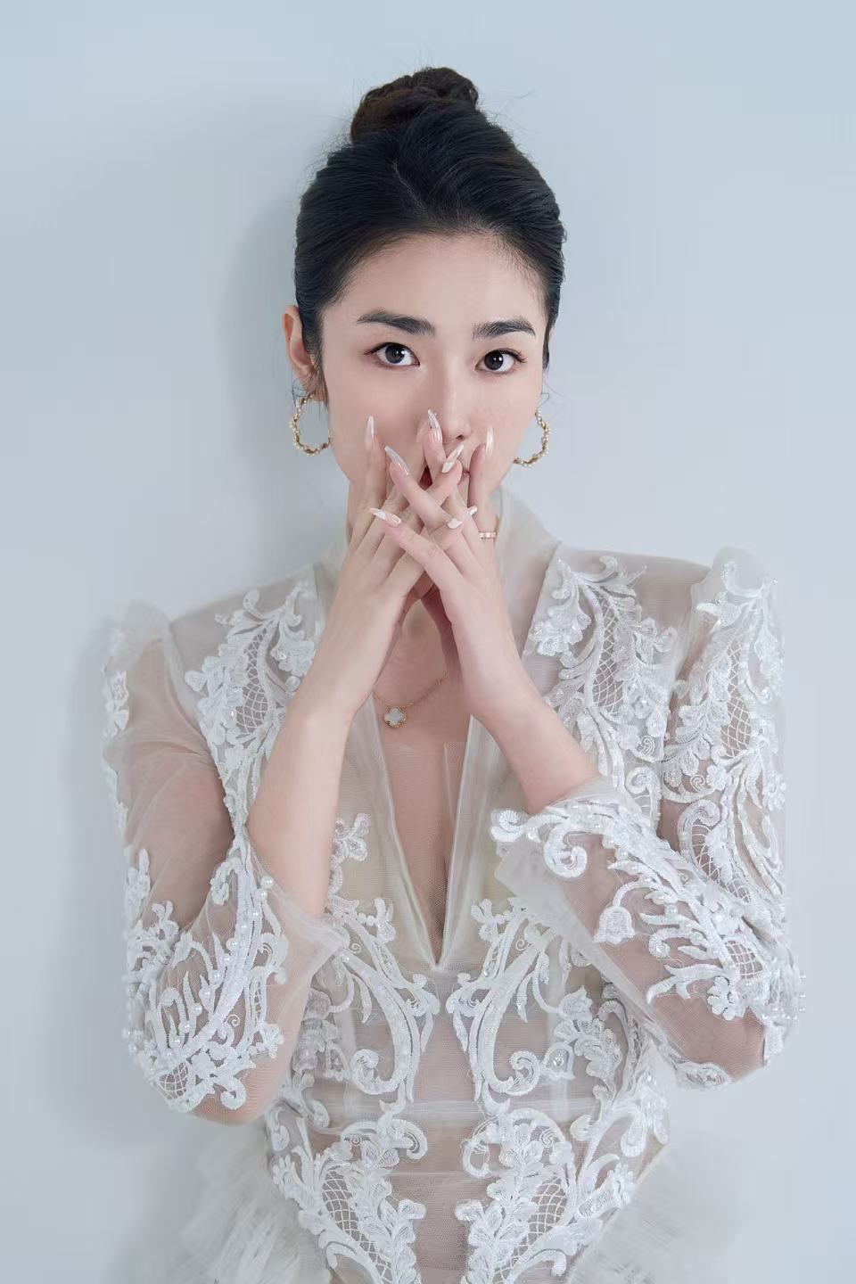

Slide 14
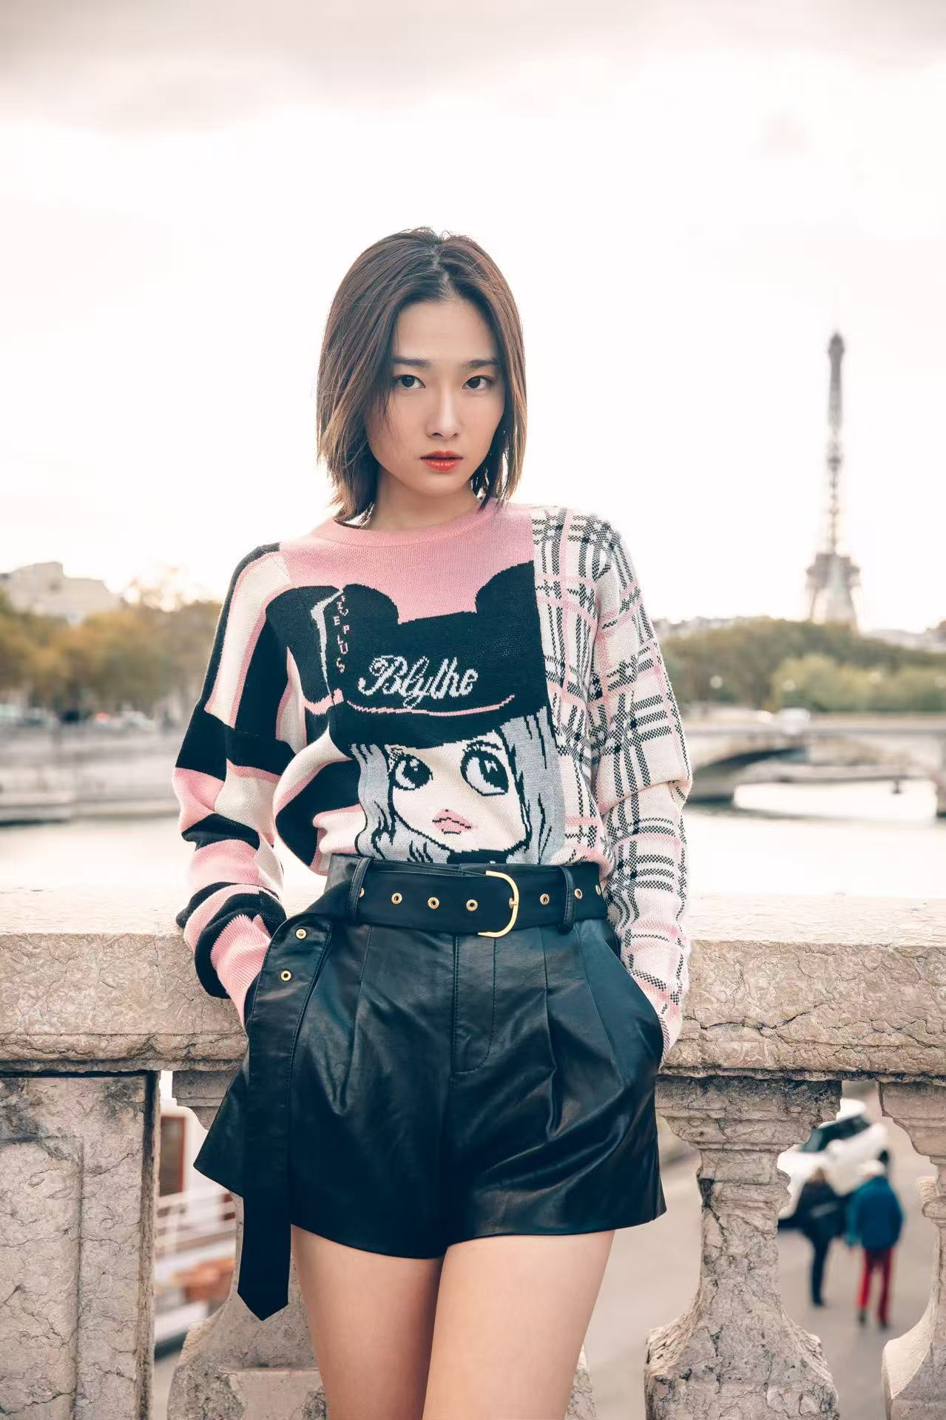
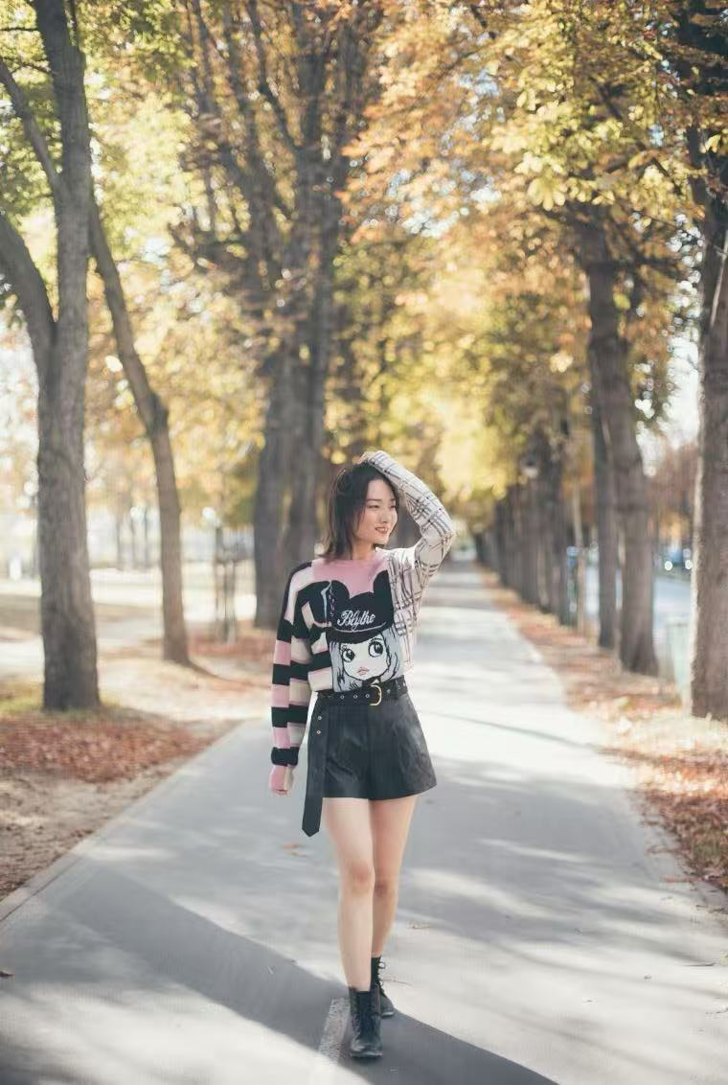
Magazine

Slide 15
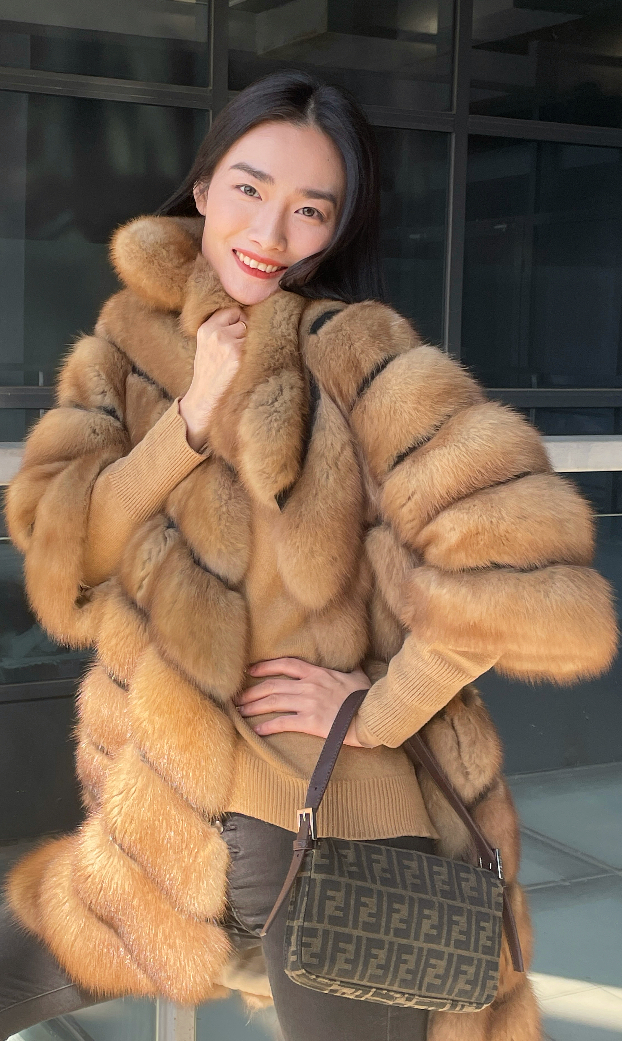
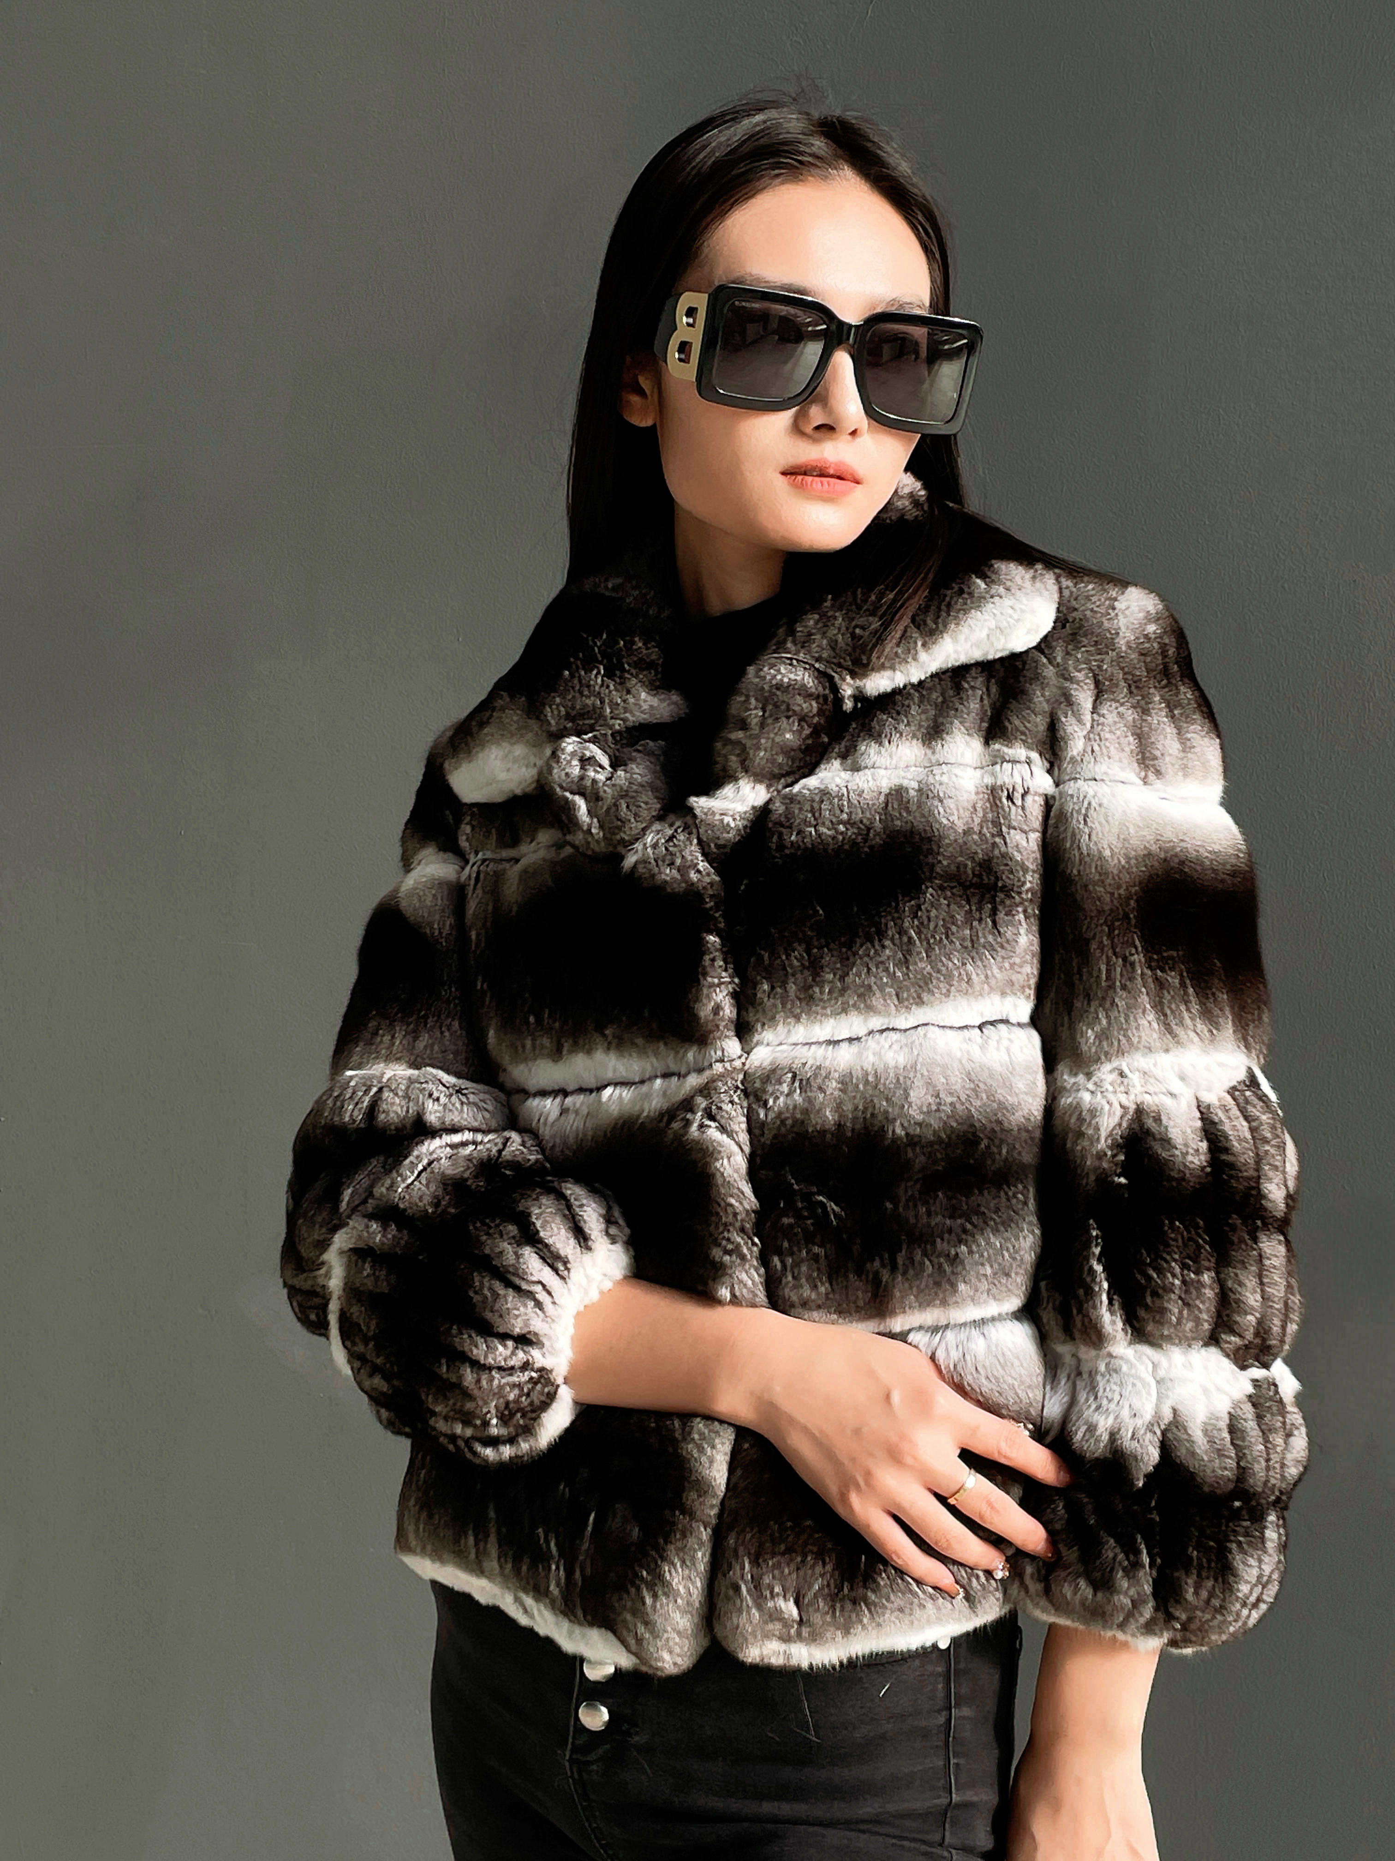
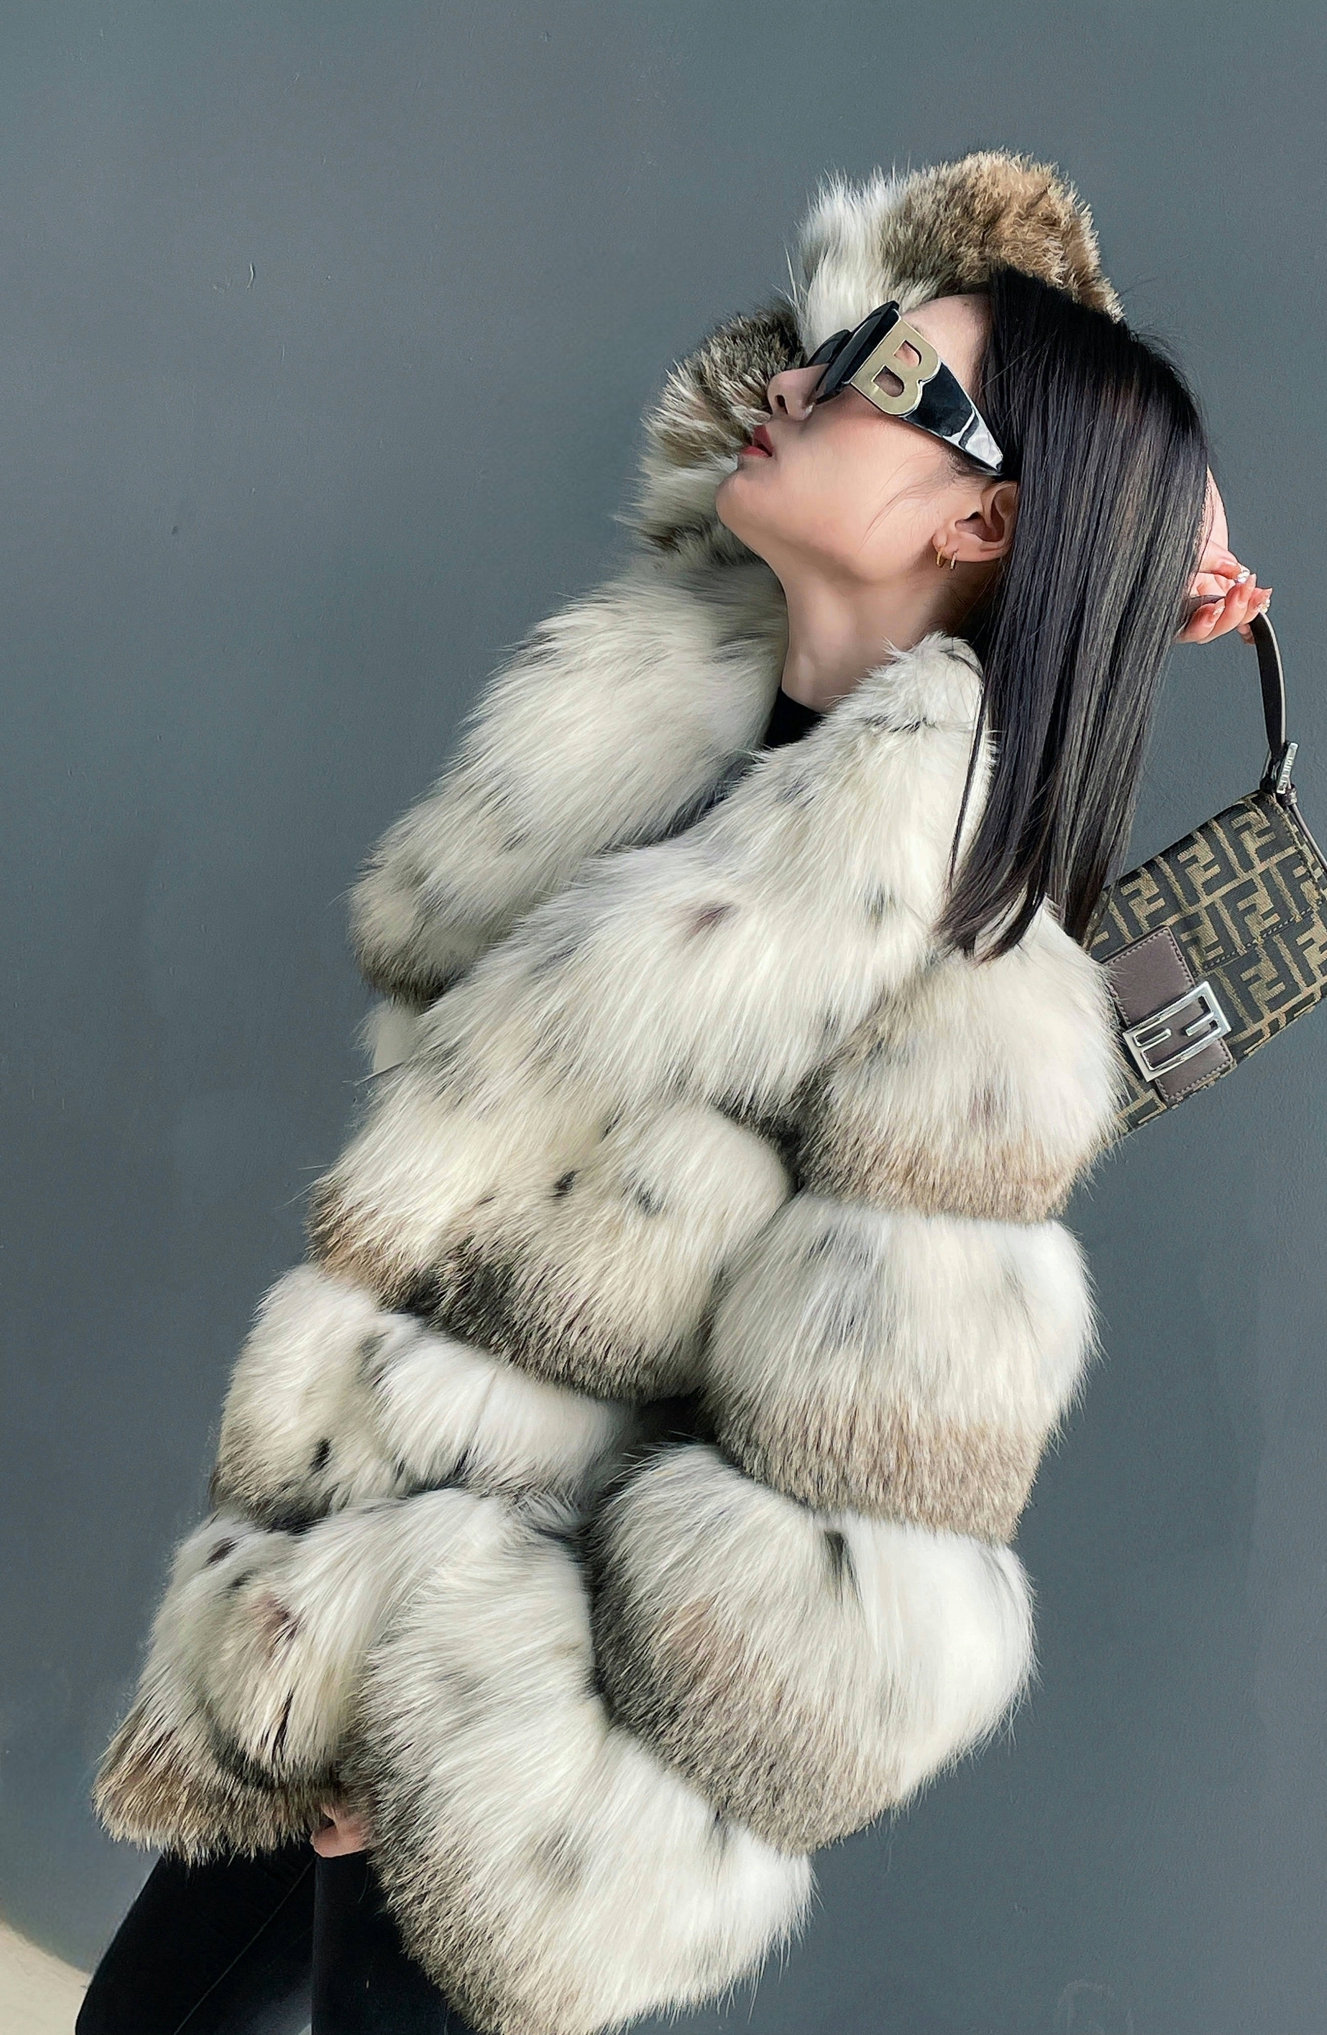
MissDUN-TaoBao

Slide 16

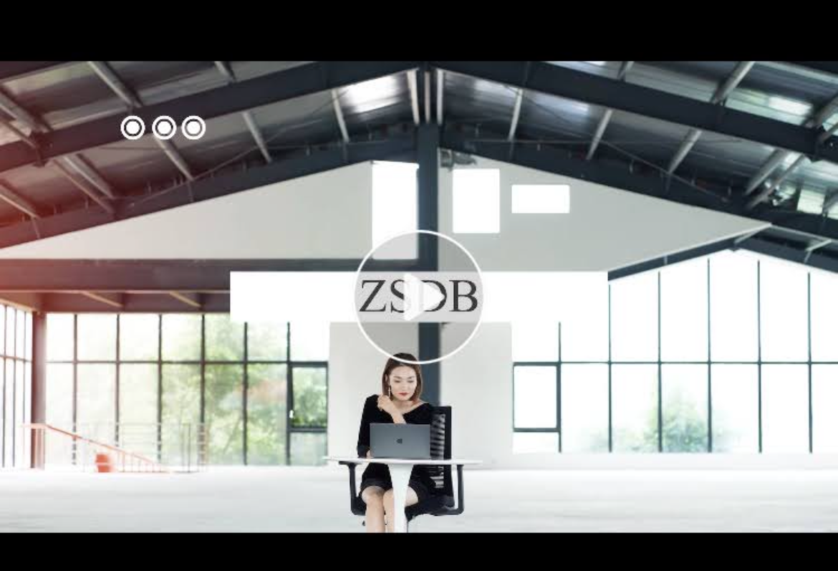
Sports brand TV commercials
Corporate promotional video

Slide 17
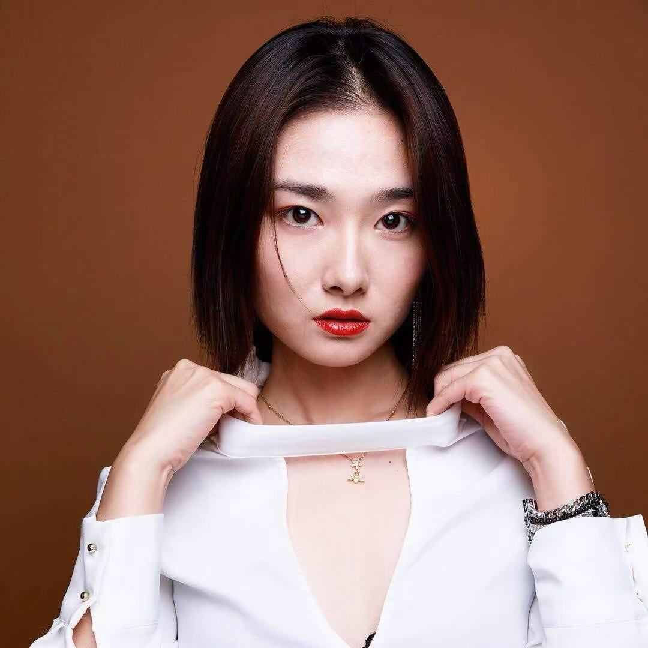
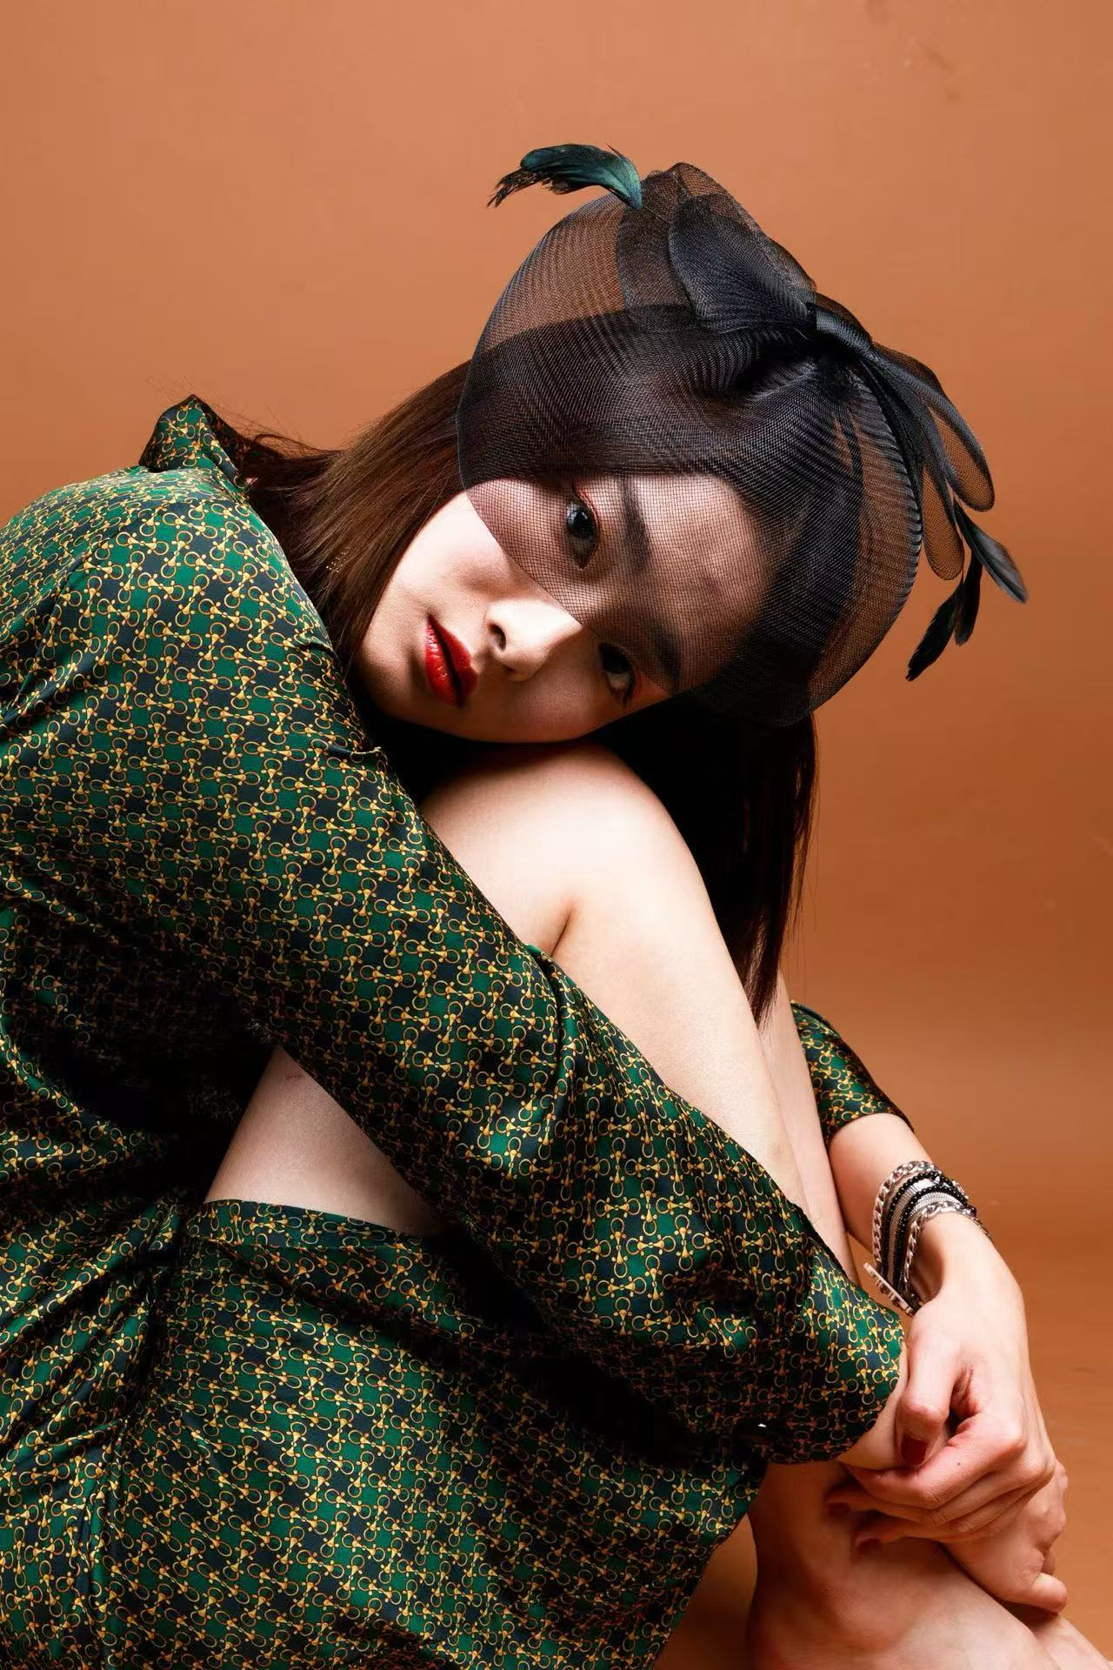

Slide 18
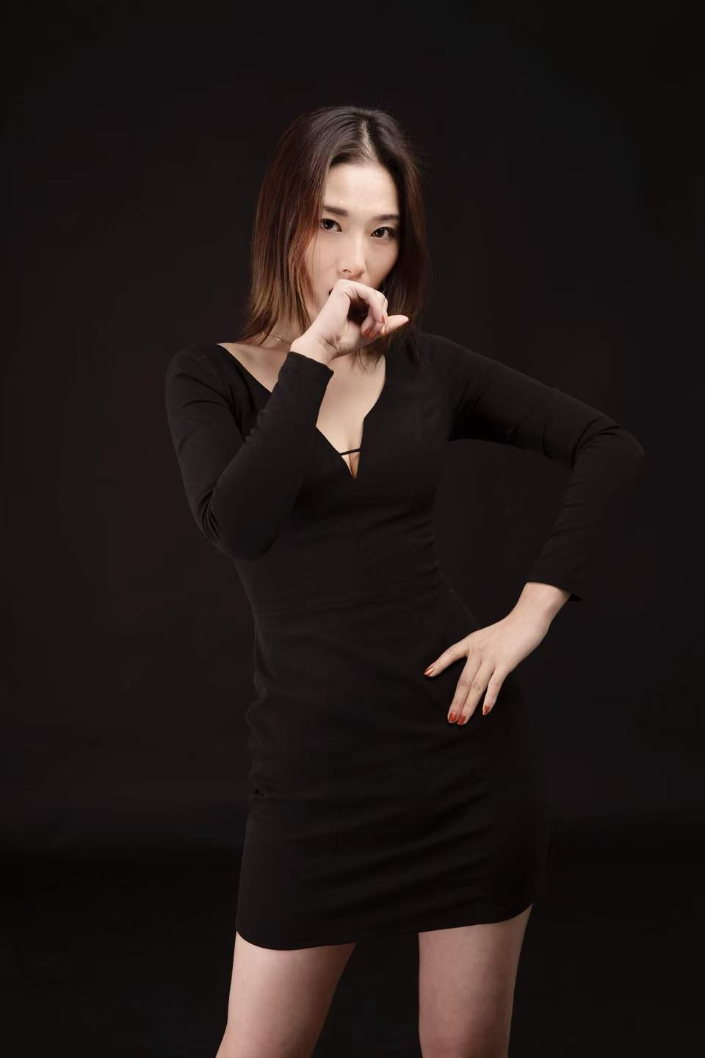
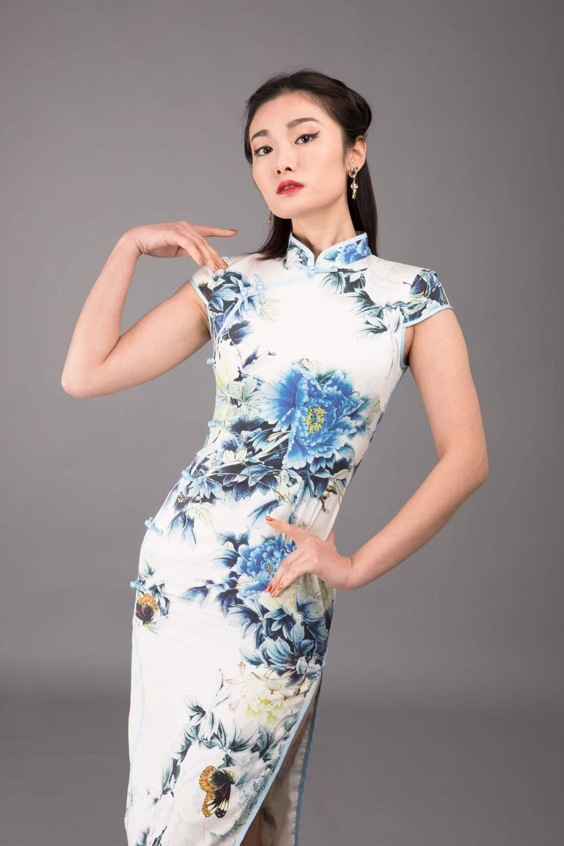

Slide 19
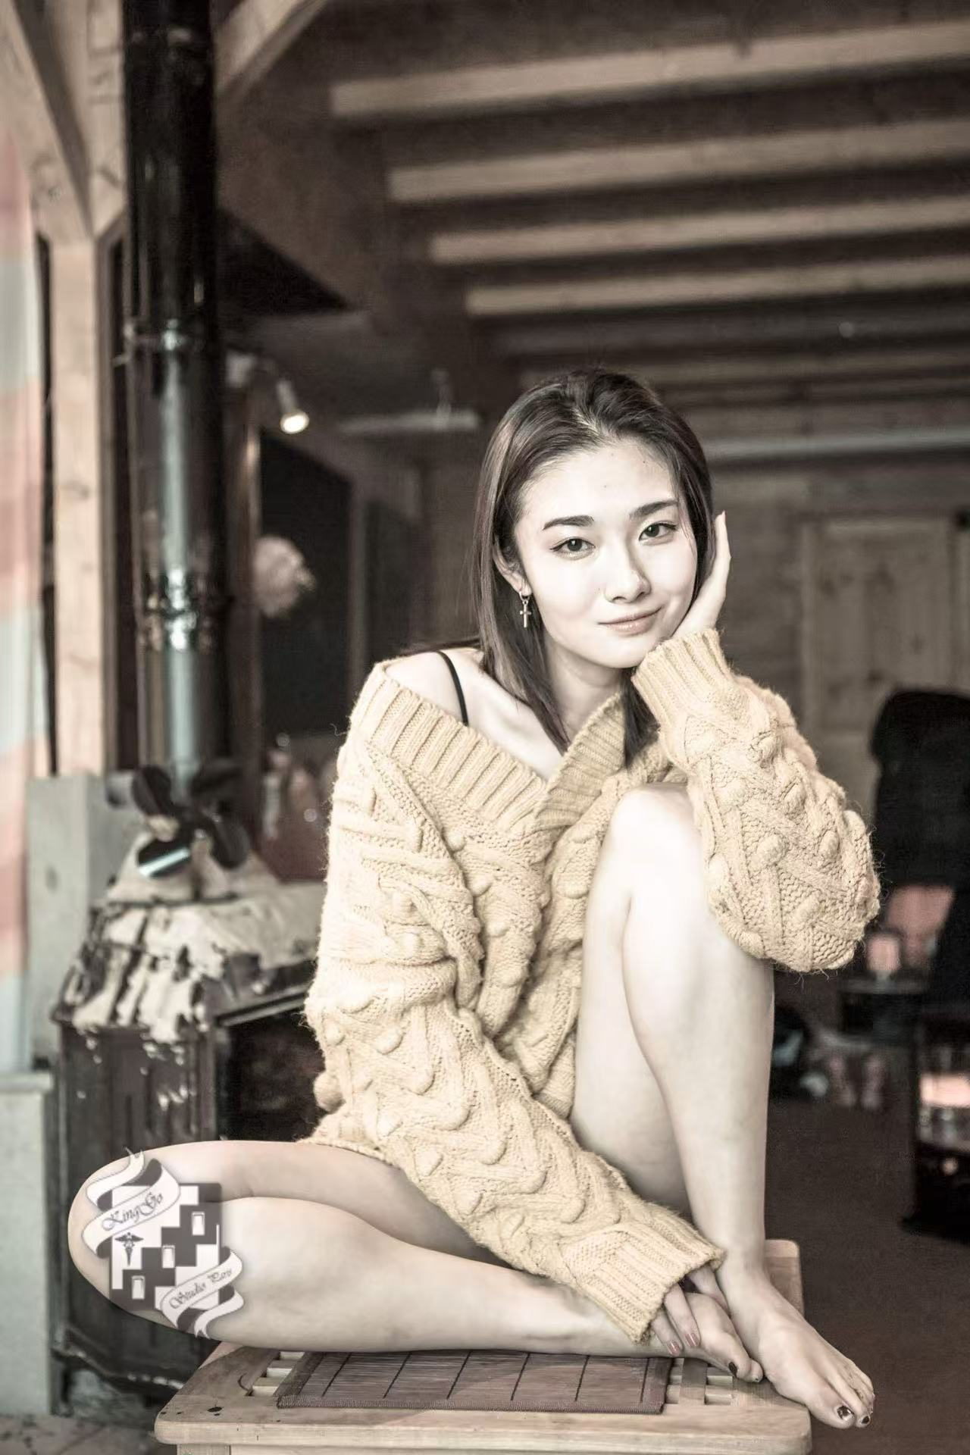
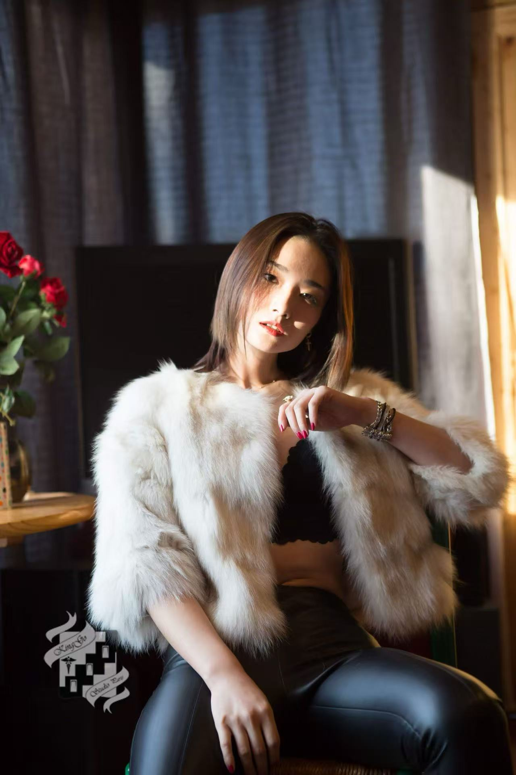

Slide 20
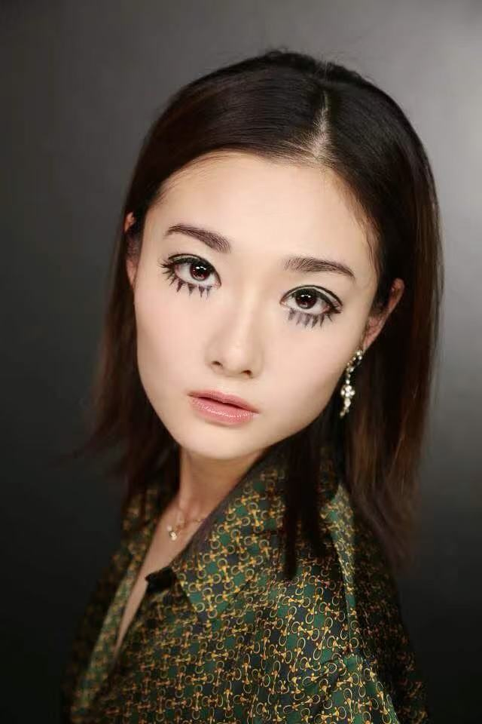
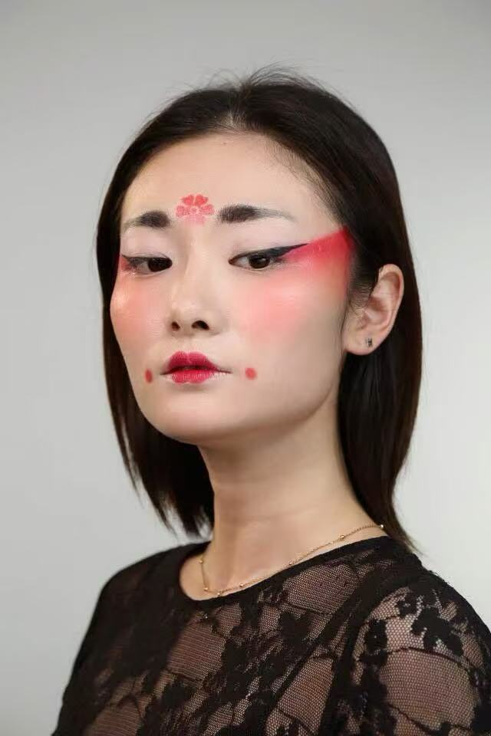

Slide 21
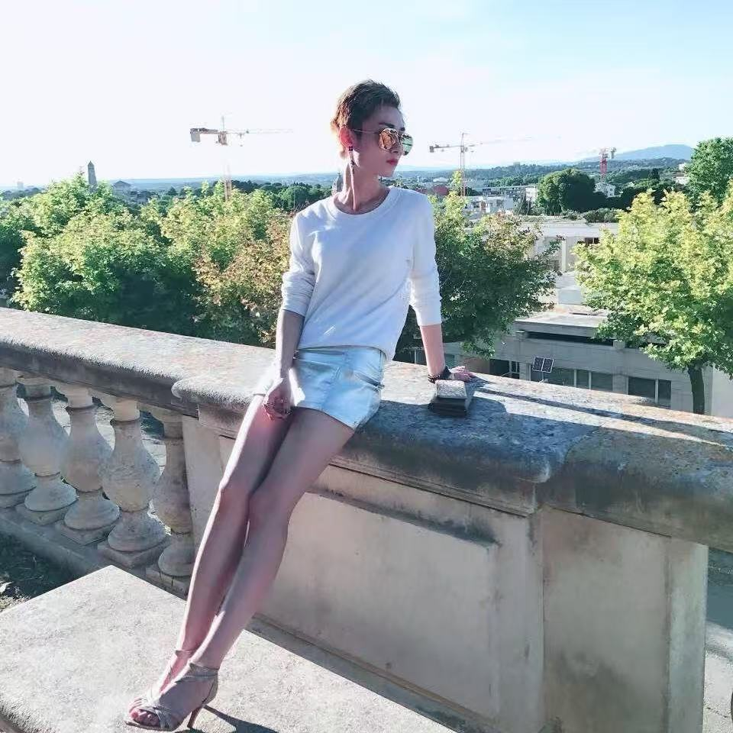
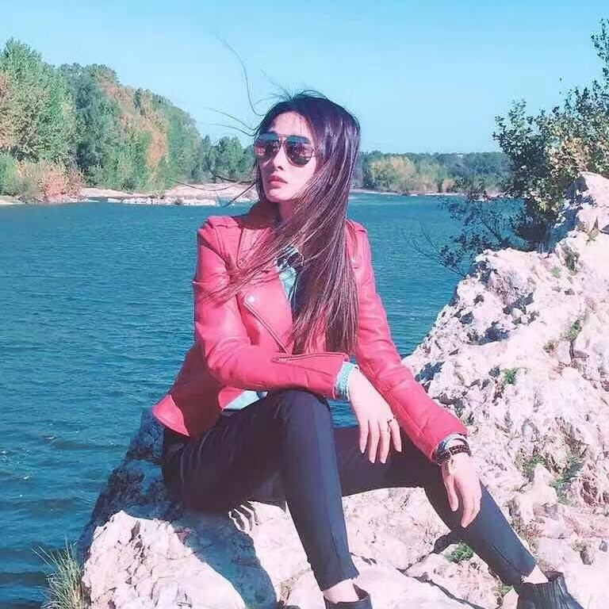

Slide 22
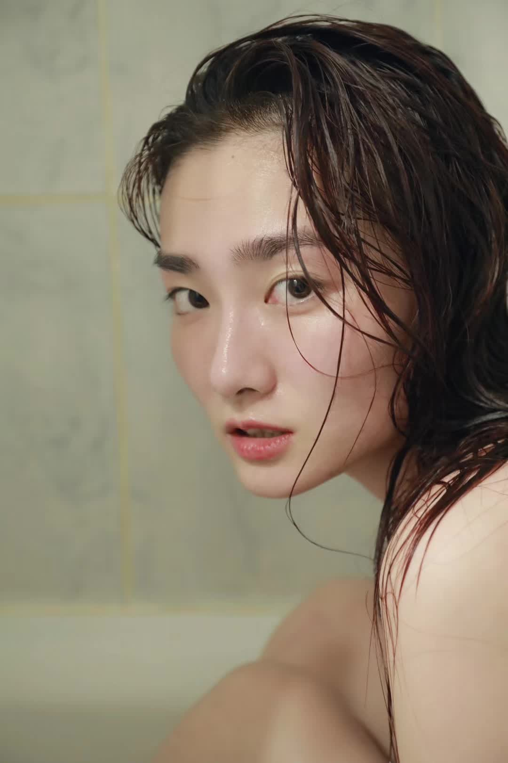
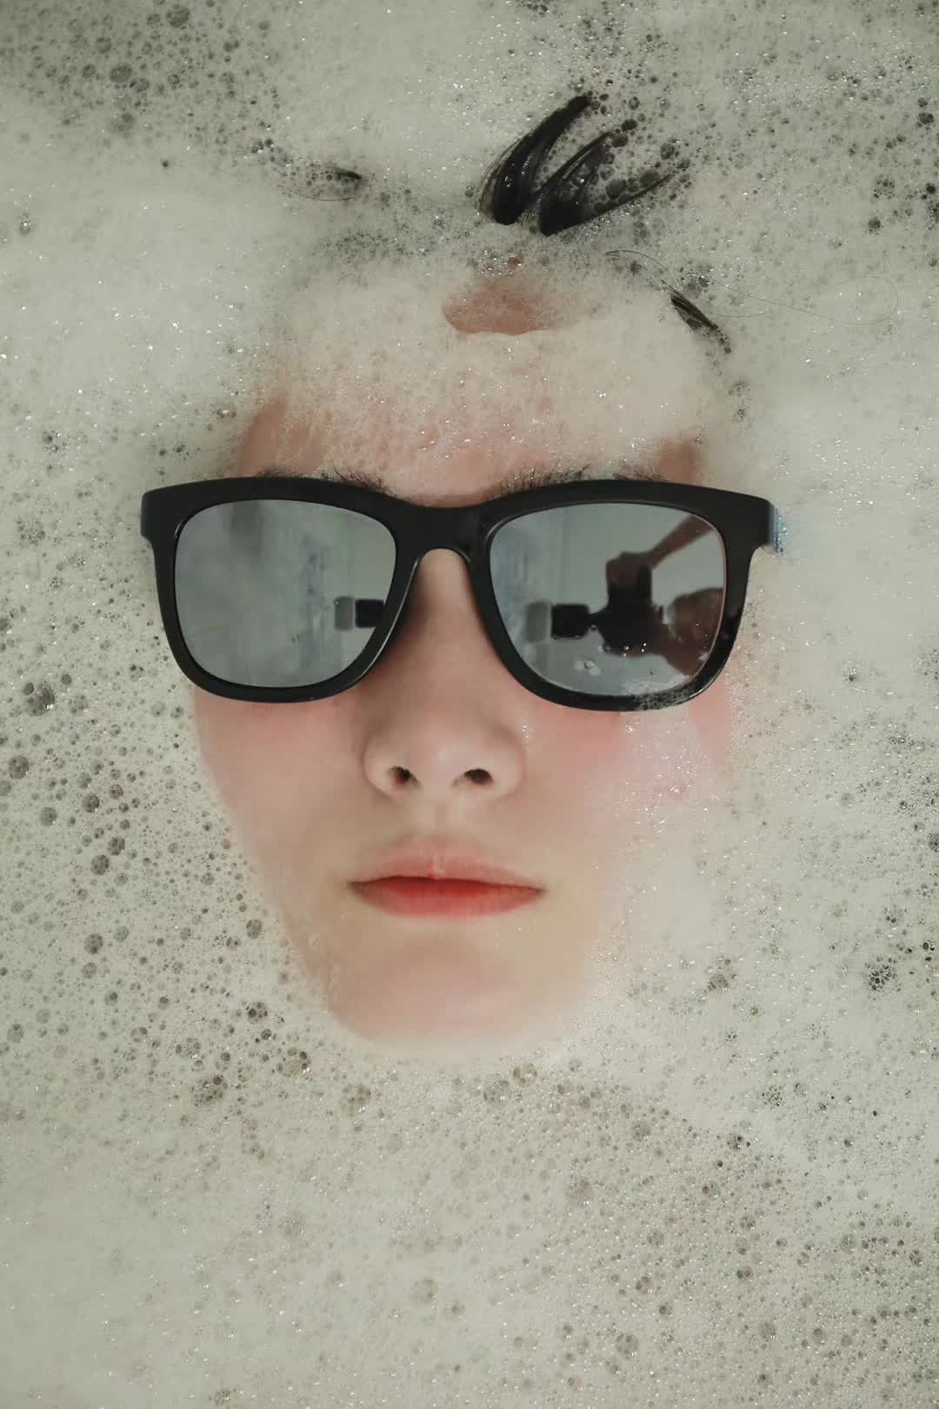

Slide 23
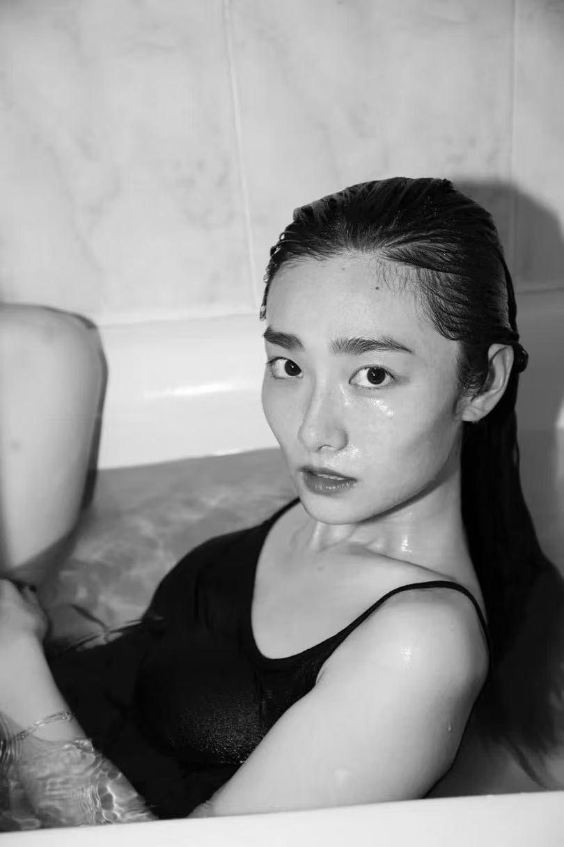

Slide 24
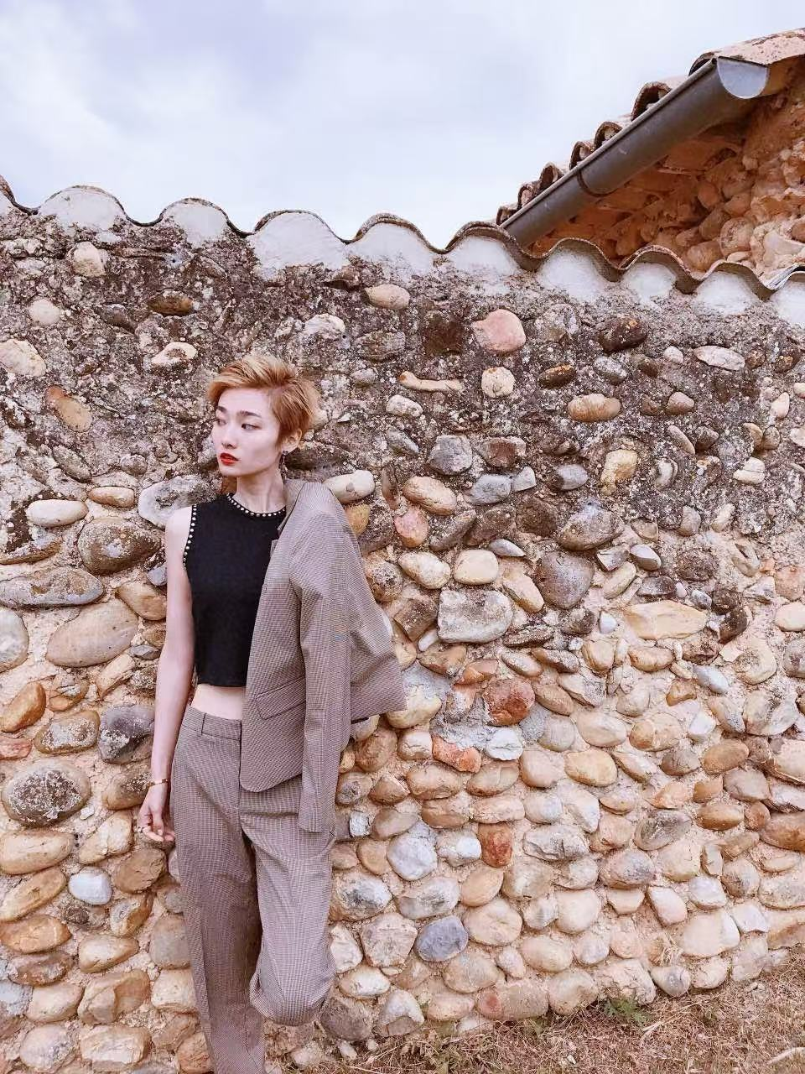
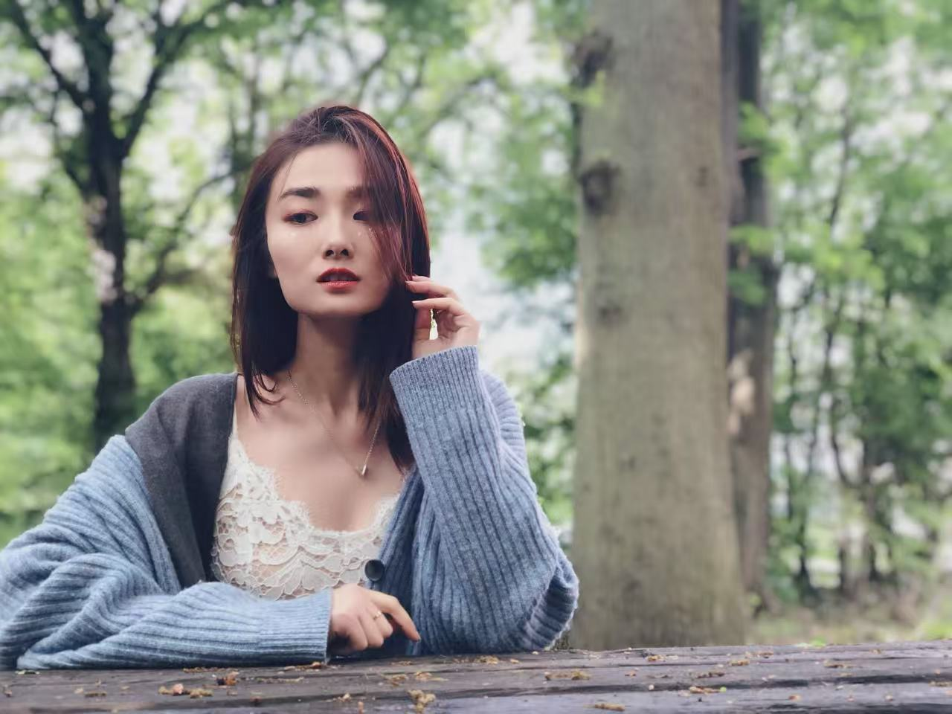

Slide 25
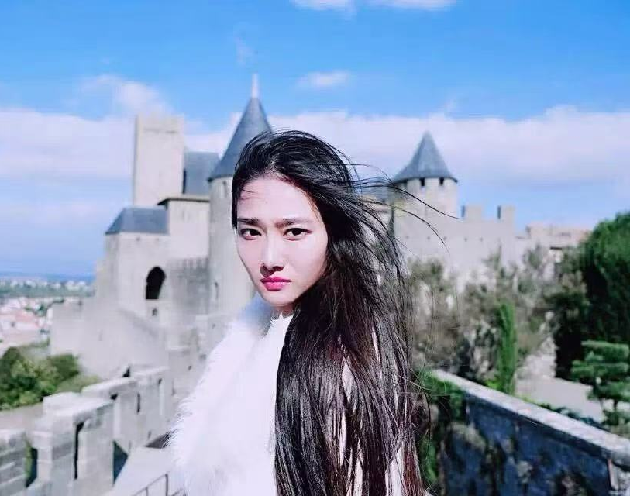
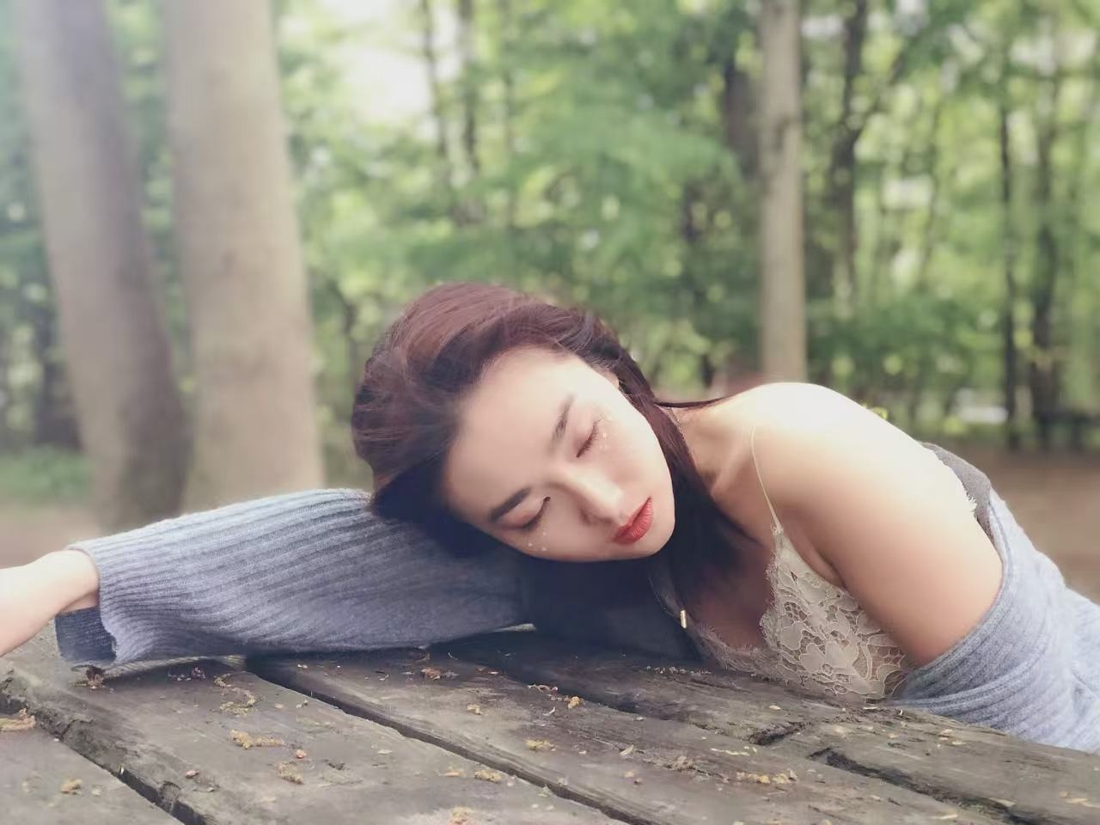

Slide 26
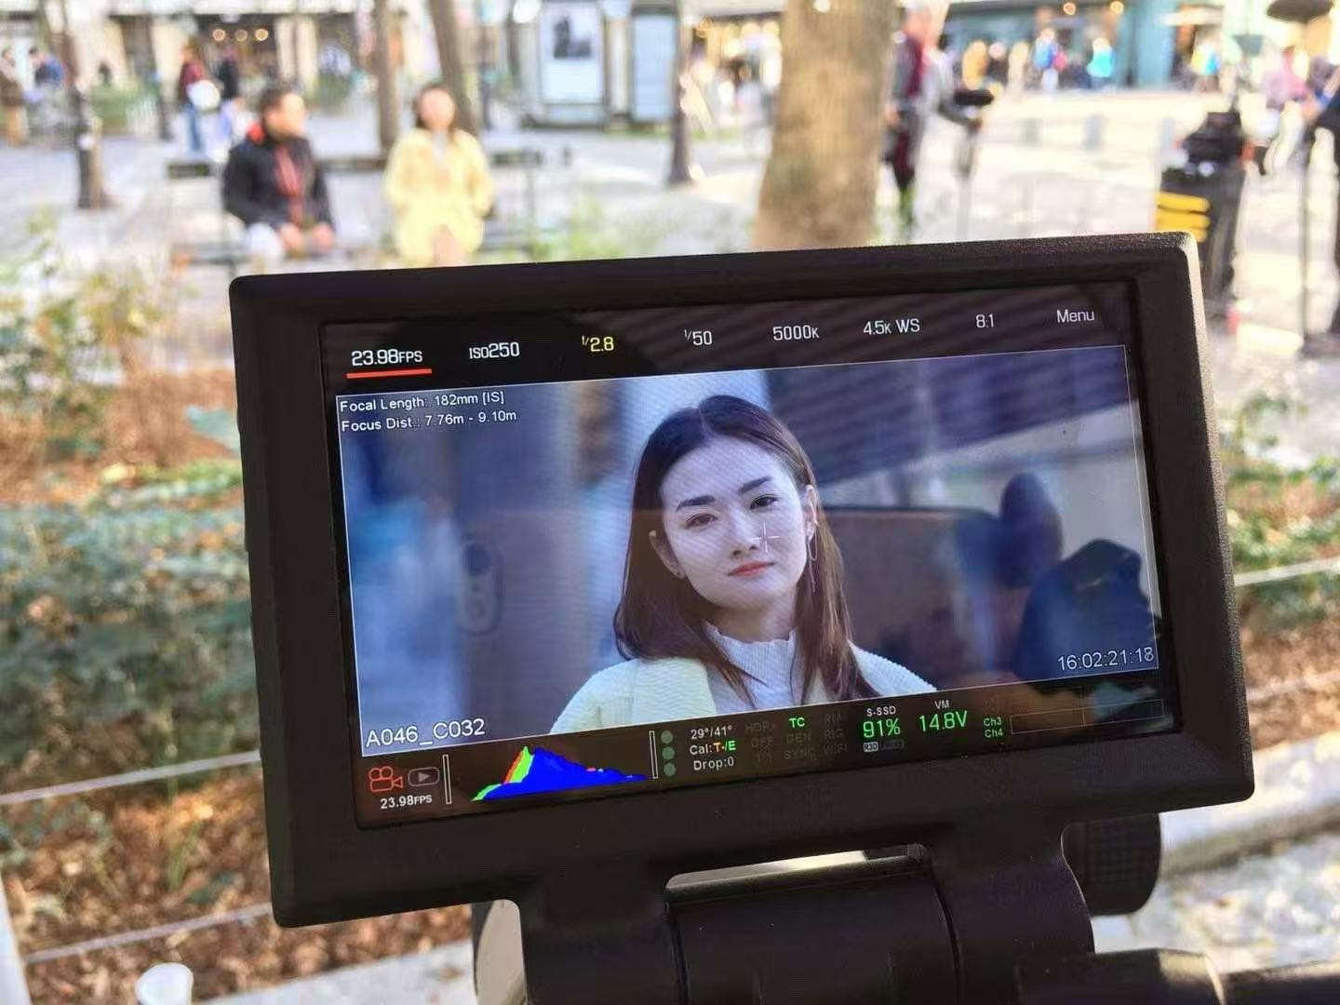
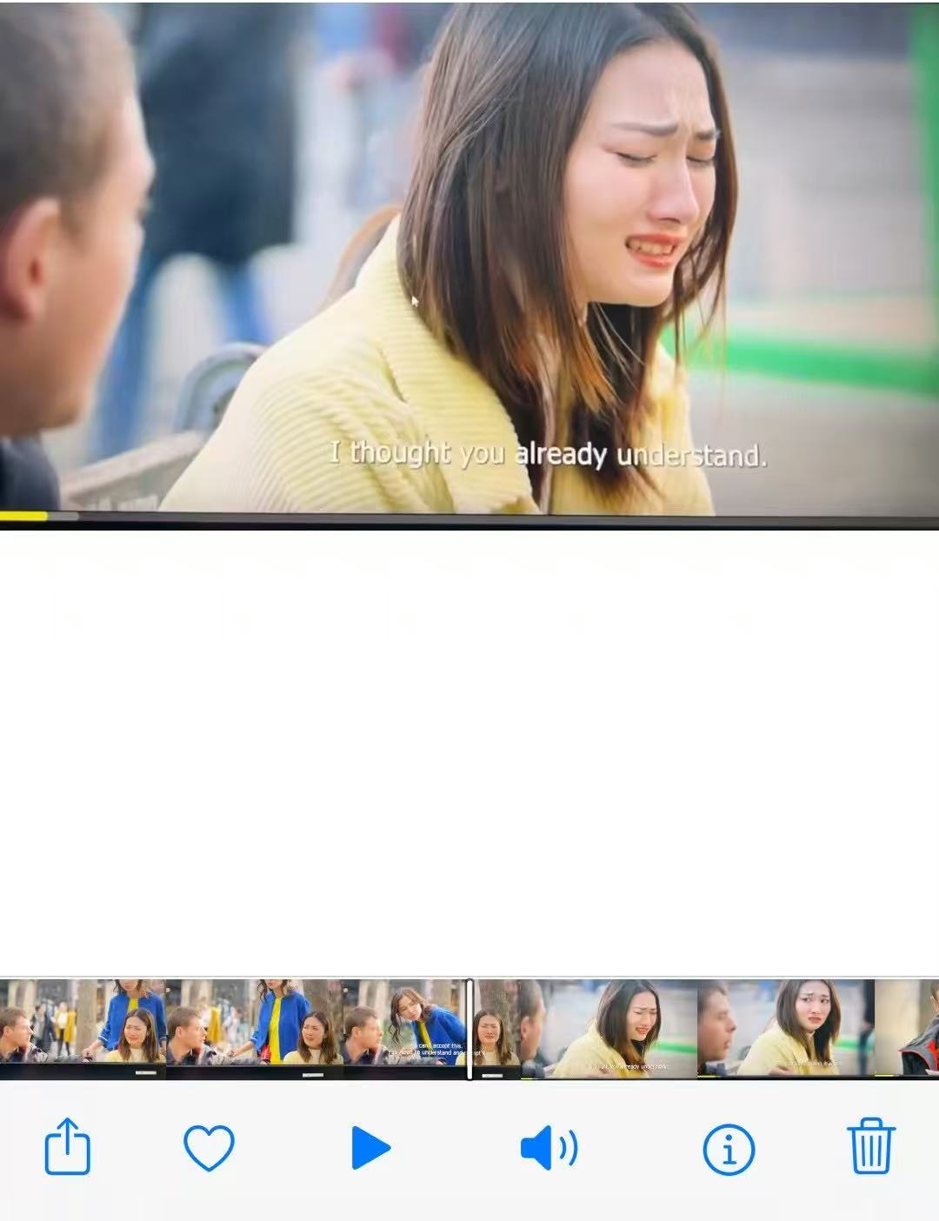
Actor
MOVIE-The Pink Thief -----Lily

Slide 27


MOVIE-The Movie Emperor
-----secretary

Slide 28



short film-Lu Zhou Lao Jiao

Slide 29



Host(Mandarin-French)
2017-2020 The Chinese Embassy in France and the French government jointly organized a number of activities, including a large-scale New Year's Eve party, International Competitions,etc.
2017-2020 Corporate business activities, such as opening ceremonies, anniversary celebrations, VIP customer events, product launches, etc.
2020-2023 Dance drama, drama, children's drama, business activities, etc.

