Slide 1
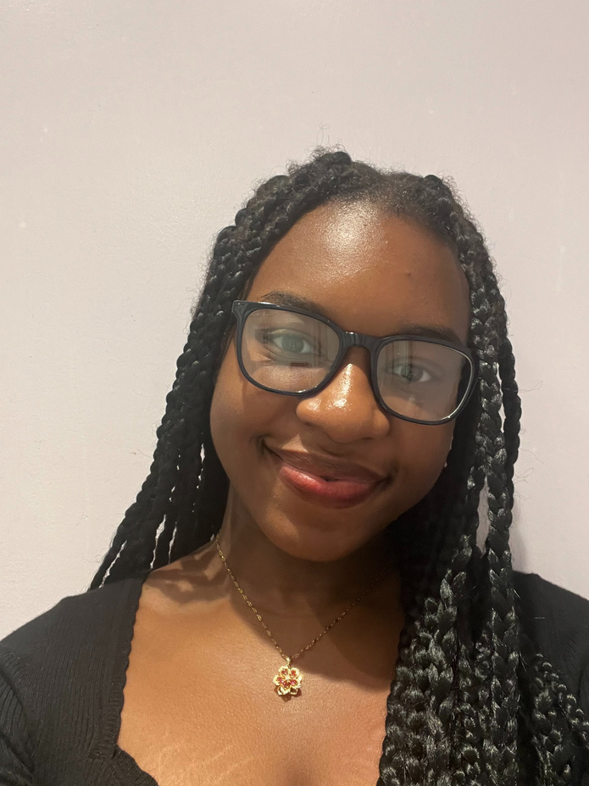
MAKAYLA
MORRISON
FILM ACTRESS, DANCER & SINGER
DESCRIPTION
Makayla “Kayla” Morrison is a 15-year-old dancer who began training at the age of three. Over the years, I have developed a strong foundation in multiple styles of dance and continue to refine my technique and performance skills. I have appeared in several stage productions, including Matilda and Newsies, where I gained valuable experience performing as part of a cast. Beyond the stage, I am passionate about expanding my artistry, whether through learning new choreography, exploring musicality, or challenging myself with riffs and song-based combinations. I am dedicated, hardworking, and eager to continue growing as both a performer and a student of the arts, with aspirations to pursue opportunities in theater and acting further.
PHYSICAL DETAILS
Height: 5'4"
Weight: 135 lbs.
Body Type: Average Build
Hair Color: Dark Brown
Hair Length: Short
Eye Color: Brown
*
CONTACT DETAILS
New York City, NY
makaylagmorrison@gmail.com
Mobile No.: 646-323-4269
TRAINING
Riverdale Country Day School
DANCE CLASSES OVER THE YEARS:
POINTE
HIP-HOP
JAZZ
MODERN
CHARACTER SHOES
BALLET
TAP
INTERESTS & SKILLS
- Stage plays
- Musicals
- Short films
- Feature films
- Commercials
- TV series
- Singing and dancing
- Ballet and contemporary
- Gymnastics
PERSONALITY
WITTY
KIND
ECENTRIC
BUBBLY
FUNNY

