Slide 1
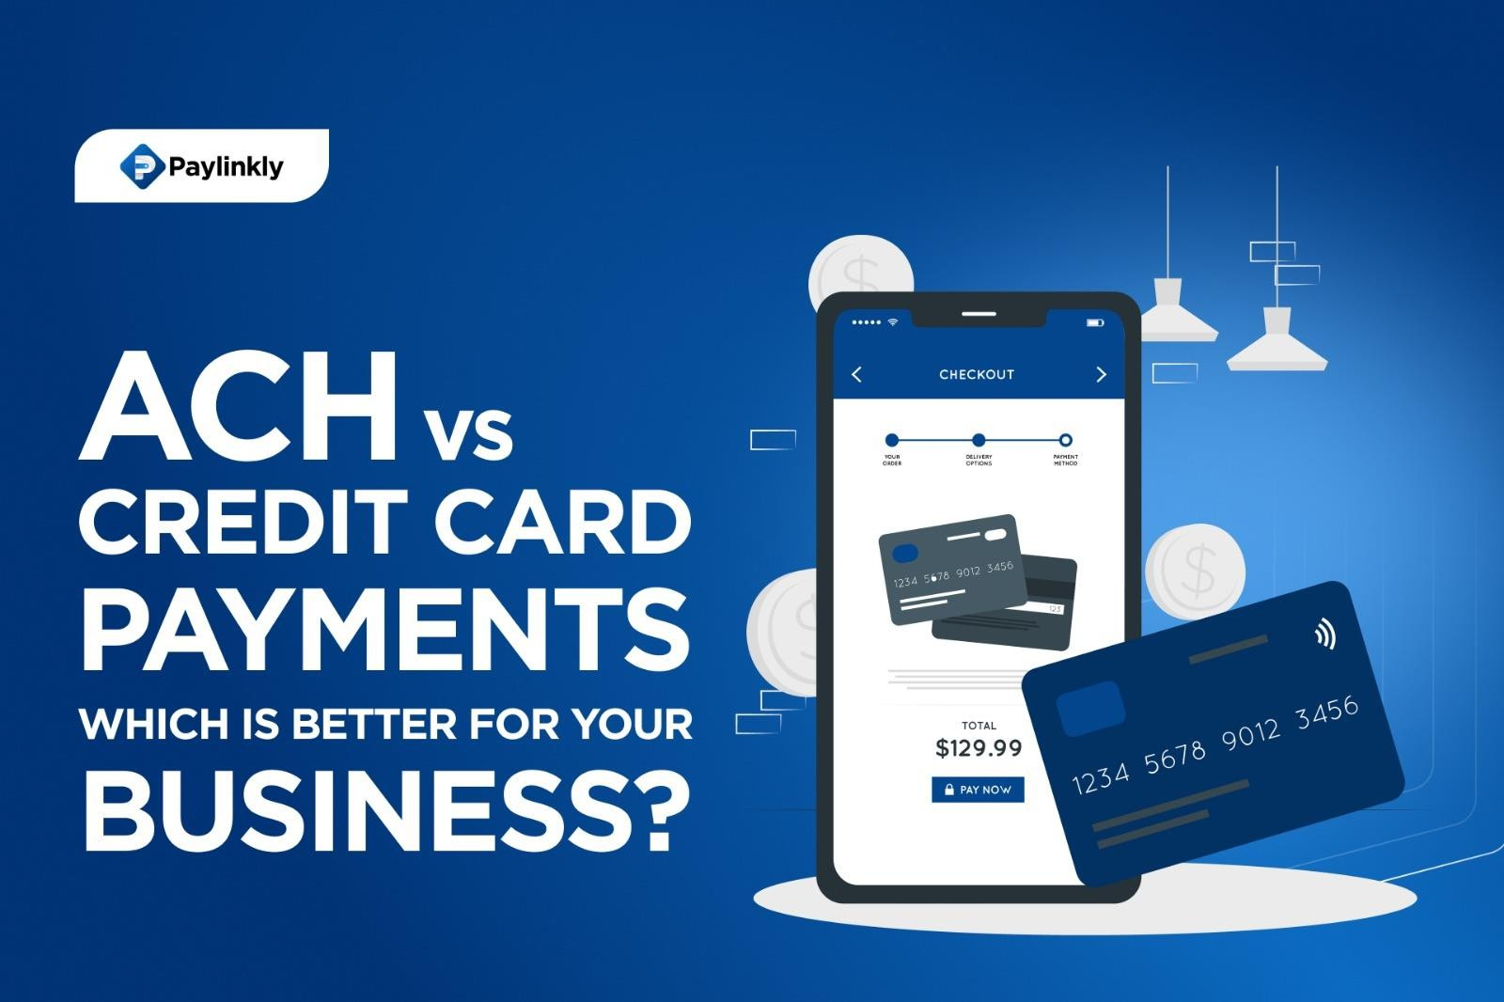
ACH vs. Credit Card Payments: Which Is Better for Your Business?
When it comes to managing payments for your business, you’re likely considering a variety of options. ACH payments for businesses and credit card payments are two of the most common methods for transferring funds, but which one is better for your specific needs? In this blog, we will explore the ACH vs credit card payments debate, comparing the cost-effective payment solutions for small businesses, the benefits of ACH payments for businesses, and other crucial factors. By the end, you’ll have a clear understanding of which payment method is better for business and how you can optimize your payment systems with solutions like. Paylinkly
Merchant services
Understanding ACH Payments for Businesses
ACH (Automated Clearing House) is an electronic network that allows businesses and individuals to process payments between banks. ACH payments can be used for a variety of transactions, such as direct deposits, bill payments, and other business transactions. Accept ACH payments and setup ACH payments for business are relatively simple procedures, often with lower fees compared to traditional credit card processing or electronic check payment processing. Many businesses also use ACH to accept eCheck payments online, offering customers more flexibility.

Slide 2
Benefits of ACH Payments for Businesses
Lower Transaction Fees: One of the most significant ACH payment pros and cons is the cost. ACH payments generally have much lower processing fees than credit card payments. Credit card processing fees vs ACH can vary, but credit cards often have fees ranging from 1.5% to 3.5% per transaction. In contrast, ACH payments tend to have fixed fees, typically lower than those charged by card networks.
Fewer Chargebacks: ACH payments for businesses are less likely to be reversed
compared to credit card payments. Chargebacks can be a major issue with credit cards, where customers can dispute a transaction and reverse it. To protect against this, many companies use a chargeback management service or chargebacks representment solutions.
Recurring Payment Efficiency: ACH vs credit card for recurring payments shows that ACH payments are a better option for businesses that offer subscription-based services or recurring billing.
Cost-Effective for Small Businesses: Affordable payment processing for businesses can be found in ACH, making it more attractive than some retail credit card processing services.
ACH Payment Pros and Cons Pros:
Lower processing fees
Better for recurring payments
Reduced risk of chargebacks
Secure and reliable transactions
Cons:
Longer processing times (1–3 business days)
Not widely accepted by all merchants or consumers
Limited international use compared to credit cards

Slide 3
Credit Card Payments for Businesses
Credit card payments are widely recognized and accepted by consumers globally. They provide fast transactions, allowing businesses to receive payments immediately. However, credit card processing comes with higher costs. Companies often research the best online credit card processing solutions, best credit card payment processing for small business, and even mobile credit card processing to find the right fit. Some also look into no fee credit card processing or Zero Cost Credit Card Processing models to reduce overhead.
Credit Card Processing Comparison
Faster Payment Processing: Unlike ACH, credit card payments are typically processed much faster.
Higher Fees: One of the primary downsides of credit card processing is the fees. For this reason, many business owners perform a payment processing analysis to identify cost- saving opportunities.
More Fraud Protection: Credit card payments offer robust fraud protection services.
Credit Card Payment Pros and Cons Pros:
Fast payment processing
Highly recognized and accepted
Robust fraud protection
Ideal for both in-person and online sales
Cons:
High transaction fees
Potential for chargebacks
Not always cost-effective for recurring payments
May have monthly or annual fees

Slide 4
Differences Between ACH and Credit Card Payments
Processing Speed: Credit card payments are generally processed in real-time, while ACH payments can take 1–3 business days.
Fees: Credit card payments come with higher processing fees compared to ACH payments, which are usually more cost-effective.
Security: Both ACH and credit card payments are secure, but credit cards offer more immediate fraud protection.
Acceptance: Credit cards are more widely accepted across the globe, whereas ACH may not be accepted by all merchants or across international borders.
Recurring Billing: For recurring payments, ACH is typically the more reliable and cost- effective option.
How to Accept ACH Payments
Choose an ACH Payment Processor (some work alongside retail credit card processing services).
Integrate with your accounting software.
Enable ACH Payment Options for Customers.
Verify Bank Details.
Monitor Payment Activity.
Forward-thinking businesses also diversify their payment mix by offering modern alternatives such as Accept Bitcoin and Crypto Payments.
Cost-Effective Payment Solutions for Small Businesses
For small businesses, the cost-effective payment solutions lie in ACH payments. With lower transaction fees than credit cards, ACH helps reduce overhead. At the same time, leveraging best credit card payment processing for small business providers can ensure customer convenience. Combining these with strategies like Zero Cost Credit Card Processing creates a strong, affordable system.

Slide 5
Average Credit Card Processing Rates
The average credit card processing rates can vary depending on your provider, but most businesses pay an average of 2.5% per transaction, plus fixed fees. By comparison, ACH may cost as little as $0.25 per payment. Businesses that perform a payment processing analysis can uncover whether switching to ACH or combining it with other options is the most effective
strategy.
Conclusion: Which Payment Method Is Better for Your Business?
In conclusion, ACH vs credit card payments depends on the nature of your business. If you prioritize fast payments and global acceptance, credit cards are best. If you prioritize reducing fees and reliability for recurring billing, ACH is the smarter option. Businesses can also benefit from offering flexibility, such as ACH, eChecks, cards, or even crypto payments, while protecting revenue with a chargeback management service

