Slide 1
A FUTURE FOR A TALENT (PROJECT)

Slide 2
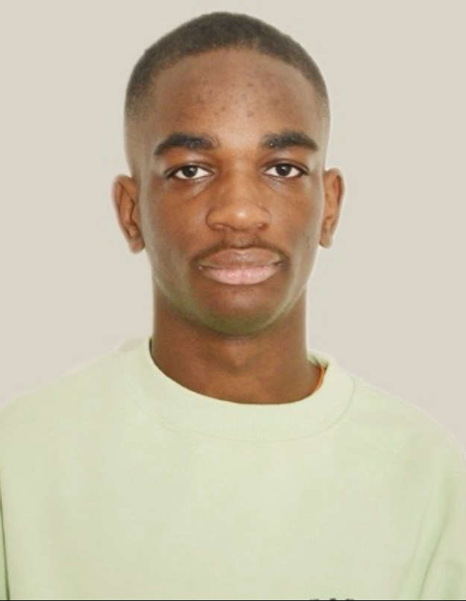
Introduction (Me):
My name is Yohanes OKANDZE. I was born on March 26, 2006, in Brazzaville, Congo, and moved to France at the age of 11. I’m currently in my first year of a Bachelor’s degree in Data at HETIC.
Driven by ambition and vision, I’ve always dreamed of creating my own international agency and becoming a CEO in the entertainment industry.
I am passionate about writing screenplays for films, series, and documentaries, and I’m committed to sharing bold, powerful stories that reflect untold voices and global perspectives.
Through my agency, I aim to discover and empower talents from around the world—especially those from underrepresented communities—and connect them to the world stage.

Slide 3
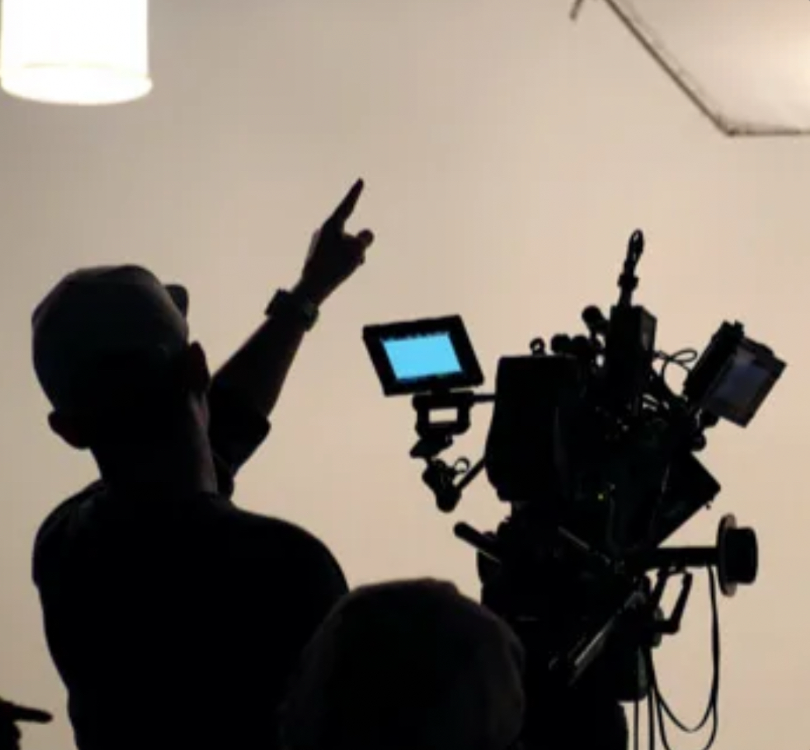
My Vision:
I want to create an international agency for music, film, television, and modeling. The goal is to discover new talents from every corner of the world and offer them opportunities they might not have due to a lack of resources, exposure, or contacts. I want to focus on young talents in Africa, Europe, and everywhere else, training them and changing their lives by giving them a platform to shine.

Slide 4
Mission of My Agency:
The mission of my agency is to develop talents, connect them with their respective fields, and support them both mentally and physically. I will connect them with the top professionals in their industry. For example, someone who wants to become an actor or singer will be introduced to big names in the industry, both from Africa and the USA, so they can be guided and mentored.
I will travel to various places around the world, like Nigeria, to film shows based on talent discovery. I will collaborate with prominent actors, artists, business people, models, designers, etc., and invite young talents to meet with these professionals. They will have the chance to discuss their projects and ambitions with the mentors they look up to.
I aim to bridge the gap between Hollywood, Africa, and other continents. My goal is to create a strong, supportive, and inspiring community that helps these talents rise.

Slide 5
Steps to Achieve My Project:
I am currently studying at HETIC in France, pursuing a Bachelor’s degree in Data Science, to strengthen my academic and technical skills.
I am intensively learning English to communicate easily on the international stage.
I will actively apply for internships in major production companies and talent agencies like Netflix, Hulu, Disney, Warner Bros, WME Agency, and more.
During my internships, I aim to present my creative ideas, my scenarios, and my overall vision to industry professionals.
I will build strong relationships with production teams and executives to open doors for collaboration and future partnerships.
I plan to send my projects and ideas directly to producers and agencies, both in Hollywood and Africa, to create opportunities even before completing my studies.
My goal is to showcase my unique vision and energy to the entertainment world and become a recognized entrepreneur and CEO.

Slide 6
Some Scenario Ideas:1
A Future for a Talent (TV Show)
“A Future for a Talent” is an international TV show where I travel across different countries to discover emerging talents in cinema, music, fashion, and design. We will organize open auditions where young talents meet iconic artists from their own country, who will mentor and advise them. Participants will share their dreams and present their projects. Selections will be based on passion and readiness to succeed, not only on skills. Winners will sign with my agency and receive full support to achieve their dreams. Those not selected will leave with significant financial support to help launch their projects. This show aims to spotlight hidden talents and build global cultural bridges.

Slide 7
Some Scenario Ideas: 2
Inside Success (Documentary Series)
“Inside Success” is a documentary series offering an exclusive look behind the scenes of Hollywood and Nollywood celebrities. The series will explore how they manage stress, prepare for their careers, run their businesses, and balance personal challenges with professional life. Through their stories, viewers will understand the real journey behind fame and success.

Slide 8
Some Scenario Ideas:3
Hidden Faces (Movie)
“Hidden Faces” is a drama film following the powerful Messy family, led by a brother and sister who have built a massive business empire. Behind their success, they hide dark secrets: betrayals, murders, hidden truths, and shattered loyalties. The story explores how ambition, lies, and greed can destroy even the strongest family bonds.

Slide 9
My Final Goals:
Sign, collaborate, and sell my scripts to major entertainment companies (Netflix, Hulu, Warner Bros, WME Agency, etc.).
Build a globally recognized agency, focused on discovering, developing, and managing talents from all backgrounds.
Become a role model for the new generation, inspiring young people to believe in their dreams, no matter their origins or financial means.
Leave my mark in the entertainment industry by creating a true bridge between talents from Africa, Europe, America, and all over the world.

Slide 10
Contact me:
Mail: yohanesbusinesspro@gmail.com
More original ideas are ready to be developed, written, and produced to inspire audiences worldwide. I can write any type of script on request.

