Slide 1
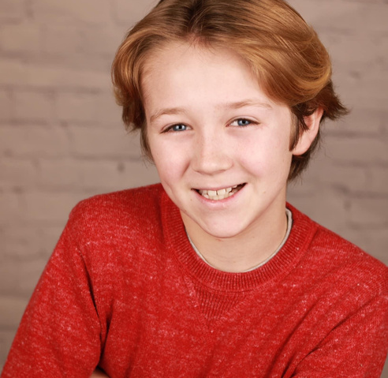
WILLIAM HELMS
STUDENT ACTOR
704-288-7888
helms.william41@gmail.com
catie.helms22@gmail.com
4309 Lancaster Hwy. Monroe, NC. 28112
BACKGROUND EXPERIENCES
Matthew’s Playhouse - Community Theater - Sarah Baumgardner Director
RAH - Community Theater - Nicole DiPietro - Director
Parkwood High School and Cuthbertson High School - Brandi Ford Director
New Town Elementary - Stacey Hea, Danell Kearns and Mandy McAllister Directors
ACADEMIC BACKGROUND
NEW TOWN ELEMENTARY
2022-2024
CUTHBERTSON MIDDLE SCHOOL
2021-2023
PARKWOOD MIDDLE SCHOOL
2023-2024
PARKWOOD HIGH SCHOOL
2024-Present
STAGE PERFORMANCES
NEW TOWN ELEMENTARY
RAH THEATER
THEATER PERFORMANCES
Mr. Mayor and Wickersham
Ensemble
ALADDIN JR.
SUESSICAL
PARKWOOD MIDDLE SCHOOL
ELF
Santas Helper
MATILDA JR.
Escapologist and Rudolfo
LITTLE SHOP OF HORRORS
Ensemble
PARKWOOD HIGH SCHOOL
CUTHBERTSON HIGH SCHOOL
FREAKY FRIDAY
Fletcher
FRANKENSTEIN’S CREATURE
William Frankenstein
MEDEA
Greek Chorus
BIG FISH
Little Will
CLUE
Professor Plum
You’re a Good Man Charlie Brown
Snoopy and Woodstock
MATTHEW’S PLAYHOUSE
REFERENCES
SUESSICAL
Wickersham Brother
BRANDI FORD
CORE SKILLS
Theater Teacher and Director
Parkwood High School
brandi.ford@ucps.k12.nc.us
Beginner to intermediate dance
Physical comedy roles
Projection

