Slide 1
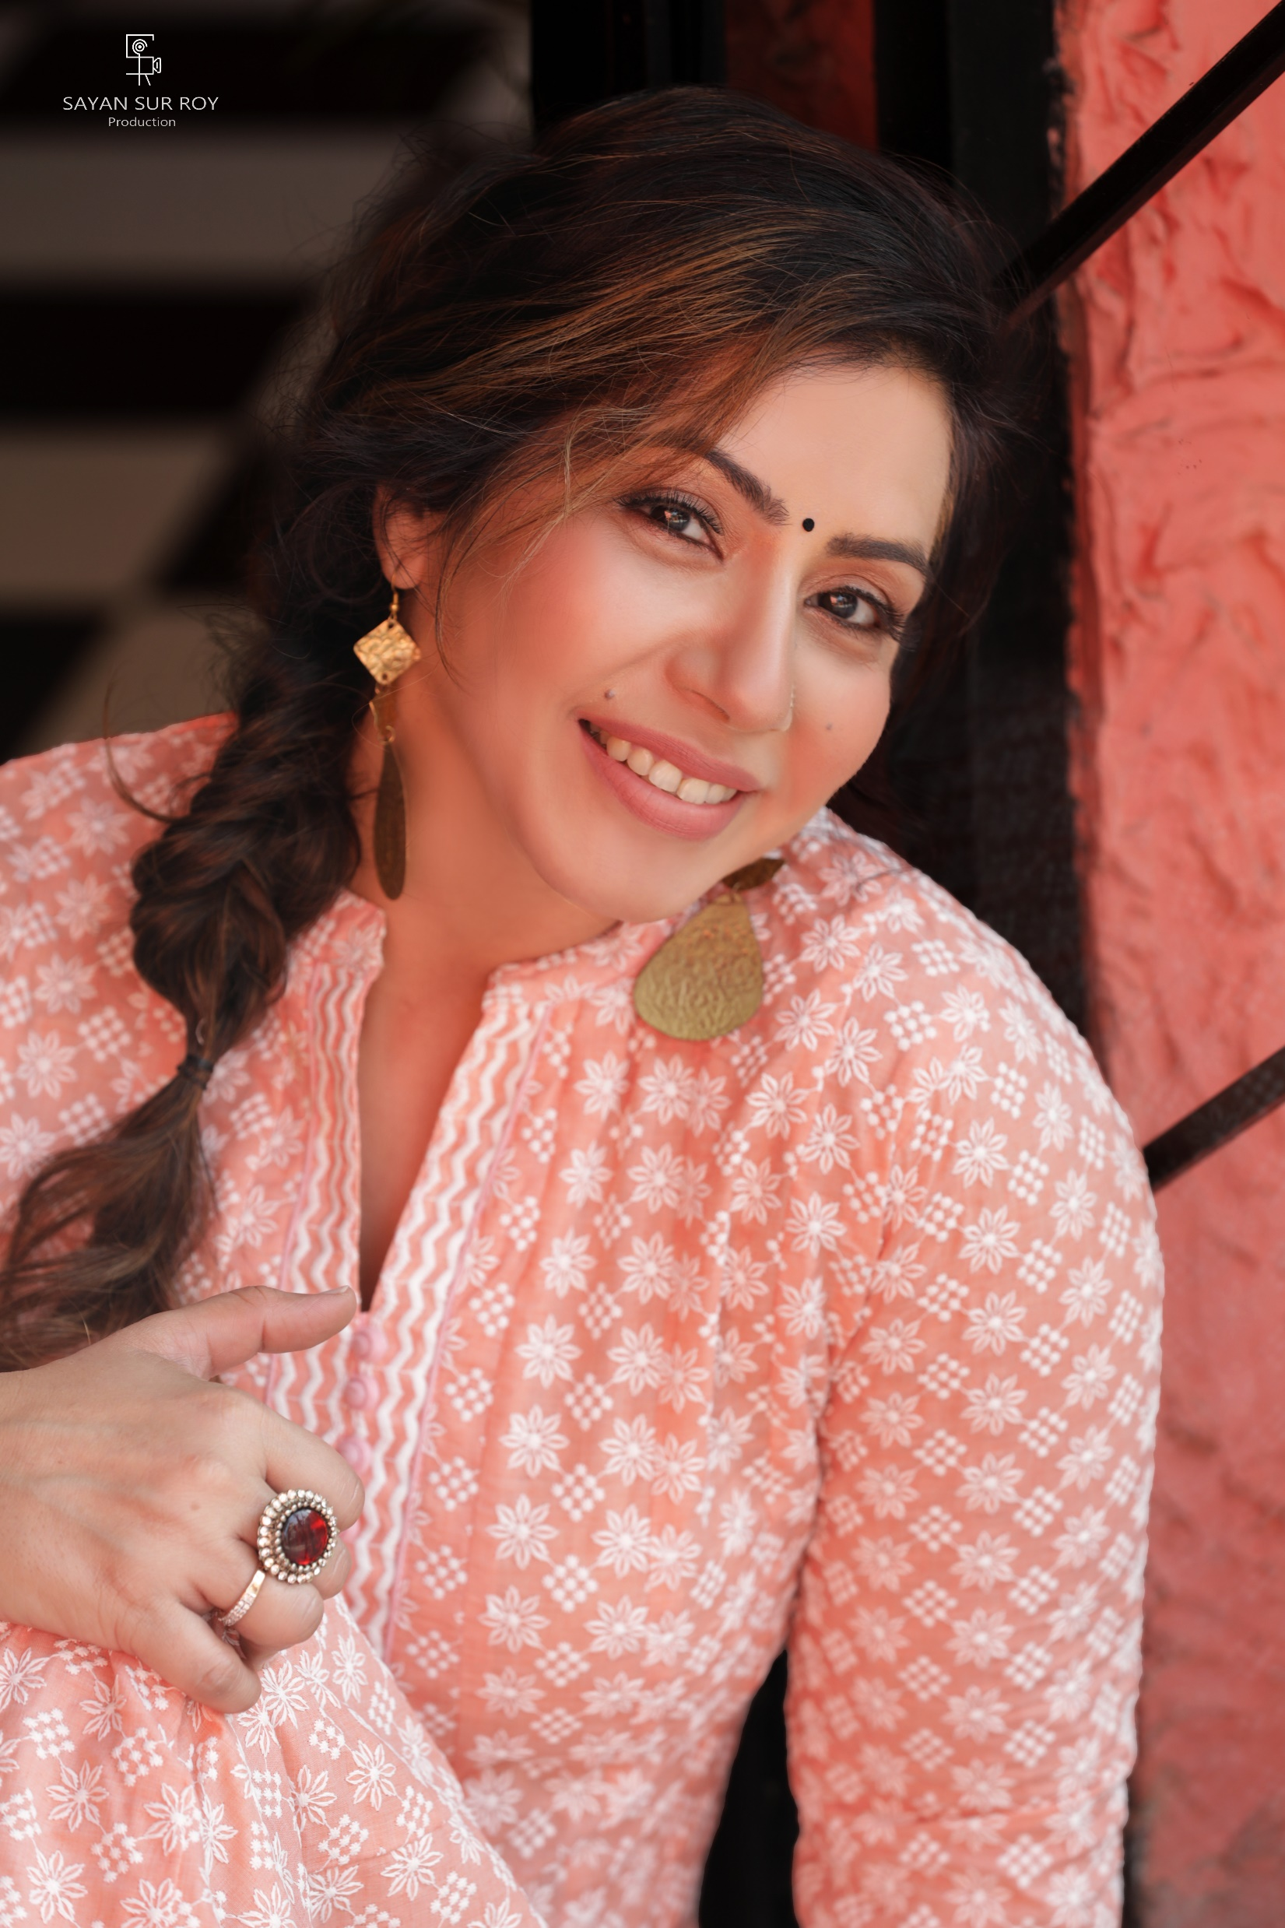
FATEMA ZAHRA ZEN

Slide 2
TO EXPLORE, EXPERIENCE, EXHILIRATE VARIED LIVES, BECOME AN ACTOR; SO HERE I AM….
FATEMA ZAHRA ZEN

Slide 3
….ME
-Fatema Zahra Zen
Height - 5’3”
Current Location – Mumbai
Language - Hindi, English, Gujarati
Introduction Link - https://youtu.be/vXc4NzZJD9U?si=SQS7z0JsD28qGpli
Instagram Link - https://instagram.com/fatema_zahra_forever?igshid=OGQ5ZDc2ODk2ZA==
LEAD IN WEB SERIES, FEATURE FILM, SHORT FILM AND AD FILMS

Slide 4
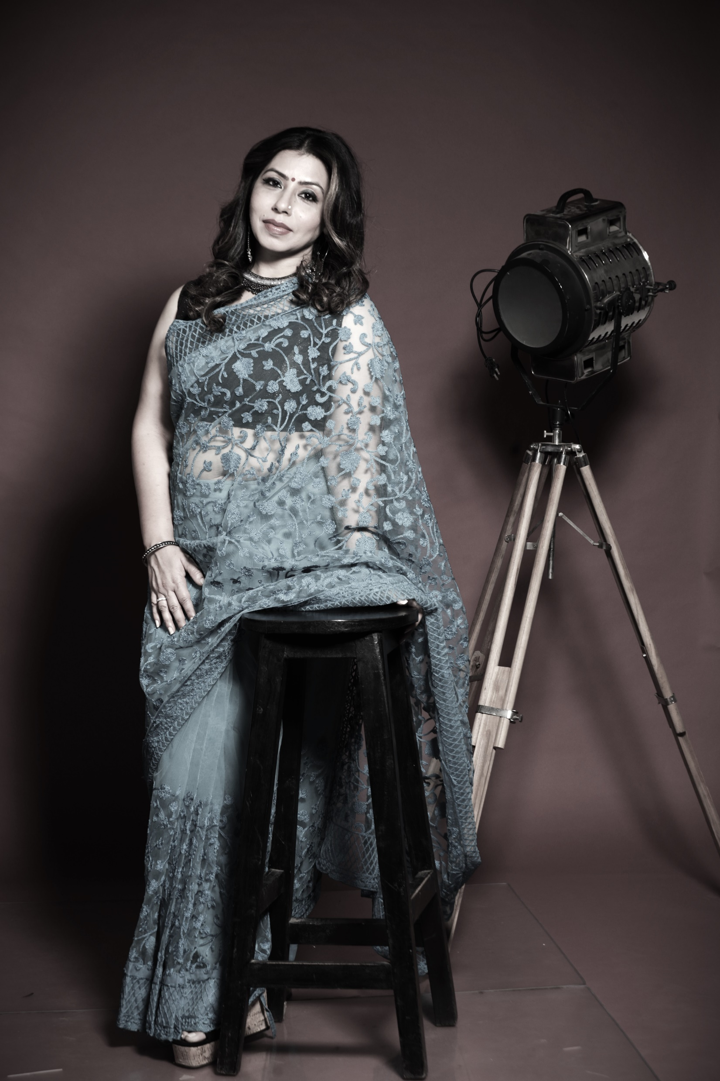
WORK LINKS
Web series ‘NAMASTEYJI, MAY I COME IN’
Teaser
https://youtu.be/2ejRUh6uh2o?si=h66q6vO1-nUCiH5y
Feature film ‘ NOT JUST A DRIVER’
https://youtu.be/Yyt_KmkYnWA?si=rtMQIIQ7deXlRo-B
TEASER-
https://youtu.be/XhUYbOrhgzo?si=nG4-wMVr4KYV4yTJ
Short film ‘NIGHT’
https://youtu.be/AGyUuIWOsKI?si=_d6tH7ssSv0Xpjn8

Slide 5
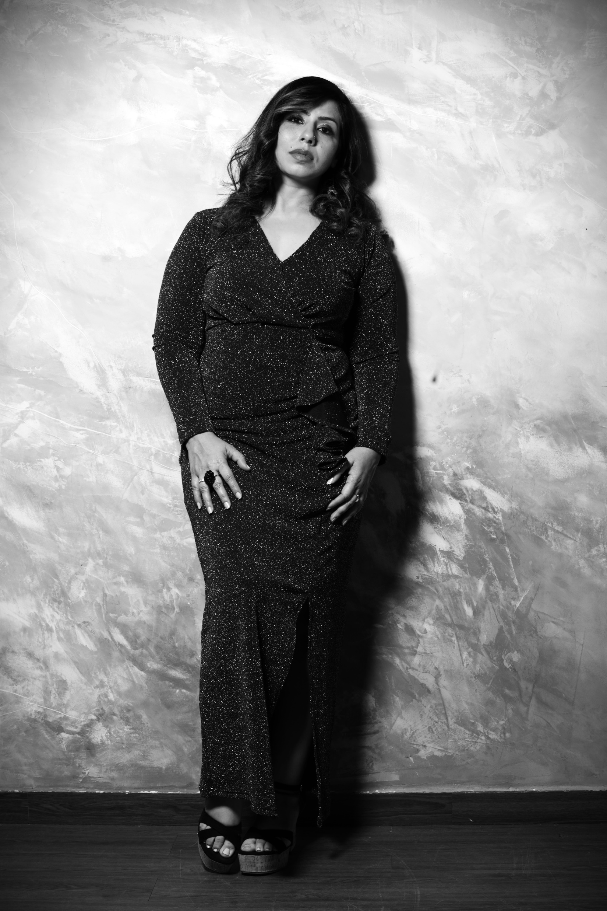
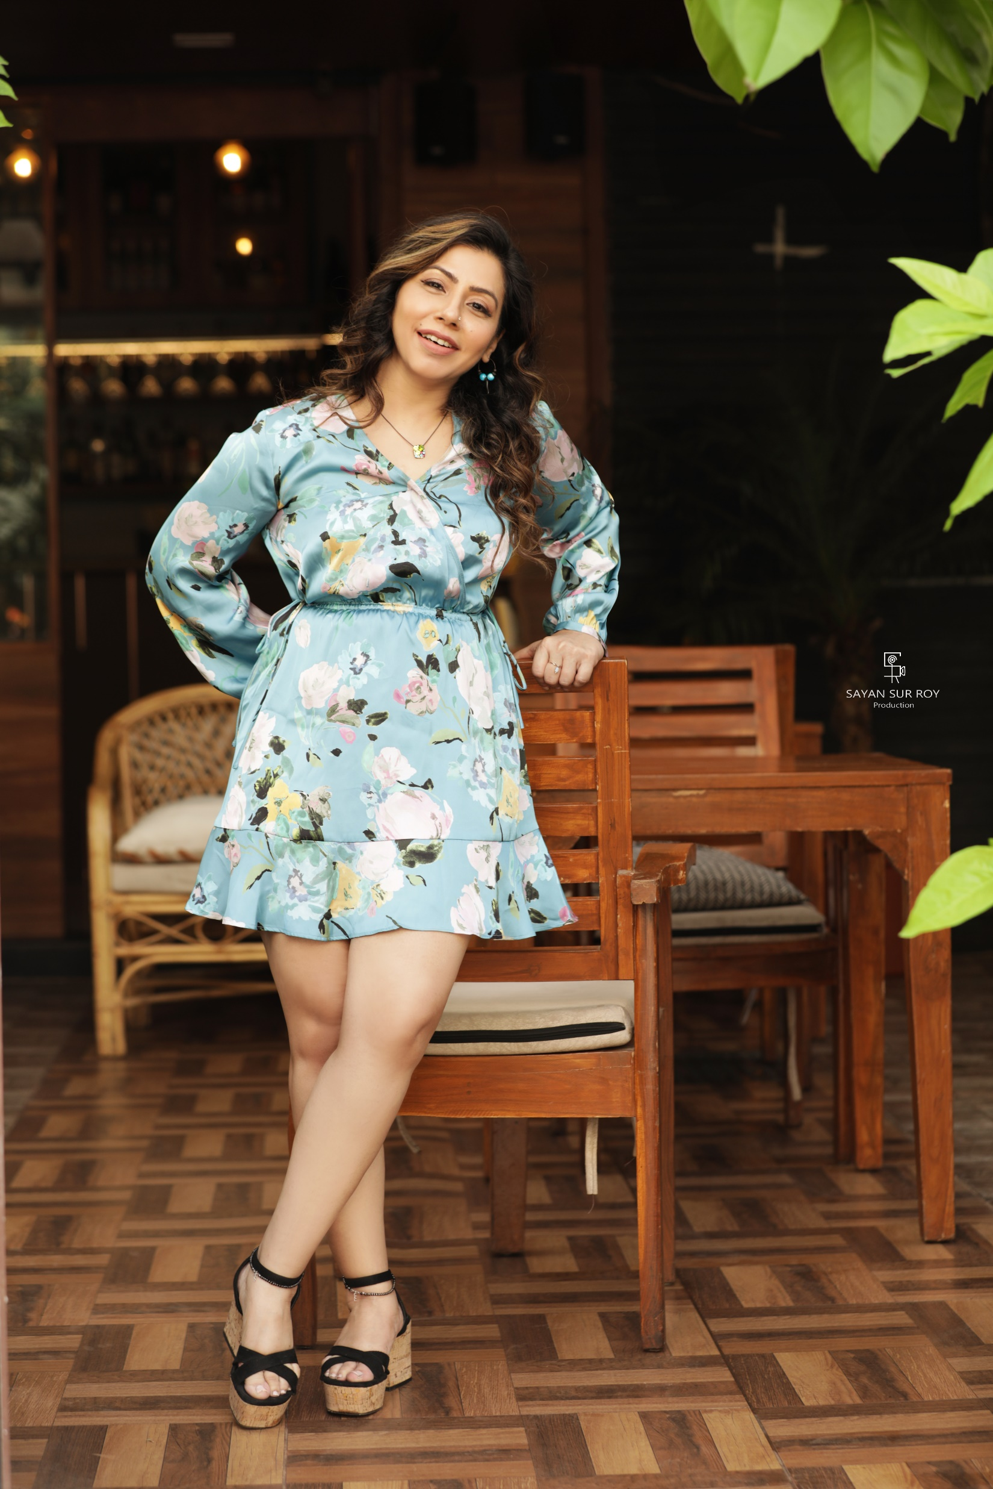

Slide 6
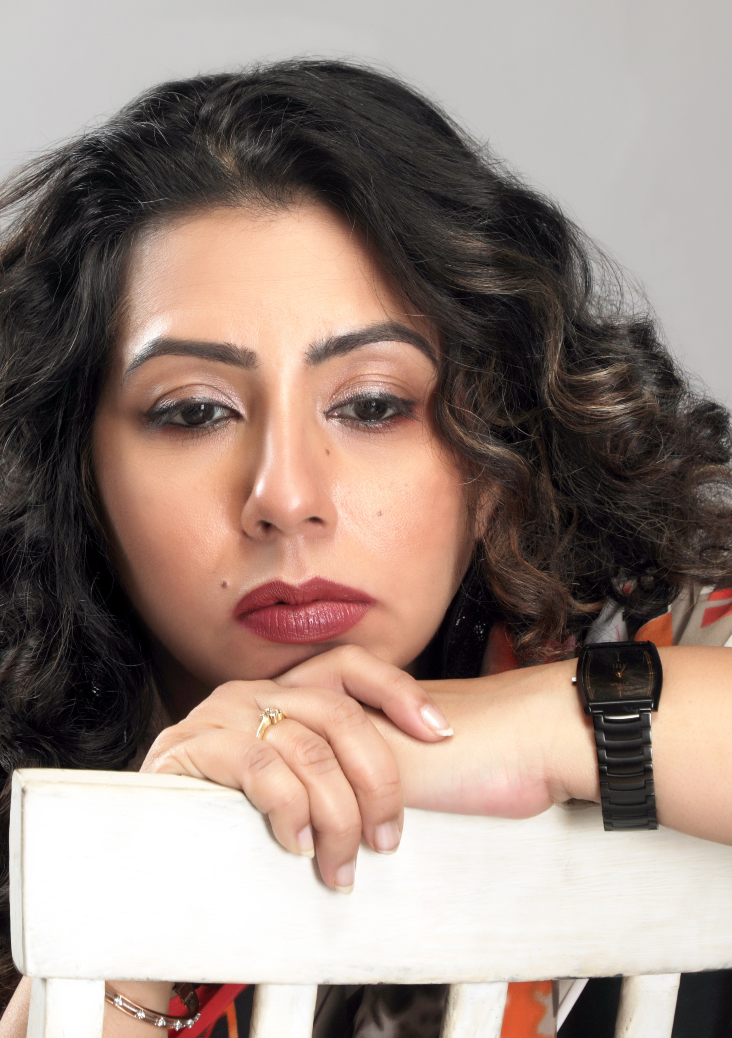
FATEMA AS ‘BRINDA’ IN
‘NAMASTEYJI, MAY I COME IN…’
COMING SOON…

Slide 7
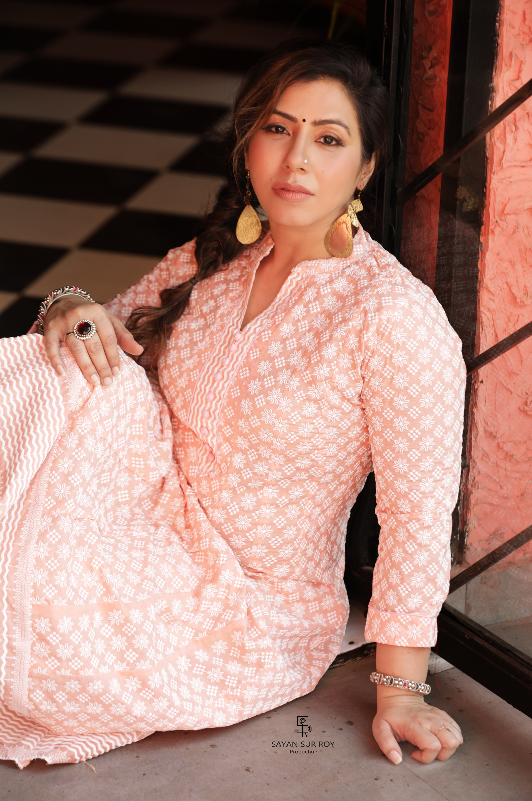
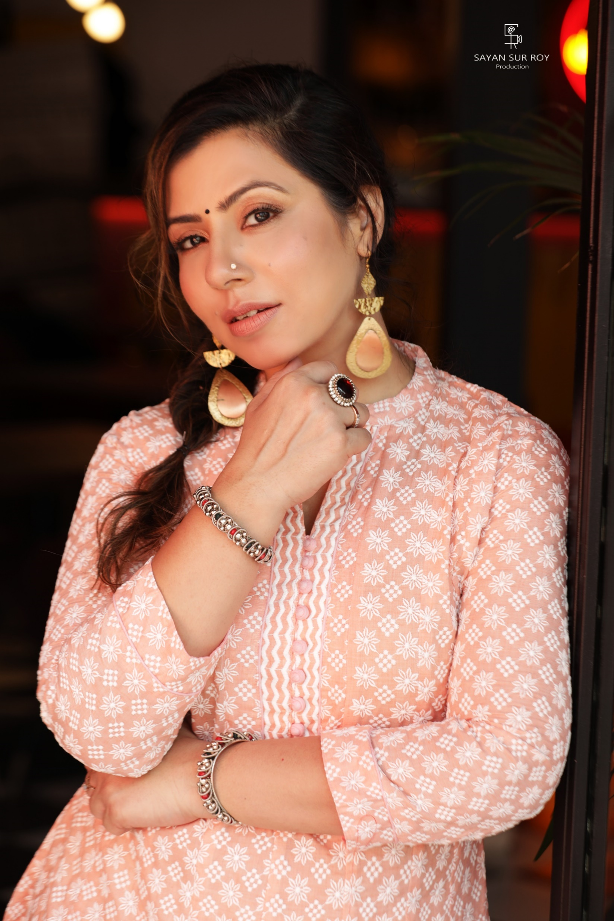

Slide 8
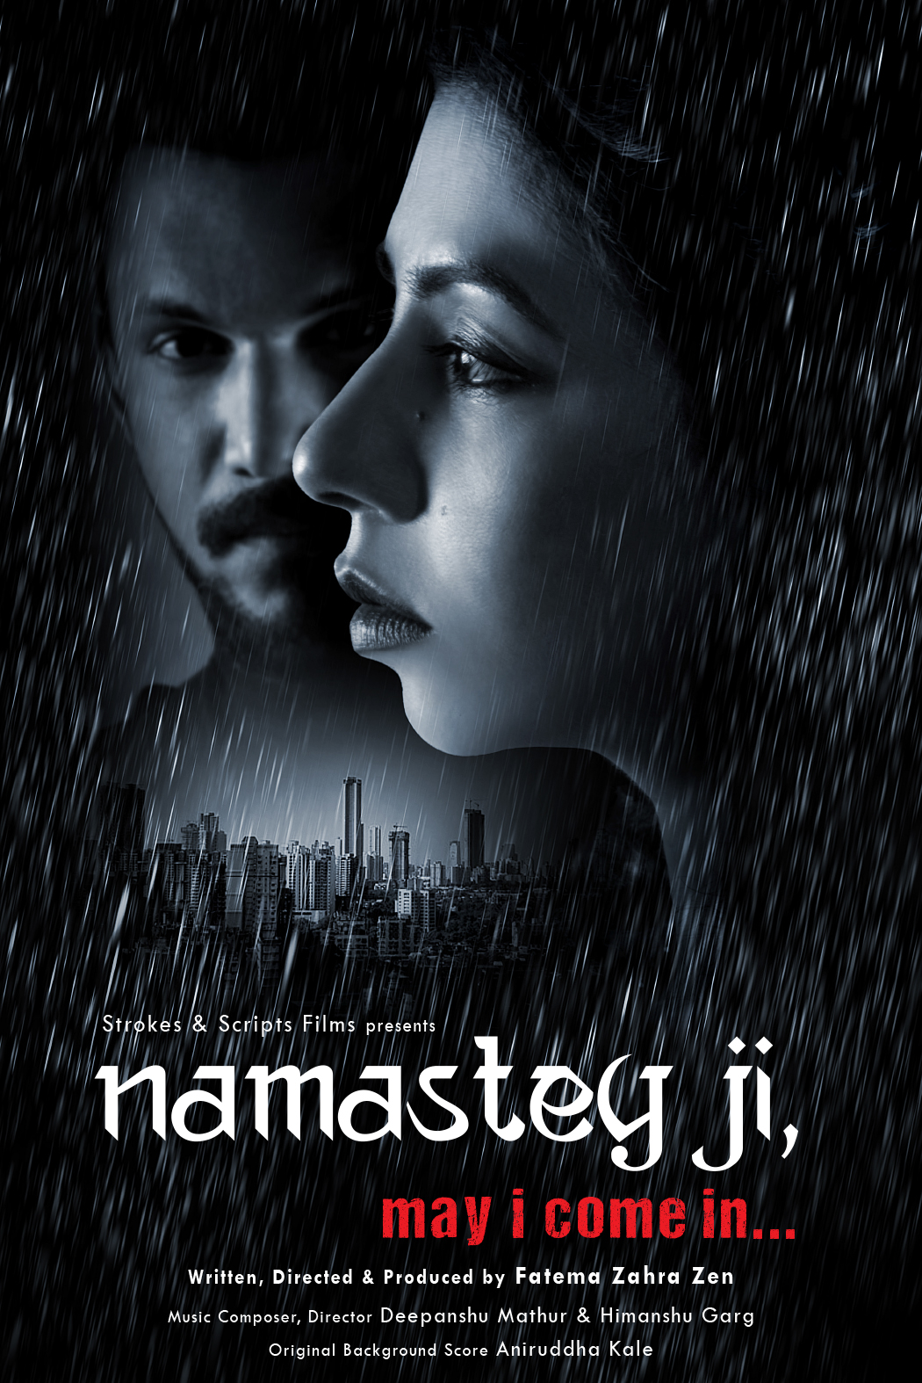


Slide 9
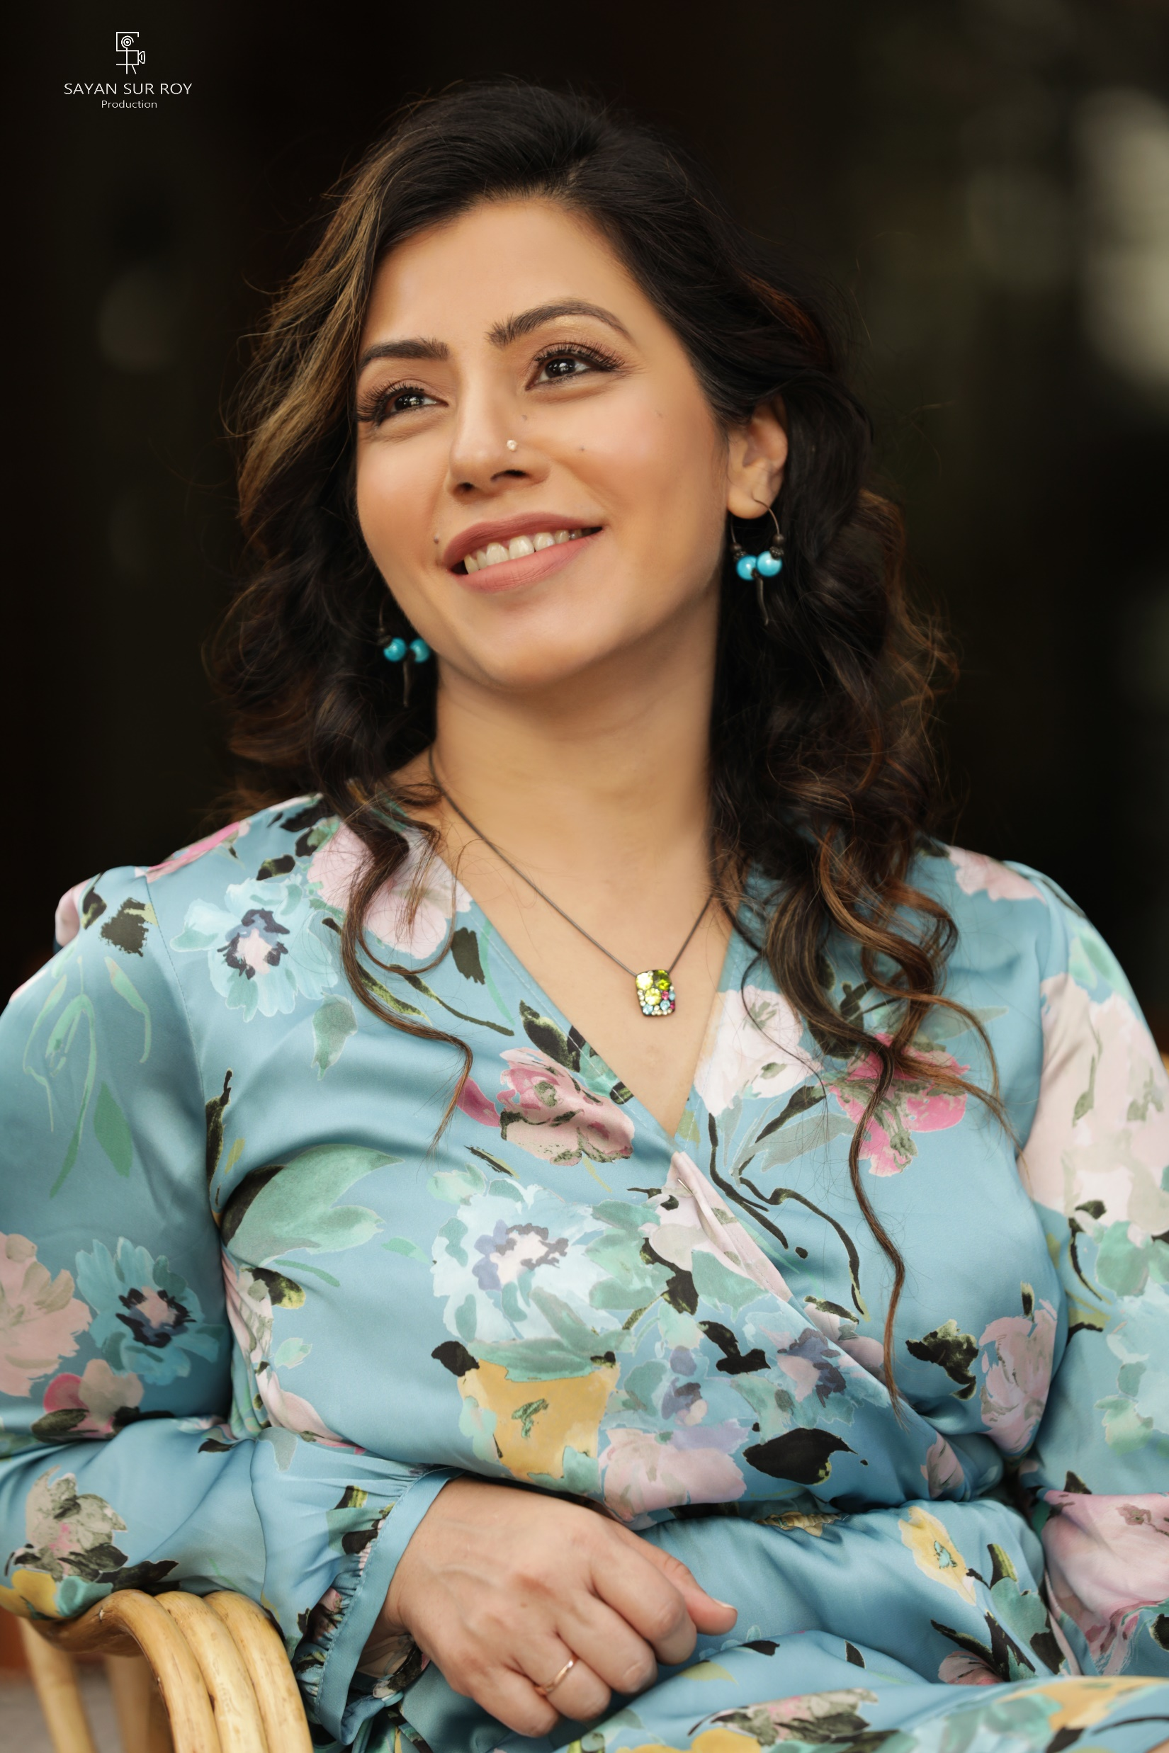
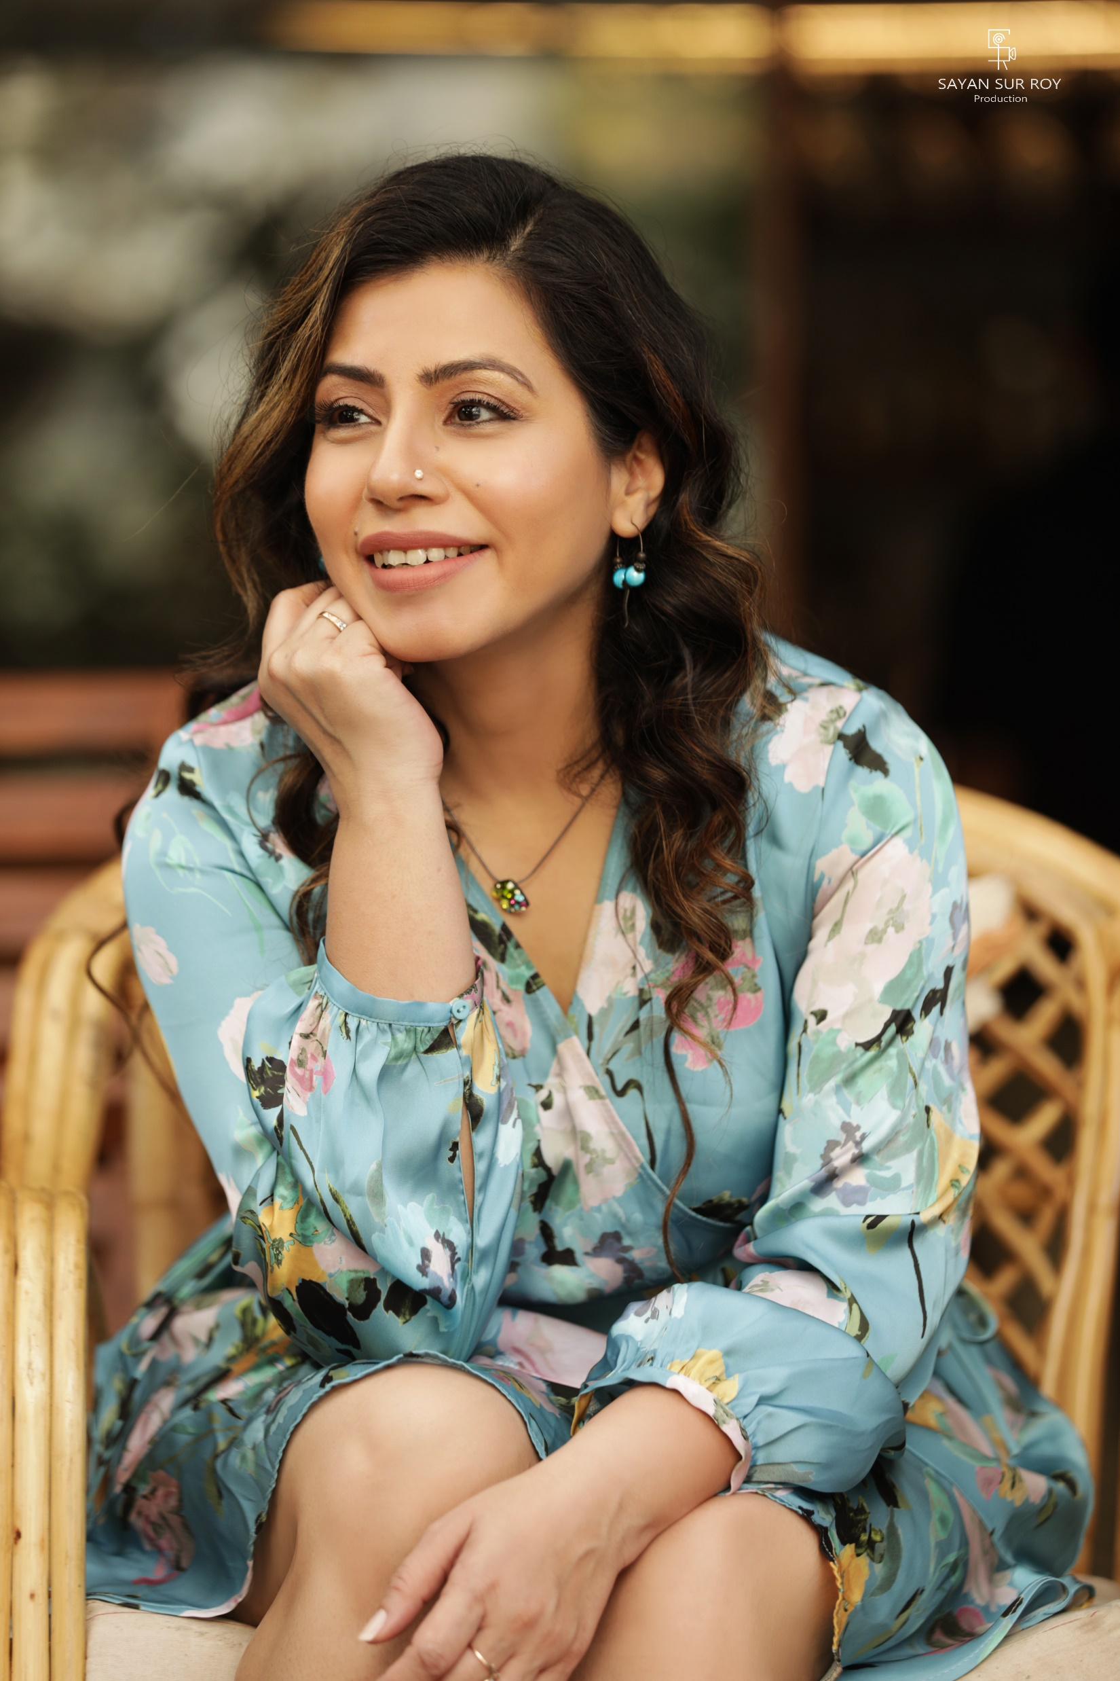

Slide 10

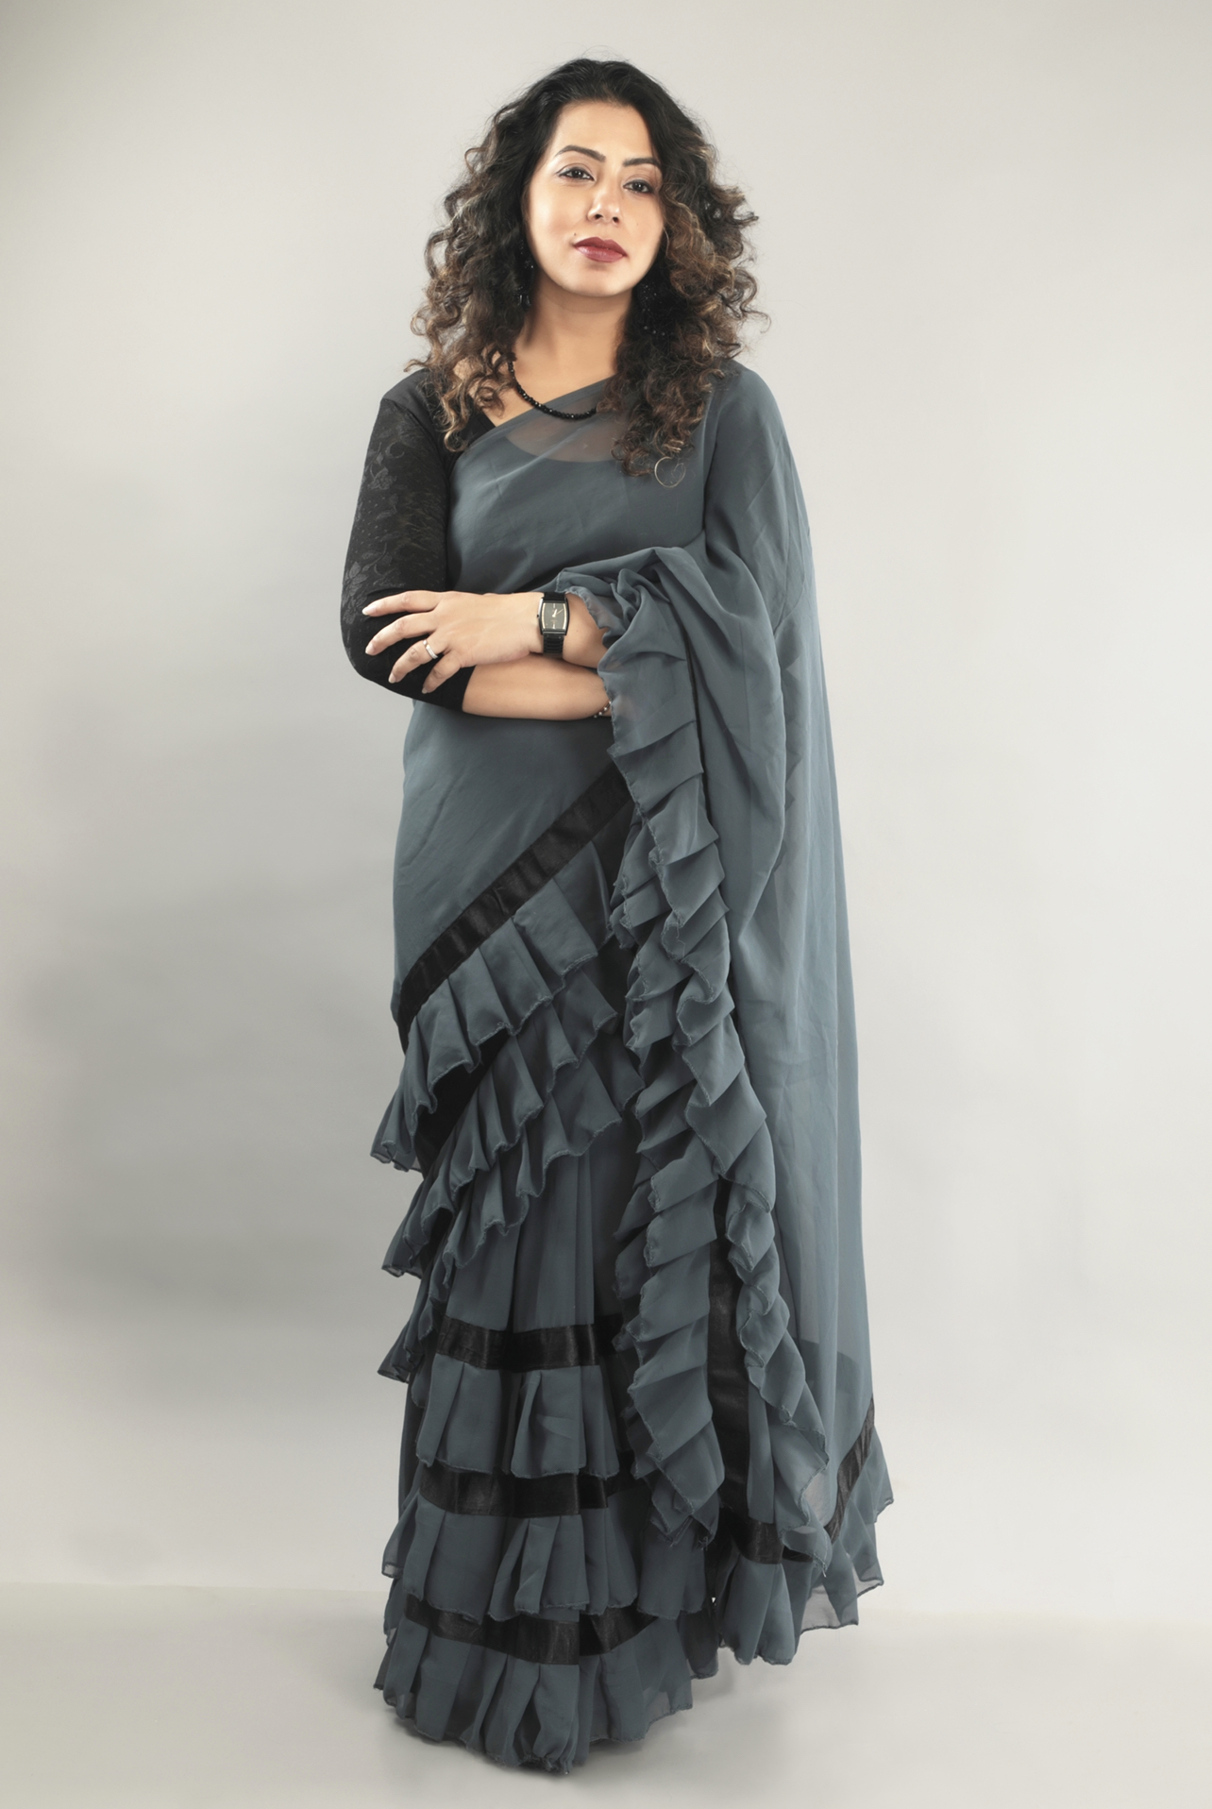

Slide 11
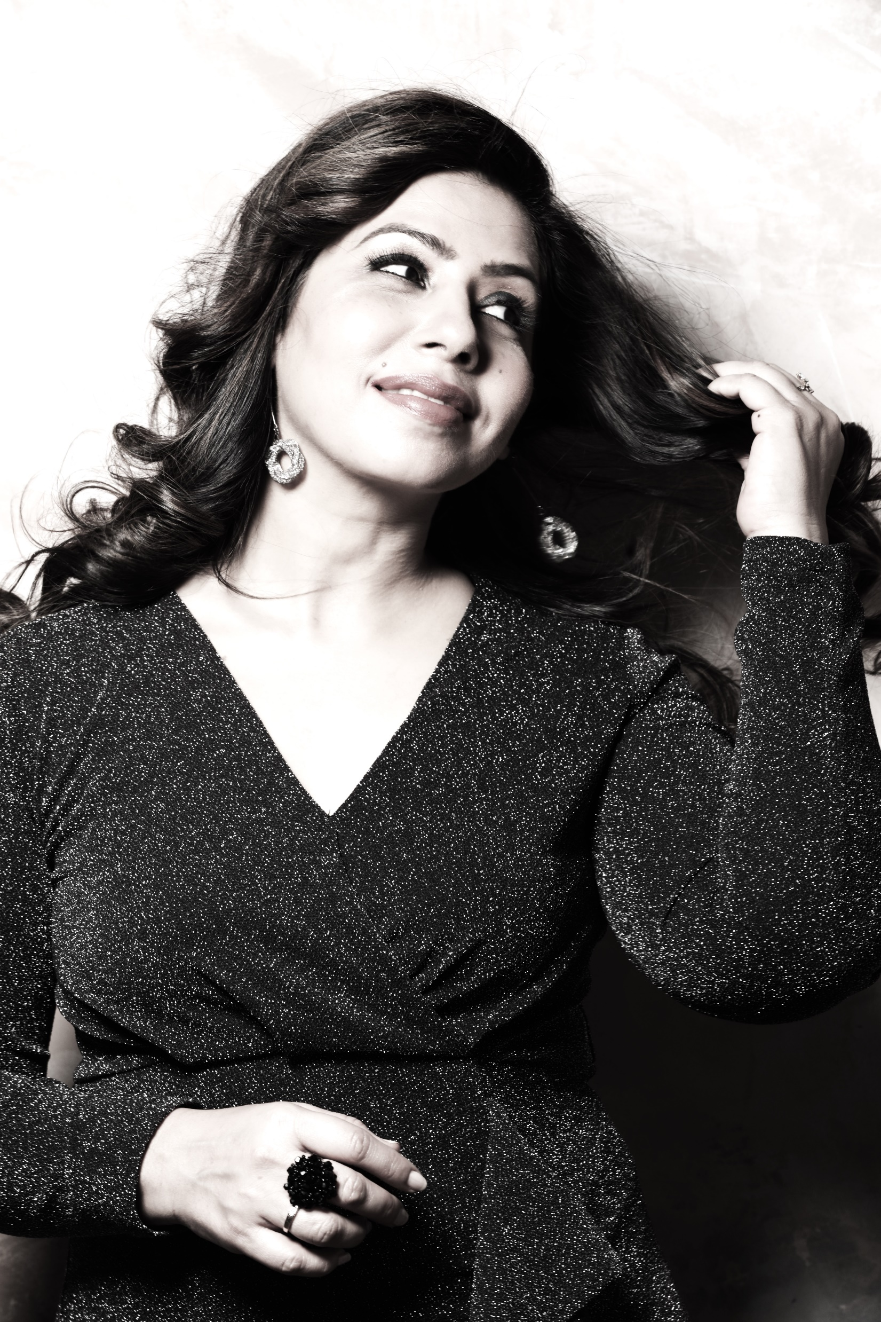
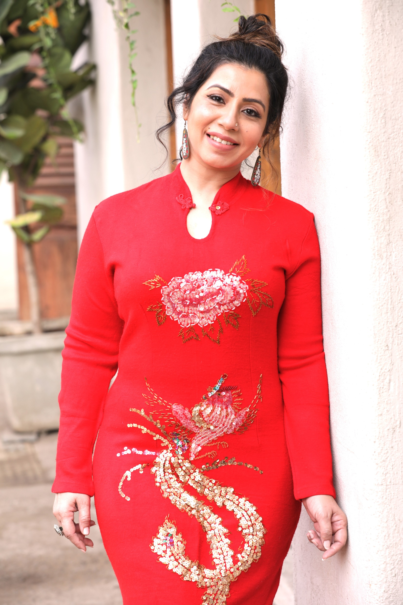

Slide 12
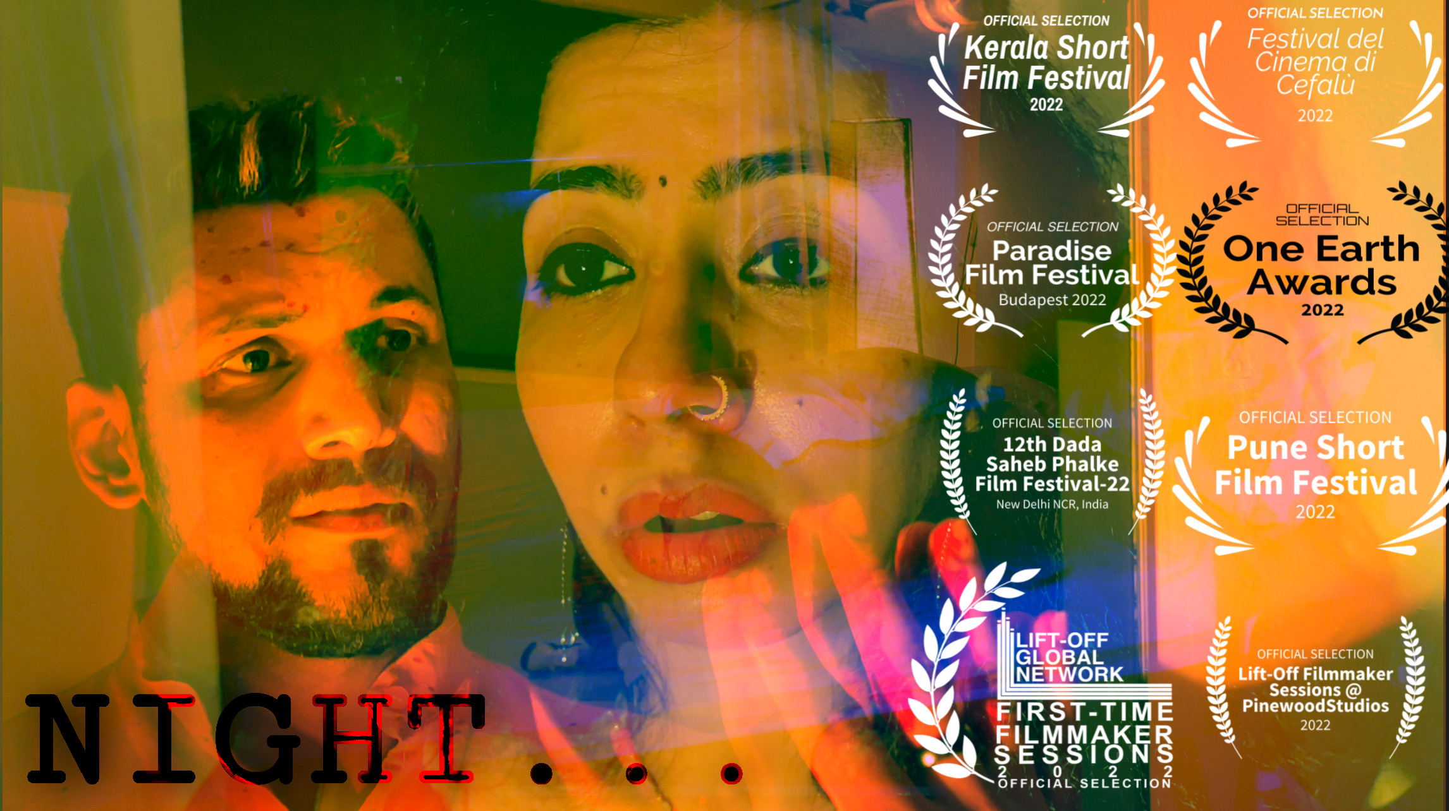
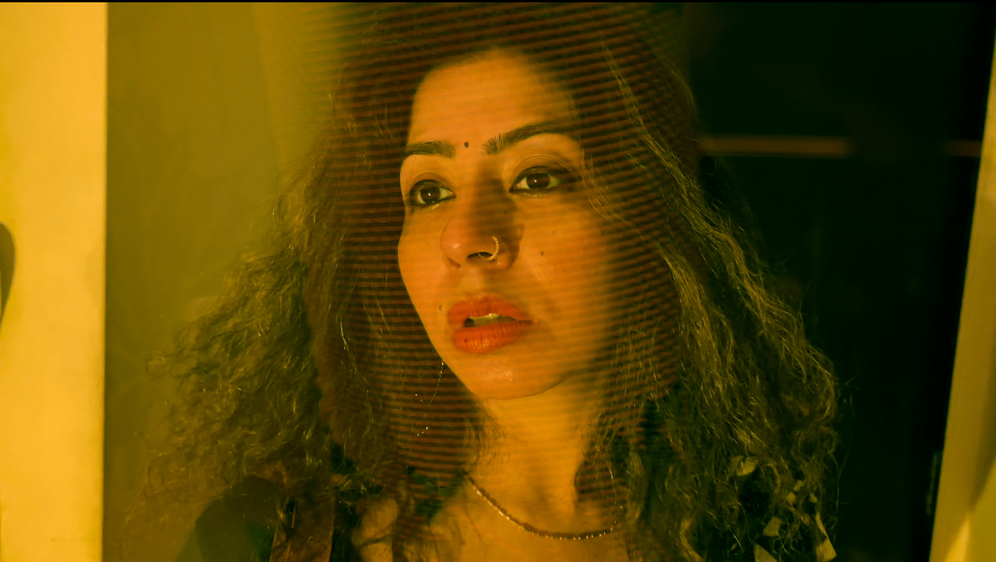
SHORT FILM ‘NIGHT’ AT ‘UNKNOWN@MEANINGFUL CINEMA’ ON YOUTUBE

Slide 13
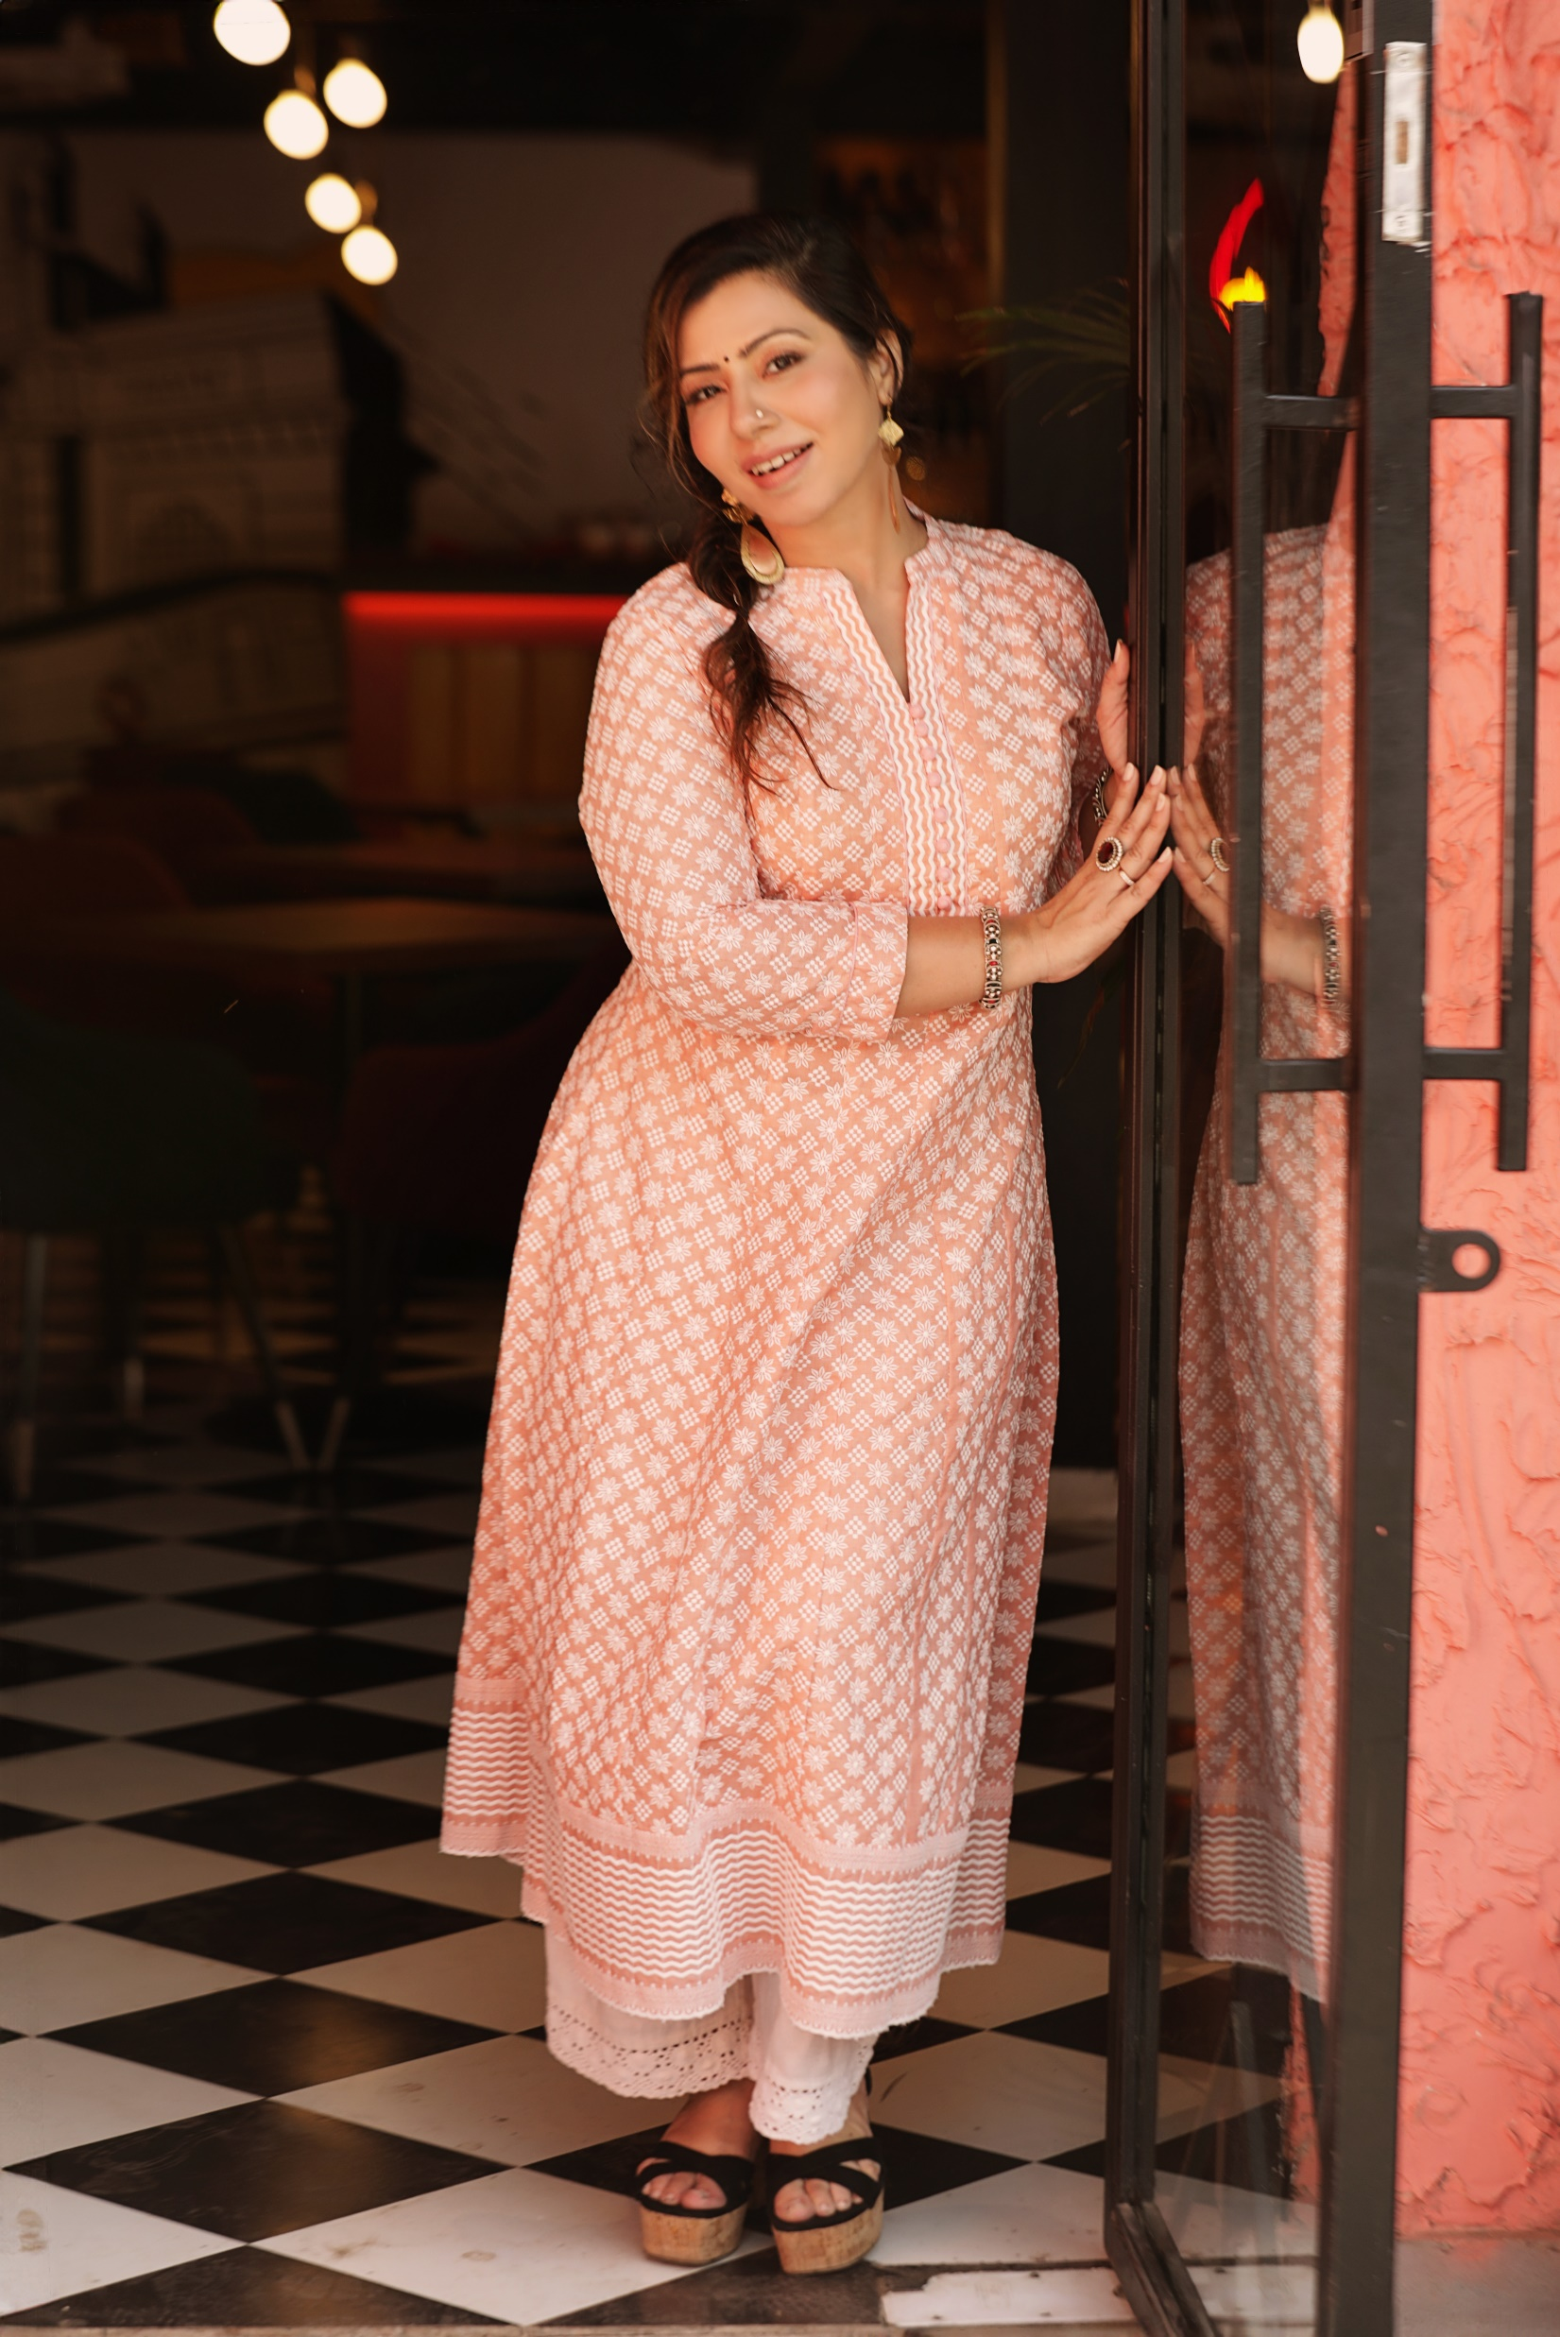
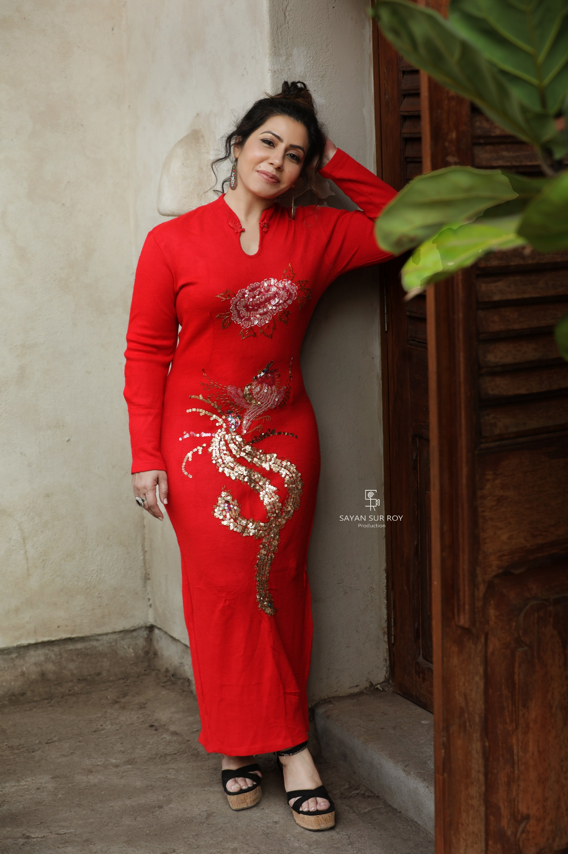

Slide 14
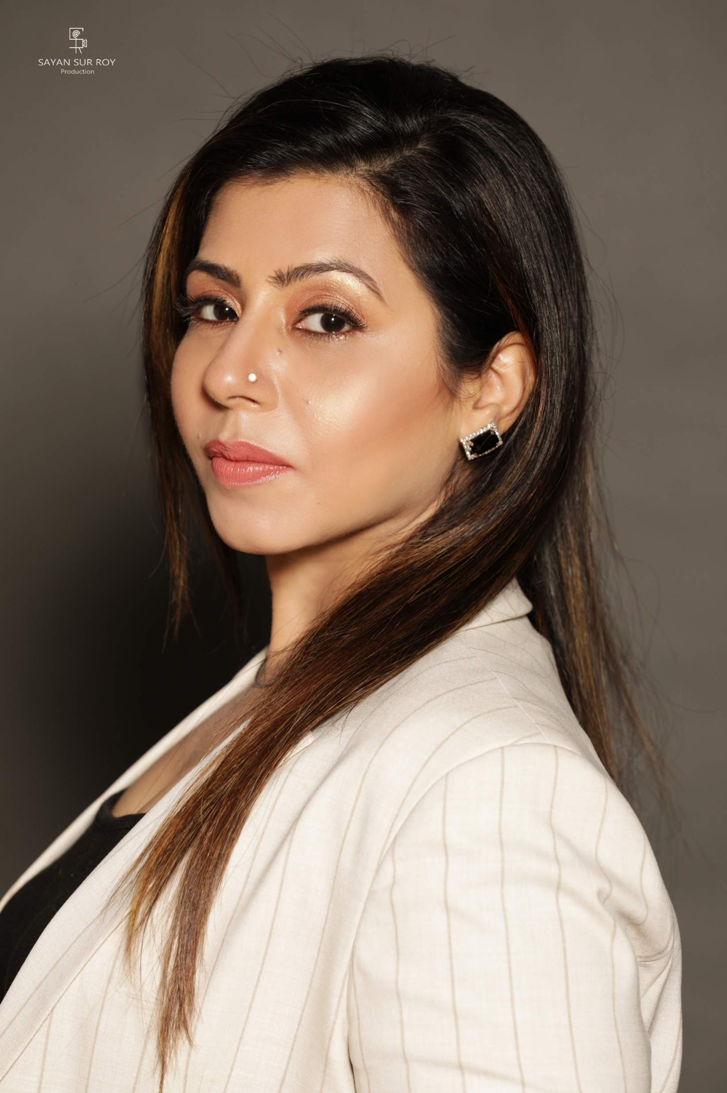
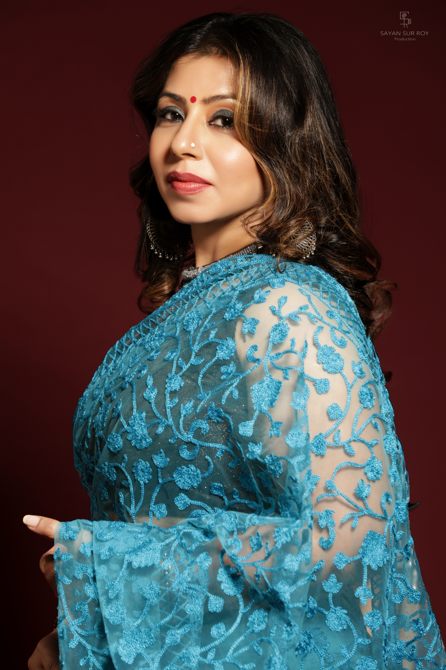

Slide 15
THANK YOU!
Instagram Link - https://instagram.com/fatema_zahra_forever?igshid=OGQ5ZDc2ODk2ZA==
EMAIL- fatemazahrazen@gmail.com
My youtube channel- unknown @meaningfulcinema

